Slide 1
Quad Rat Vitals Monitor
Advisor: Peter Klomberg
Client: Alex Converse, Ph.D.

Slide 2
Overview
PET Imaging
Requirements
Existing Devices
Previous Semester’s Work
This Semester’s Work
Communication Options
Housing Design Options
Where do we go from here?
Acknowledgements

Slide 3
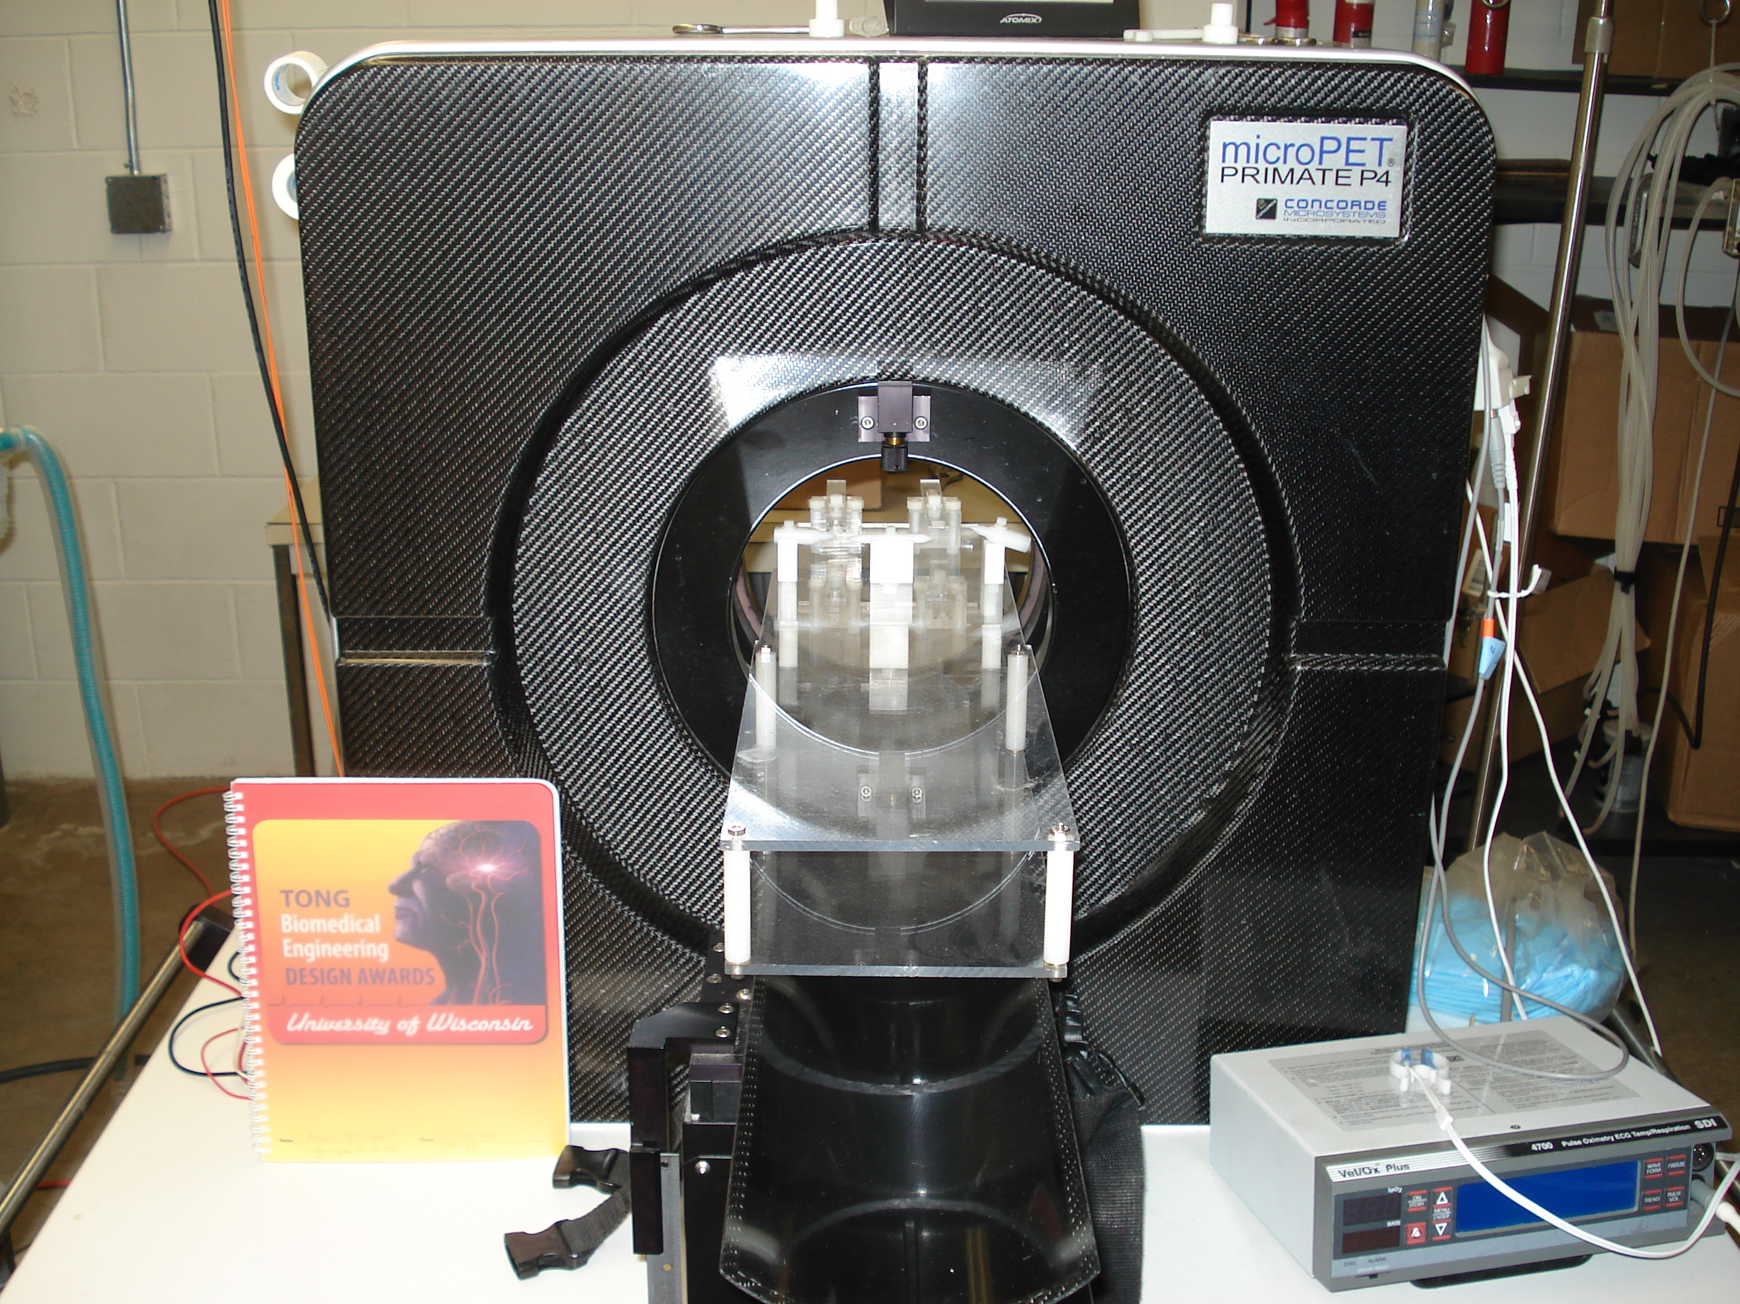
PET Imaging of Rats
Positron emission tomography (PET) scans to monitor location of radiotracers in rats’ brains
Client scans four anesthetized rats at a time
  Needs to monitor the rats’ vitals
PET scanner at Harlow Primate Lab
Current pulse oximeter used by client

Slide 4
Device Requirements
Client needs to simultaneously monitor four rats
  SpO₂ levels, accuracy of ±2%
  Heart rates up to 500 beats per minute
  Respiratory rates of 20 to 30 breaths per minute
  Rectal temperatures of 93 - 100° F
Non-invasive probes and user-friendly interface

Slide 5
Existing Devices
Client currently uses rudimentary devices to monitor vitals
Available: MouseOx
  Pulse oximeter for mice and rats
  Over $7000, one rat at a time

Slide 6

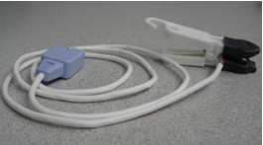
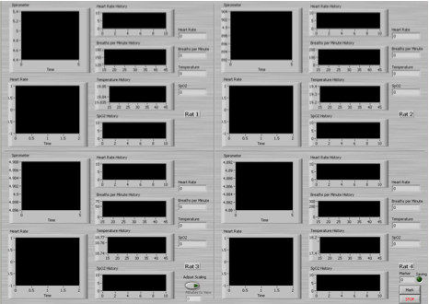

Previous Semester’s Work
Finalized sensors and algorithms to measure temperature and breathing rate
Built pulse oximeter probe
Developed graphical user interface for project
FSR
Pulse Oximeter Probe
LabVIEW Graphical User Interface
Thermistor Probe

Slide 7
This Semester’s Work
Started developing pulse oximeter calibration curve
Configured LabVIEW to receive data from pulse oximeter
Started integrating thermistor and FSR circuits with ADC of pulse oximeter
Investigated using ‘GumStix’ for data processing

Slide 8
Communication

Slide 9
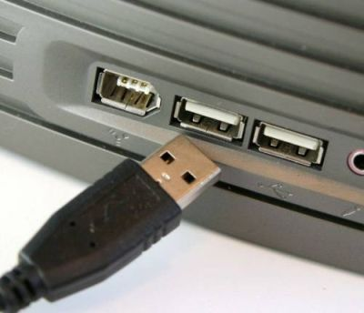
Universal Serial Bus (USB)
Pros:
  Fast communication speed
  Plug and play
  Familiarity
  Inexpensive
Cons:
  Complex programming
  Difficult interfacing with microcontroller
  4 cables would be cumbersome
http://www.novopc.com/wp-content/uploads/2008/10/usb.jpg

Slide 10

Wireless Fidelity (WiFi™)
Pros:
  Communication speed in excess of device requirements
  Wireless
  Familiarity
  Portability
Cons:
  Expensive
  Susceptible to interference
http://www.freewarepocketpc.net/software_images/wifi-toggler.1.gif

Slide 11

Bluetooth®
Pros:
  Moderate communication speed
  Easiest to interface with circuit hardware
  Less expensive option
Cons:
  Insufficient number of input ports
  Hard to initially pair with computer
  Computer is not currently Bluetooth compatible
  Requires extensive research
http://www.finesttech.com/wp-content
/uploads/2009/04/bluetooth_large.jpg

Slide 12
Design Matrix – Communications Link
Criteria | USB | WiFi™ | Bluetooth®
Programming Feasibility (35) | 29 | 28 | 31
Cost( 15) | 12 | 9 | 9
Operability (15) | 12 | 10 | 8
Communication Speed (30) | 25 | 30 | 20
Aesthetics (5) | 1 | 5 | 5
Total (100) | 79 | 82 | 73

Slide 13
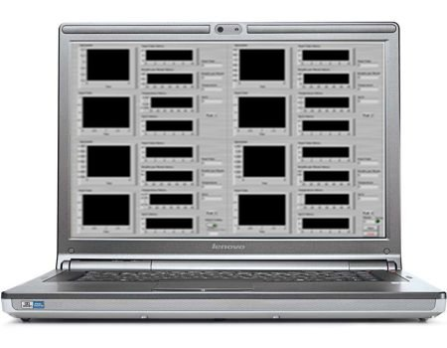
Block Diagram
Rat 1
Board
Rat 2
Board
‘Motherboard’
(GumStix®)
Signal Processing
Rat 3
Board
http://www.computercoupons.com.au/blog/wp-content/uploads/2009/11/lenovo-laptop-computer.jpg
Rat 4
Board

Slide 14
Circuit Board Housing

Slide 15
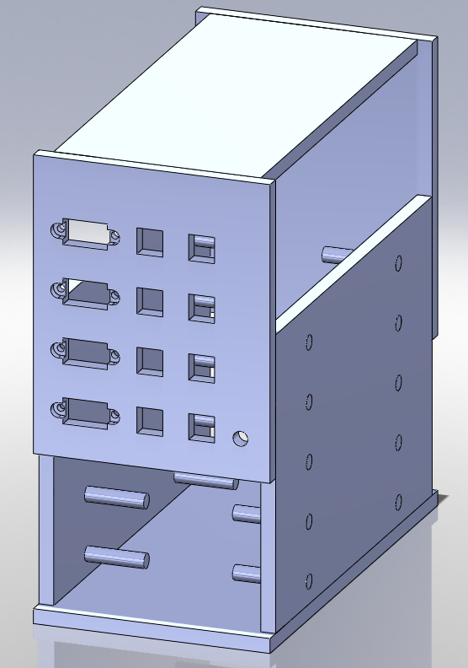
Pegged 3 x 3 Design
Pros:
  Easy to construct
  Simplified installation
Cons:
  Modification of circuit boards is difficult
  Least stable
Receptacles for probes
Pegs for circuit boards

Slide 16
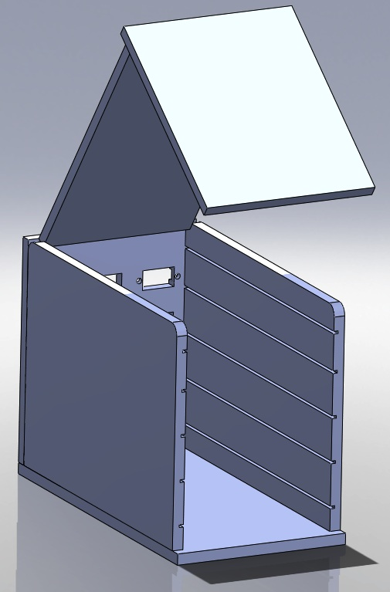
Toaster Oven Design
Hinged door
Pros:
  Permanent receptacle wall
  Easy access to boards
  Most stable
Cons:
  Precise alignment of receptacles and board required
Grooves for circuit boards

Slide 17
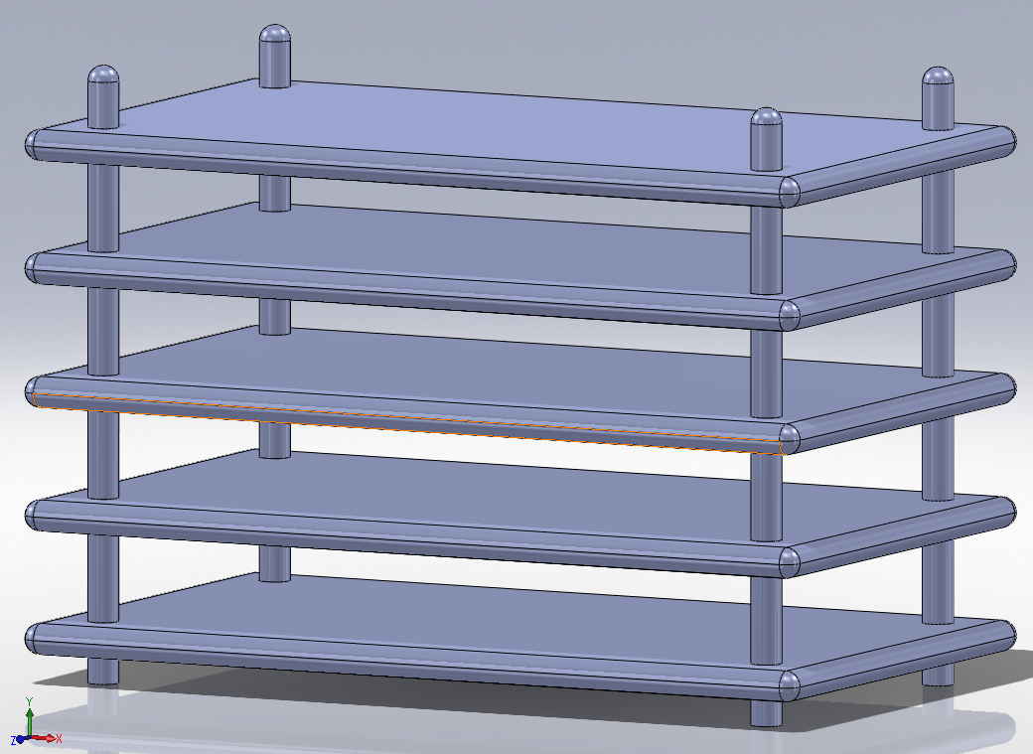
Bunk Bed Design
Pros:
  Easy access for troubleshooting
  Aesthetically pleasing
  Easy to manufacture
Cons:
  Exposed circuit elements
  Difficult to interface separate boards
Platform for circuit board

Slide 18
Design Matrix - Housing
Criteria | Pegged 3 x 3 | Toaster Oven | Bunk Bed
Manufacturing Feasibility (30) | 26 | 22 | 26
Ergonomics (40) | 30 | 35 | 25
Durability (20) | 15 | 17 | 14
Aesthetics (10) | 7 | 7 | 10
Total (100) | 78 | 81 | 75

Slide 20
Where do we go from here?
Construct extra probes
Order materials and build box
Print and build circuit boards
Develop algorithms to process pulse oximeter signal
Finish GUI to incorporate pulse oximeter data

Slide 21
Acknowledgements
Peter Klomberg
Dr. Alex Converse
Liz Ahlers
Amit Nimunkar
Professor John G. Webster

Slide 22
Questions?

