Slide 1

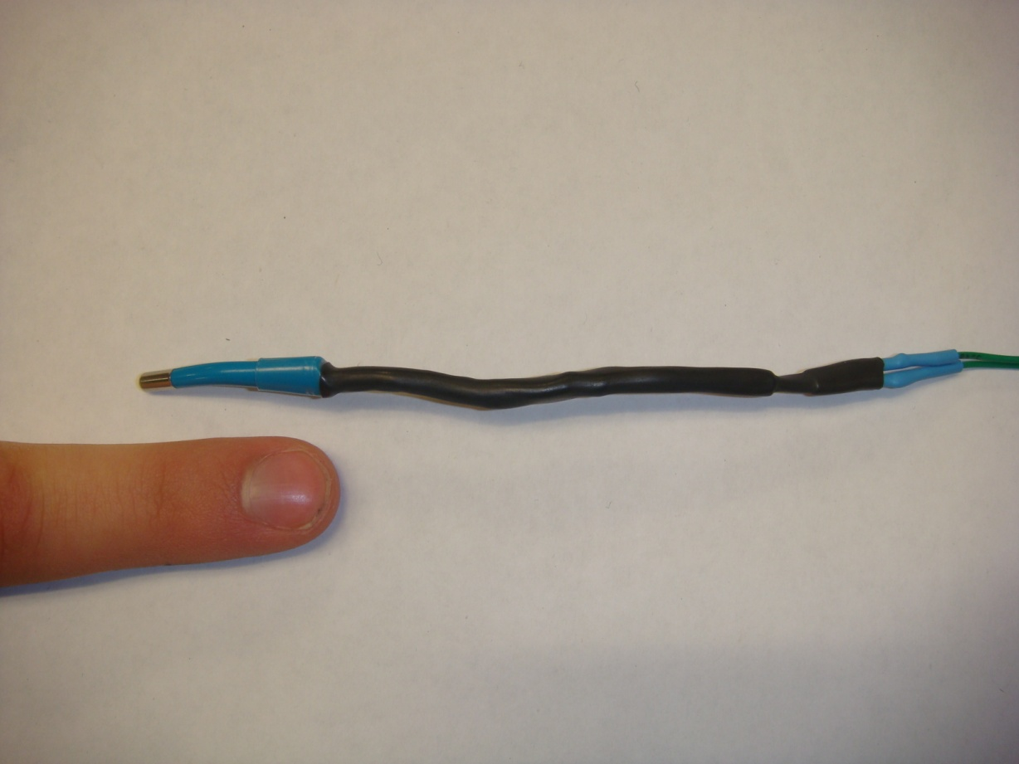
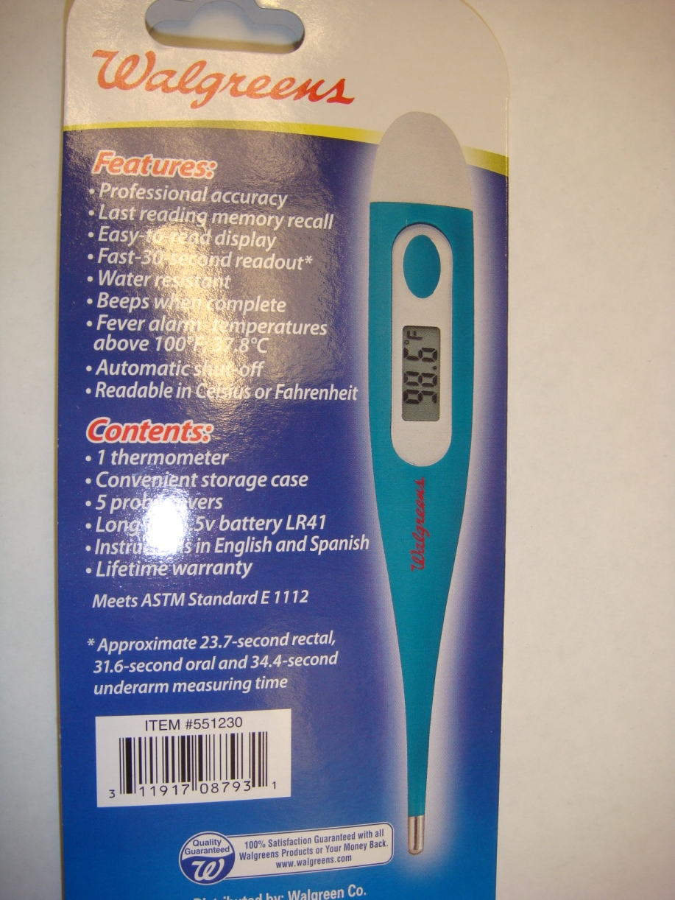
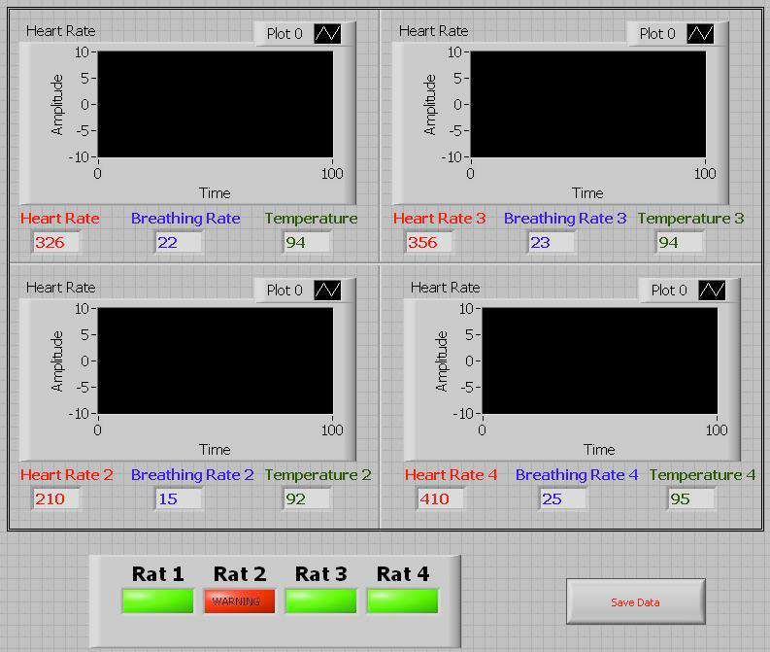
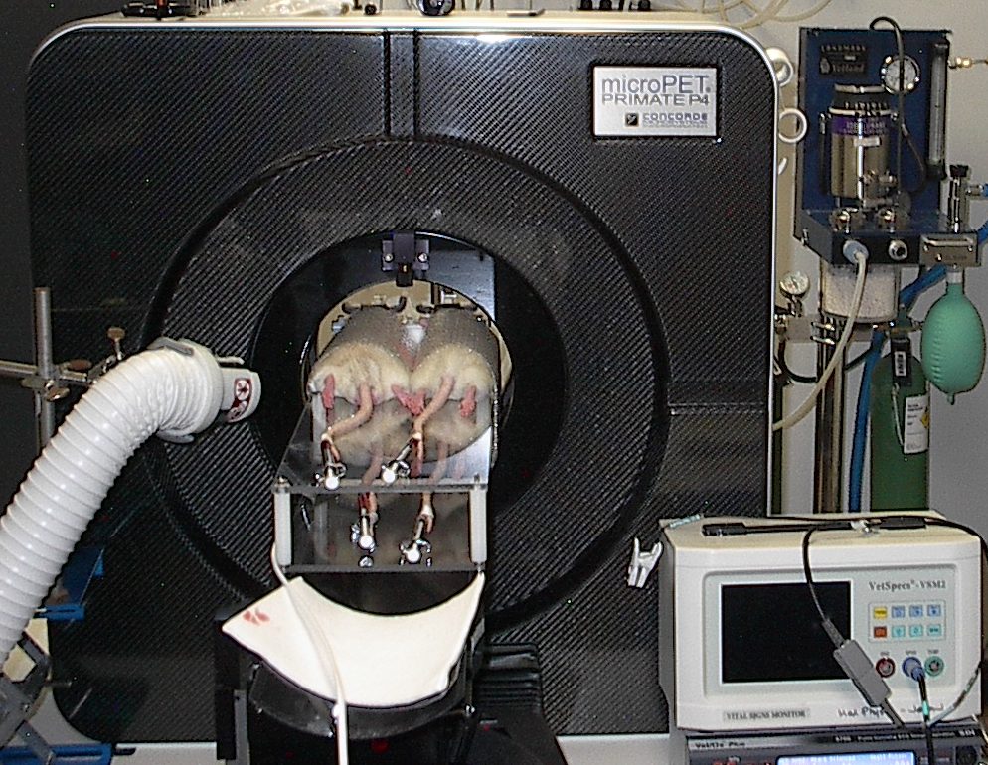
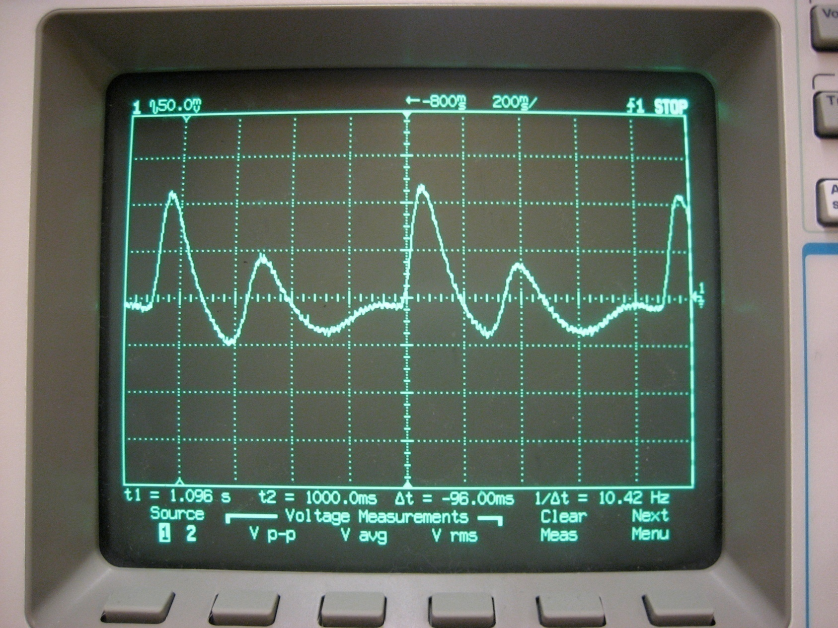
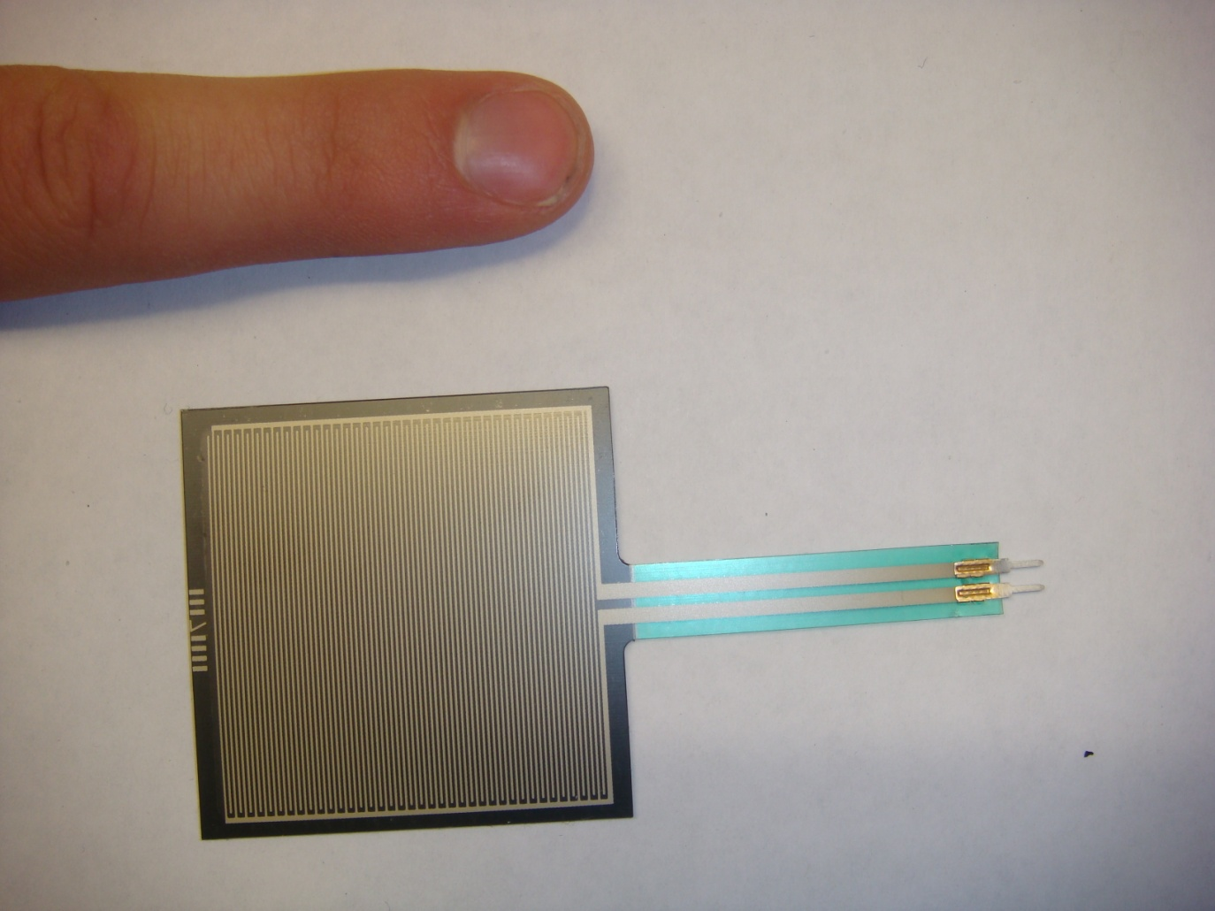
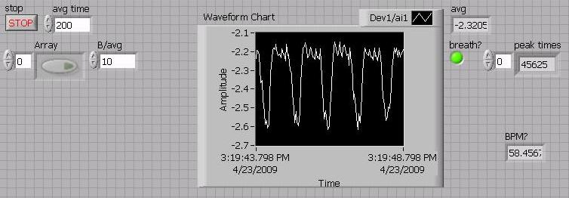
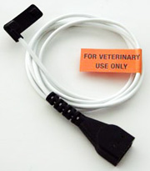
Quad Rat Vitals Monitor
Jack Ho, Joseph Yuen, Nathan Werbeckes
Advisor: Thomas Yen, PhD. Client: Alex Converse, PhD.
Abstract
Final Design
In the course of our client’s research, PET imaging of rats are often used. During each scan, four rats are anesthetized and manually kept under anesthesia for the course of a few hours. Because the current system of anesthesia requires manual adjustments, the vitals of each rat must be monitored constantly. Currently our client is using a veterinary pulse oximeter designed for “small animals” (such as dogs, cats, and monkeys). However, since the rat has a relatively much higher heart rate, the machine often displays inconsistent readings, greatly reducing the efficiency of anesthesia delivery. Our novel monitoring device allows for the record and display of heart rates, respiratory rate, and body temperatures of four rats simultaneously during PET imaging experiments in order to maintain appropriate anesthesia dosages on each of the four rats independently.
Temperature
Heart Rate
Integration
Computer
LabView
DAq Box
Heart Rate
Temperature
Respiratory Rate
Digital human oral thermometers were used for creating temperature sensors. Thermistors were removed and placed in a simple circuit of a voltage divider and a non-inverting op amp.
We used a pulse oximeter circuit and sensor to display the blood plethysmograph.
With each waveform representing a pulse, we can record the heart rate with a peak detection algorithm.
Background
Heart rate and SpO₂
  Client uses veterinary pulse oximeter
Temperature
  Client uses digital oral thermometer
Respiration Rate
  N/A
LabVIEW front panel displaying heart rate, respiratory rate, and temperature. Graph area will display plethysmograph.
Voltage vs. Temperature. After testing of the thermistor, we found that within our design specification range (~90-110 °F) the correlation between temperature and output voltage was very near linear with a R² greater than 0.975.
Future Work
Plethysmograph signal from the modified pulse oximeter clip running through the constructed circuit.
SpO2 value calculations
Further expand on the circuitry to allow for the acquisition of plethysmograph signals from both LED’s to calculate the SpO₂ levels.
Automation of anesthesia
Designing program that controls Isoflurane
flow rate based on the condition of a rat.
Current Devices
Respiratory Rate
Veterinary Pulse Oximeters
Designed for humans, e.g. Nellcor and Criticare
Not sensitive enough to detect the mouse pulse
MouseOx by Starr Life Sciences, pulse oximeter specialized for mouse
Acknowledgments
Design Criteria
We would like to thank all of those who contributed, especially Professor Thomas Yen, PhD, Client Alex Converse, PhD., Amit Nimunkar, Jon Baran, Chris Esser, Liz Ahlers, and Jeff Moirano for their support and assistance.
  SpO₂ (±2%)
  Heart rate (200-500 bpm)
  Rectal temperature (93 – 100°F)
  Respiration rate (20-30 bpm)
Force Sensing Resistors (FSR) are placed underneath the rat’s abdomen to detect changes in force between exhalation and inhalation.
When the rat breathes it pushes down on the FSR and a voltage divider along with a DaQ detects the change in voltage. Our LabVIEW program displays the differences and calculates breaths per minute.
References:
Webster, J. G., Design of Pulse Oximeters. IOP Publishing Ltd 1997.
Ford D., D. Nachreiner, R. Thomas, “Design of a Pulse Oximeter for Use in Mice”. 2005.

