Slide 1
Heart Phantom
Lacey Halfen, Jessica Hause, Erin Main, Peter Strohm and Fan Wu
Client: Orhan Unal
Advisor: Willis Tompkins

Slide 2
Outline
Physiology of the Heart
Atrial Fibrillation
  Symptoms and complications
  Treatment procedure
Client’s Research
Design Specifications
Final Design
  Casing
  Heart chamber
  Tubing connections
  High definition block
Future Testing

Slide 3
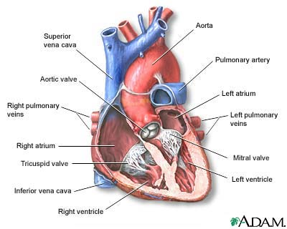
Heart Physiology
http://www.nlm.nih.gov/medlineplus/ency/images/ency/fullsize/1056.jpg

Slide 4
Atrial Fibrillation
Characterized by
  Irregular atrial beating
  Disordered electrical signals
  Poor blood flow
  Increased blood clot risk
Complications
  Stroke (blood clots)
  Heart Failure

Slide 5
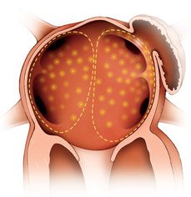
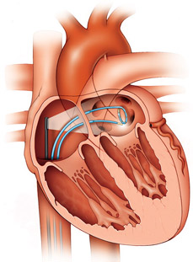
Atrial Fibrillation Treatment
Pulmonary Vein Isolation
  Catheter Pathway
    Enters at femoral vein
    Travels through inferior vena cava into right atrium
    Puncture through to left atrium
  Tissue Ablation
    Irregular impulses originate from pulmonary veins
    Scaring of heart tissue to isolate irregular signals
http://www.cpmc.org/services/heart/tx/pvai.html

Slide 6
Client’s Research
Treatment of atrial fibrillation under MRI guidance
  Solenoid-tipped catheter
  Awaiting FDA approval
    Animal/phantom testing
    Human testing

Slide 7
Design Specifications
Size
  Diameter 13’’
  Length 13’’
Vasculature
  Pulmonary Veins: inlets
    10 – 20 mm (diameter)
  Superior Vena Cava: outlet
    20 – 30 mm (diameter)
  Inferior Vena Cava: catheter entry point
    20 – 30 mm (diameter)
Heart chamber division
  Permeable foam membrane
  Thin disposable membrane
MRI compatible (no ferrous materials)
Transparent and leak proof

Slide 8
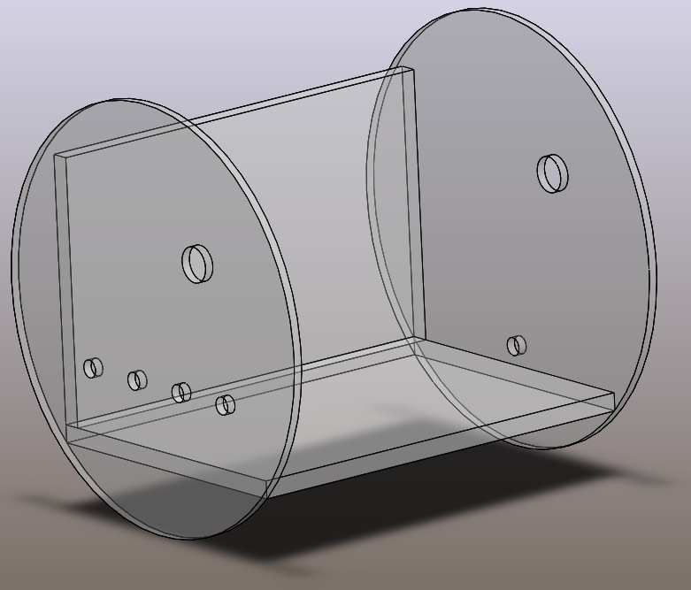
Final Design - Casing
Superior
Vena Cava
Inferior
Vena Cava
Pulmonary Veins
Outlet to system
Drain
Catheter entry point with sheath
Inlets to system
Pump connection

Slide 9
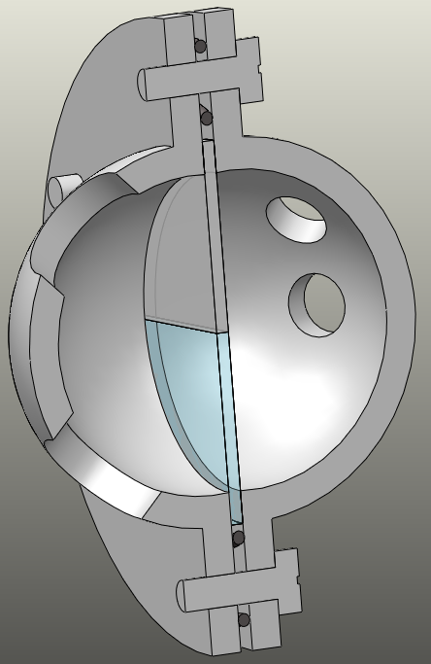
Final Design – Heart Chamber
Superior
Vena Cava
Screws & Bolts
Seal heart chamber
Outlet
Pulmonary Veins
Inlets
Disposable Septum
Permeable Foam Membrane
Catheter puncture from right to left atrium
Allow fluid flow from left to right atrium
Inferior
Vena Cava
O-rings
Catheter entry point
Seal heart chamber

Slide 10
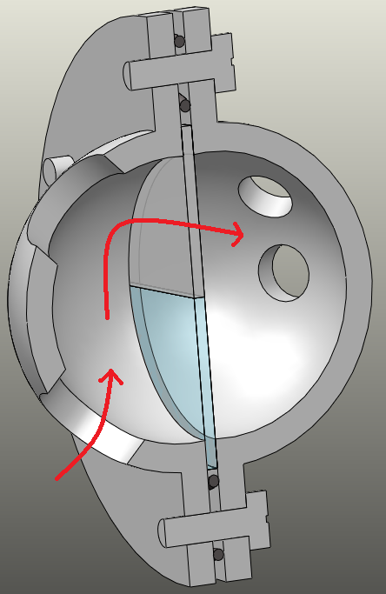
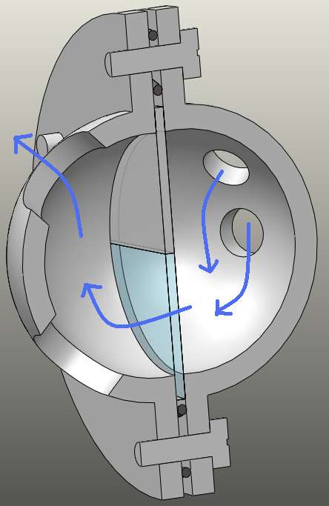
Final Design – Heart Chamber Cont.
Catheter Pathway
Flow Pathway

Slide 11

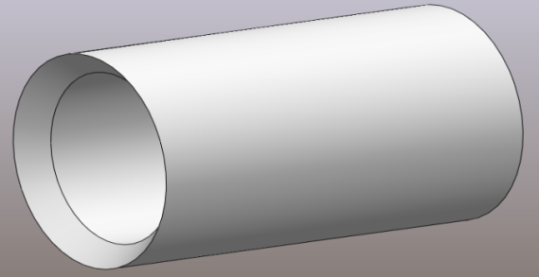
Final Design – Tubing Connections
Snap Grip
Acrylic Wall
Polycarbonate Tubing
Tapered to prevent catheter from catching
Tygon Tubing

Slide 12
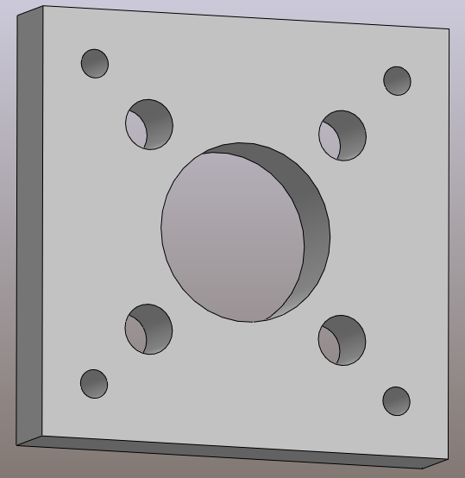
Final Design – High Resolution Block
Visualization of catheter and surrounding vasculature on MRI
Central hole
  Inferior vena cava
Small holes
  Surrounding vasculature

Slide 13
Future Testing
Leak Testing
  Static and dynamic
Flow Testing
  No air in tubing
  Laminar flow
MRI Testing
  Visualization of catheter
  High resolution block
Septum Testing
  Determine permeability and ease of replacement

Slide 14
Questions?

Slide 15
References
Mayo Clinic Staff (2007) Heart Disease: Atrial Fibrillation. Retrieved February, 2009, from http://www.mayoclinic.com/

