Slide 1

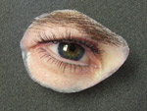
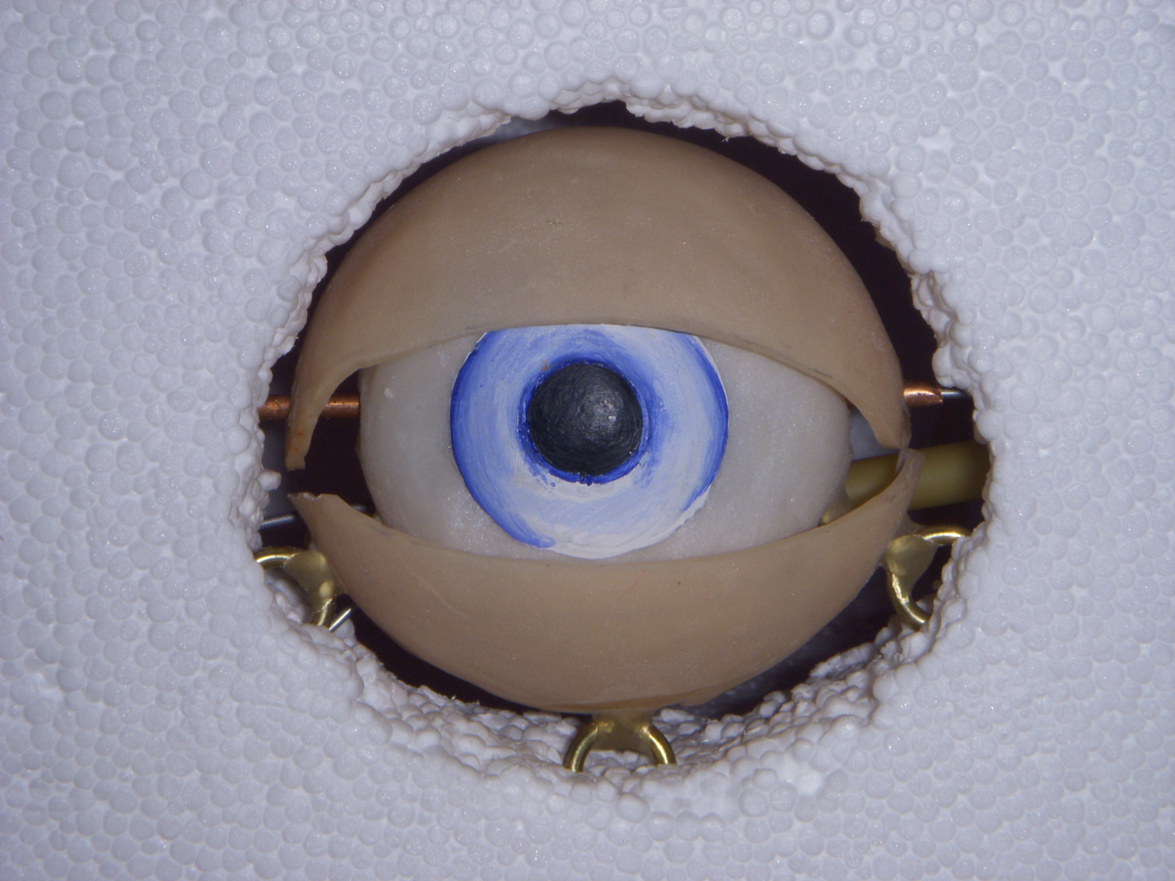
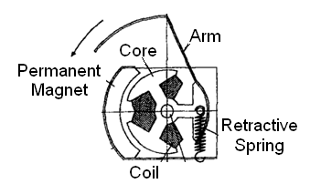
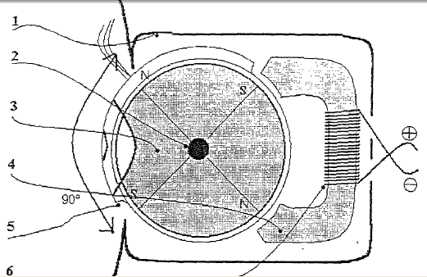
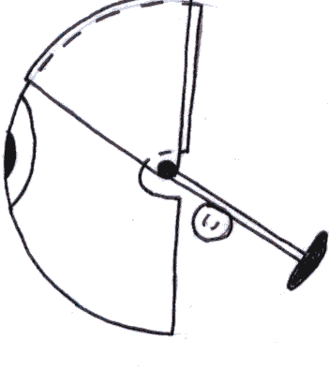
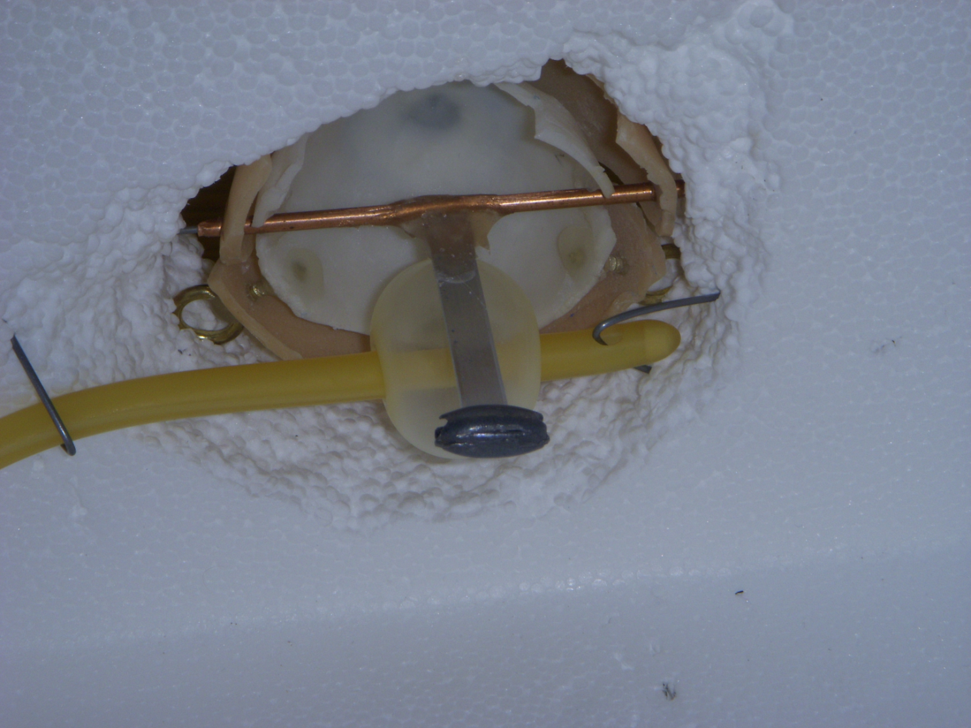
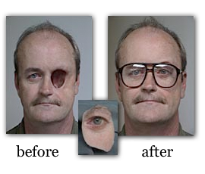
BLINKING ORBITAL PROSTHESIS
Carmen Coddington, Bryan Jepson, Elise Larson, Michelle Tutkowski
Advisor: Willis Tompkins, Ph.D.
Client: Greg Gion, MMS, CCA
Abstract
Competition
Prosthetic eyes are a common solution to physical deformity. An orbital prosthesis is an artificial eye that closely mimics a natural eye. Although current prosthetics improve natural appearance, they are still noticeable because they do not blink. We will create a mechanism that allows an orbital prosthesis to blink. Our team considered technical and physiological feasibility, as well as client input, to develop a prototype that exemplifies a pneumatic solution to this problem.
Fabrication of the design has resulted in a prototype 54.5% larger than an actual prosthesis. This prototype demonstrates successful operation of the mechanism. Continued work will decrease the scale of the prototype to a realistic size.
Final Design
Non-blinking prosthesis ^{[2]}
  Realistic appearance
  Reliable
  No blinking function
Electromagnetic Activator ^{[3]}
  Synchronized with other eye
  Limited blinking function
  Unrealistic appearance
  Not commercially available
Doll’s Eyelid ^{[5]}
  Patent number 20020049023
  Reliable blinking function
  Designed only for dolls
Pneumatic Mechanism
  User triggers air bulb
  Air bulb inflates balloon
  Balloon inflation forces lever upward
  Lever rotates central axis
  Eyelid rotates into closed position
  User releases air bulb causing balloon deflation
  Counterweight pulls eyelid into open position
Cost Analysis
Figure 6: From top to bottom: traditional prosthesis, ^{[2]} electromagnetic activator design,^{[3]} doll’s eyelid design. ^{[5]}
Motivation
Item | Price
Silicon-Coated Latex Straight Foley Catheter- 16 Fr/ 5cc | $1.71
Acrylic eye piece and eyelid | $5.00
Loop Screws (3) | $2.00
Copper Tube | $0.40
Steel Wire | $0.20
Aluminum Lever Arm | $0.10
Air Bulb | $7.99
Polymethyl Methacrylate $3.57/ oz | $0.71
Total Cost | $18.11
Figure 2: Front view of blinking orbital prosthesis.
Design Criteria
Medical Arts Prosthetics Clinic
  - Custom prosthetics (eyes, ears, noses, fingers)
  - Strive for most life-like restoration
Many causes for eye loss
  - Trauma
  11,000 incidents per year in US ^{[4]}
  - Disease ^{[1]}
Orbital prosthetics provide more natural appearance
Client currently provides non-blinking eye replacements
  - Silicone material
  - May draw attention from lack of blink
  - 17,000 to 22,000 blinks daily ^{[3]}
2.75 cm
  Reliably blinks on command
  Primarily self-contained
  Natural appearance
  Contained within 5.5 cm³
  Weight less than 45 g
  No detrimental health effects
  Maintained easily
  $500 or less
Weight
Balloon
Future Work
Central Axis
Figure 4: Rear view of blinking orbital prosthesis. Note the inflated balloon.
Figure 3: Cross sectional view of the mechanism.
Scale Down Prototype
Refine Design
  Consider enclosure of mechanism
  Extend tubing to actuator
  Improve closed air system
  Integrate eyeglasses
Material Changes
  Silicone lower lid, upper lid cover
  Smaller catheter (LACRIcath)
  Dense, lead-free counterweight
Further Testing
  Longevity
  Performance in diverse settings
Advantages
  Does not depend on battery
  Blinks on command
  Realistic blink duration
  Closed air system
Component | Current | Ideal
Diameter (cm) | 5.5 | 3.0
Lever Length (cm) | 4.6 | 2.5
Tube Diameter (Fr) | 16.0 | 9.0
Balloon Volume (cc) | 5.0 | 3.0
Closure Force (N) | 1.96 | 1.06
Ergonomics
  Not necessary to remove prosthetic
  Can maintain a closed position
  Remains open upon failure
  Minimal irritation to surrounding tissue
Testing
Figure 1: Example of traditional orbital prosthesis. ^{[2]}
+
Goal: To create a primarily self contained, blinking orbital prosthesis to give prosthetic users a more realistic appearance.
Maximum Balloon Capacity: 420mL
  Air bulb contains 25 mL air
  Bulb volume insufficient to overload balloon
References
Force of Closure: 1.96 N
  Greater than minimum force of closure
[1] Adkisson, Jay. April, 2006. Coping with Monocular Vision after Enucleation or Eye Loss from Cancer, Accident, or Disease. ISBN: 9780595392643
[2] Gion, Gregory, Allison Vest. Medical Art Prosthetics Clinic. http://www.medicalartprosthetics.com/content.php?page=galleries&gallery=orbital
[3] Honda M., A.Niimi, M.Ueda“New Orbital Prosthesis With a Blinking Eyelid: Report of a Case” Journal of Oral and Maxillofacial Surgery, Volume 57, Issue 6, Pages 730-733
[4] Lee, P., Wang, C. C., & Adamis, A. P. (1998). Ocular neovascularization: An epidemiologic
review. Survey of Ophthalmology, 43(3), 245-269 17
[5] Simeray, Janick . December 2001. http://www.freepatentsonline.com/20020049023.pdf
Average Duration of Blink: .374s
  Typical blink .3-.4s
  Continued use showed consistent blink duration: no slowing observed
Acknowledgements
Figure 5: Number of blinks at at a given duration. Duration of blink(s) represents time for closure and reopening. n=19
-Greg Goion, Medical Art Prosthetics
-Tom Yen, BME Department
-Willis Tompkins, BME Department
-BME Design Spring 2008 Ryan Kimmel, Alison Mcarton, Joel Gaston, Hallie Kreitlow
-BME Design Fall 2008 Padraic Casserly, Katie Pollock, Becca Clayman, Andrew Bremer

