Slide 1
SILS Liver Retractor
Nick Ladwig, Kevin Hanson,
Kara Barnhart, Daniel Jonovic
Client: Dr. Jon Gould
Advisor: Professor Mitch Tyler

Slide 2
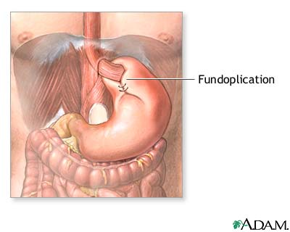
Nissen Fundoplication
Treatment for chronic heartburn by GERD
Daily problem for 15 million Americans
Upper stomach wrapped around esophagus
Liver retracted to expose surgical site
Fundoplication
http://adam.about.com/surgery/Gastroesophageal-reflux-series.htm

Slide 3
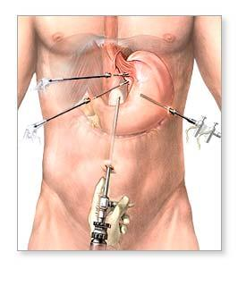
Current Trend
Single incision laparoscopic
  Need single port liver retractor
Other Applications
  Adrenal gland, Heller’s, Lap Band, Bariatric
  200,000 surgeries/yr
Umbilicus
(SILS Port)
http://adam.about.com/surgery/Gastroesophageal-reflux-series.htm

Slide 4
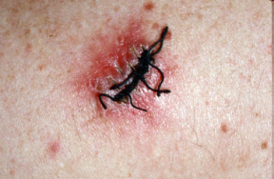
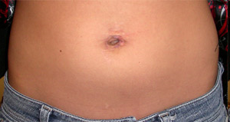
Motivation
Decrease # of incisions
  Cosmetic
  Less risk of infection
  Patient satisfaction
http://www.skininfection.com/images/ImgLib/Large_380/WoundInfection/Surgery_Sutures.jpg
http://my.clevelandclinic.org/PublishingImages/Urology/umbilical_incision.jpg

Slide 5
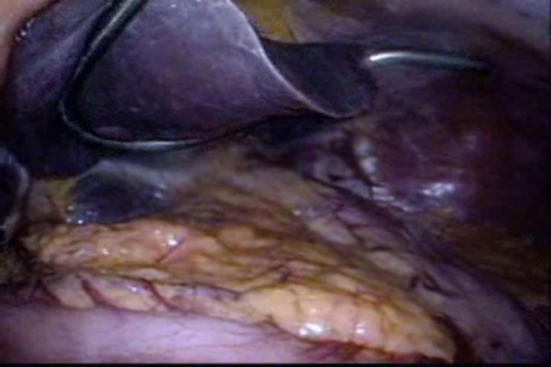
Nathanson Retractor
Dedicated
port required
Liver
Gastroesophageal Junction
http://adam.about.com

Slide 6
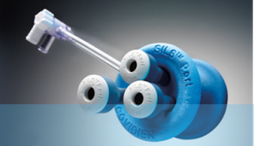
Problem Statement
Use in single incision surgery
Retract left liver lobe to abdominal wall
Expose gastroesophogeal junction
Safely deployed and removed
Fit through laparoscopic port
http://www.covidien.com/campaigns/pagebuilder.aspx?topicID=175991&page=SILSPort:Main

Slide 7
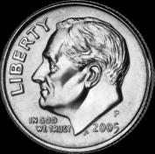
Design Specifications
<5 minute deployment
Within 1 cm of abdominal wall
Distribute weight of left lobe (2.3N)
Fit through 12 mm port
Non-toxic
Sterilizable
http://upload.wikimedia.org/wikipedia/commons/thumb/1/17/2005_Dime_Obv_Unc_P.png/603px-2005_Dime_Obv_Unc_P.png

Slide 8

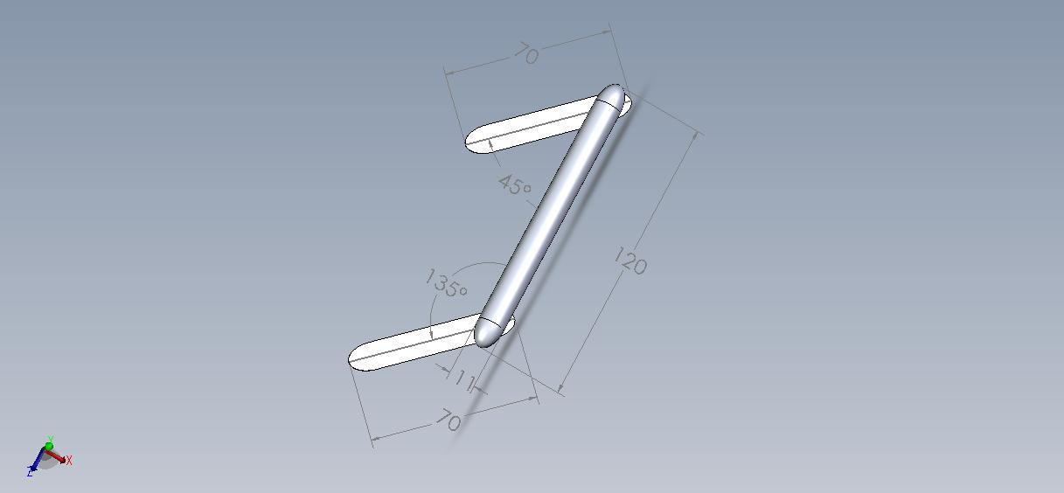
Last Semester Design
Deployment
Retraction
Notes:
8

Slide 9
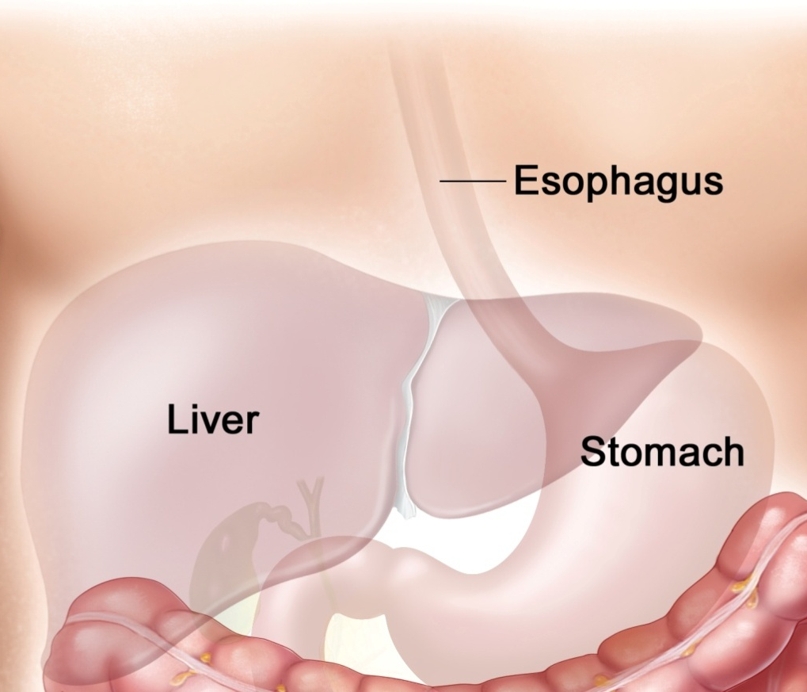
Deployment Procedure
  Attach suture to left crus
  Thread suture through retractor
  Insert retractor
  Deploy retractor
  Move retractor under liver
  Pass suture out abdominal wall
  Apply tension to retract liver
1
6
http://www.meb.uni-bonn.de/cancer.gov

Slide 10
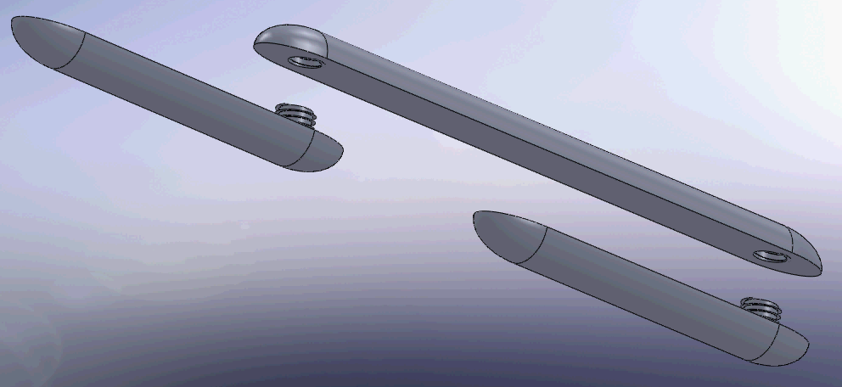
Hinge Design 1: Screw
Arm has male threads
Base has female threads
Deployment
  Arms ½ screwed, straight
Retraction
  Surgeon screws arms until tight
  Requires additional tool
  When tightened arms at 45° and 135°
Female
Threads
Male
Threads
Notes:
10

Slide 11


Hinge Design 2: Detents
Arm axle fits into base – rotation axis
Surgeon manually moves arms into position
Spring-coupled peg fits into 1 of 2 base detents
  Detents lock arms for deployment or retraction
  Spring relaxed with peg in detents
Detents
Axle
Peg
Notes:
11

Slide 12
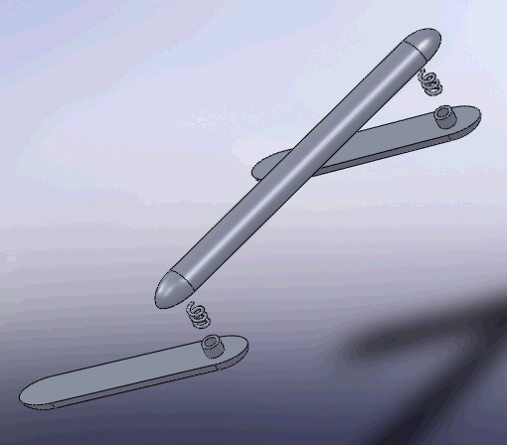
Hinge Design 3: Spring Loaded
Hollow cylinder axle
  Torsional spring inside connecting arm to base
Deployment
  Straight arms
  Torsional spring in tension
Retraction
  Tension release rotates arms
  Spring relaxed
Hollow Axle
Torsional Spring
Notes:
12

Slide 13
Design Matrix
 | Weight | Screw | Detents | Spring Loaded
Ease of Fabrication | 15% | 11 | 7 | 11
Ease of Deployment / Removal | 25% | 13 | 16 | 21
Reliability | 20% | 15 | 16 | 18
Cost | 10% | 9 | 6 | 7
Risk for Trauma | 30% | 29 | 29 | 28
 | Total | 77 | 74 | 85

Slide 14
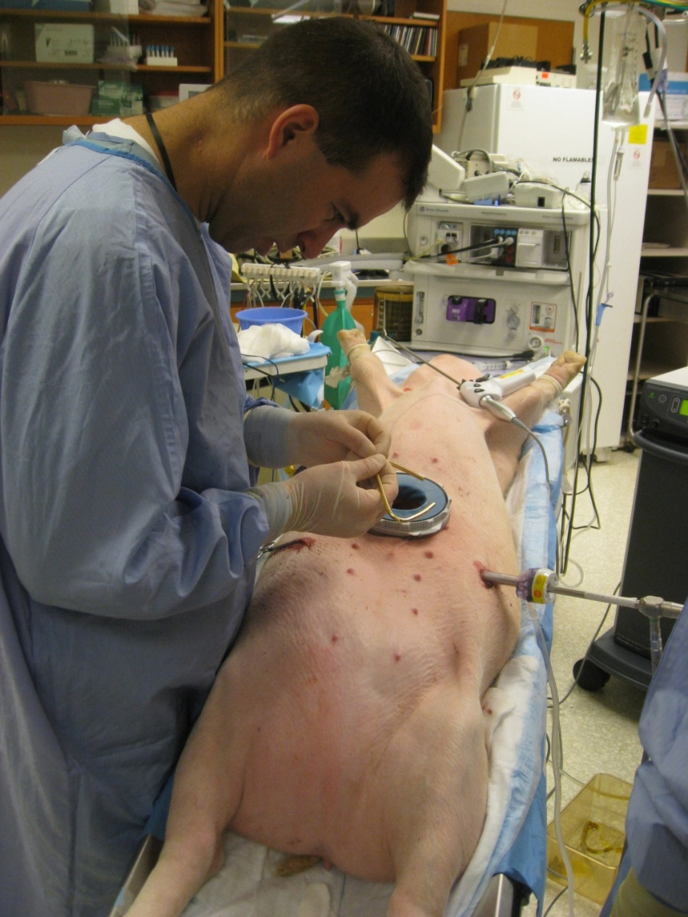
Future Work
Determine spring constant
Construct prototype
Test device
Submit invention disclosure

Slide 15

Questions?

