Slide 1
Intracranial Pressure Sensor
Client: Dr. Josh Medow
Advisor: Prof. Willis Tompkins
Team Members:
Sarah Sandock (BWIG)
Jamon Opgenorth (Comm.)
Dan Miller (Leader)
Brad Lindevig (BSAC)

Slide 2
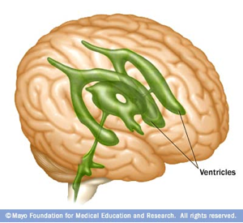
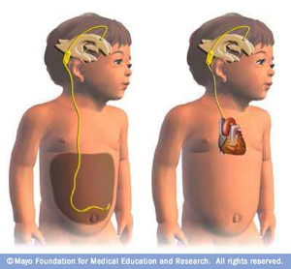
Physiological
Hydrocephalus
Cerebrospinal Fluid (CSF)
Ventricles
Shunts

Slide 3
Status Quo
Complication
Our Goal
Current Studies

Slide 4
Design Criteria
Sensor
No recalibration
Drift stability (± 2 mmHg)
Reliability (0.1% error)
Range (-30 mmHg to 100 mmHg)
Telemetry data and power transmission
Small size (Under 50 cm^2)
Must not interfere with other medical devices
Notes:
Device
1) No recalibration - once implanted, the device needs to continue to accurately measure and transmit data without the need for invasive adjustments
2) Drift stability - 2 mmHg to 3 mmHg over 20 years
3) Reliability - within 0.1% error
4) Range - 30 mmHg to +100 mmHg
5) Telemetry data and power transmission - no protruding wires, no battery
6) Small size - on the order of 1 cm (the size of the typical neurosurgery drill)
7) Must not interfere with existing diagnostic instruments, including MRI and CT
Testing
- Design and build phantom model
- Test the prototype device with at least 100 pressure data points within normal and abnormal ICP range
- Determine the device's stability to drift
Circuit drift and the need for recalibration are cornerstone device specifications. These and other important parameters such as pressure range will be determined with the help of a phantom model that can simulate the conditions found in a patient's head.

Slide 5
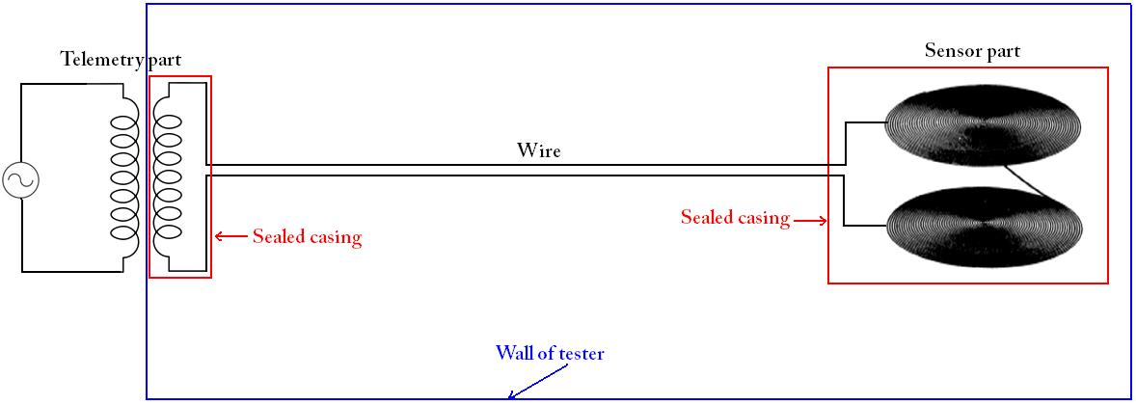

Sensor
LC “Tank” Circuit
Telemetry
Capacitor and inductor
Resonant Frequency
  Varying Capacitance
Inductive transfer of power
Magnetic field

Slide 6
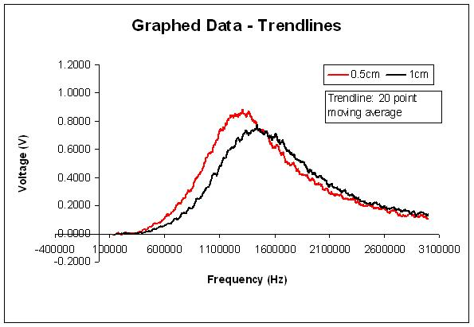
Design Criteria
Testing
Will need to test -30 mmHg to 100 mmHg
Determines the accuracy of the device
Correlate resonance frequency to pressure
Determine the device's stability to drift
Simulate the conditions found in a patient's head

Slide 7
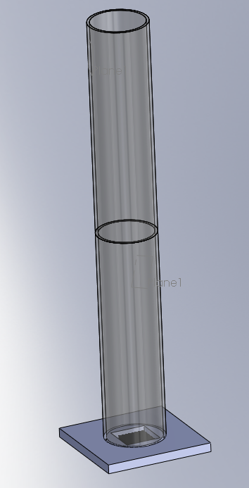
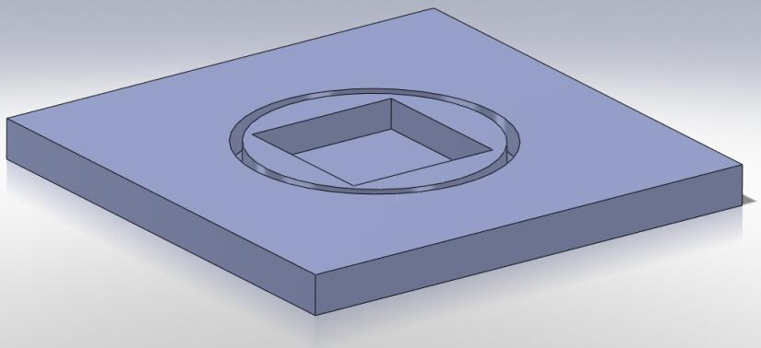
Design 1: Plastic Pipes
Components
  Integrated base
  54” w/ 6” PVC pipe
  Plug with hose
Pros
  Adjustable
  Allows vacuum use
  Portability
Cons
  Readjusting for different heights

Slide 8
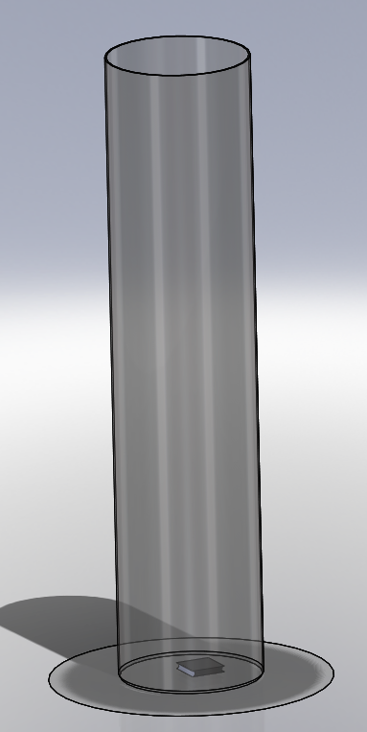
Design 2: Graduated Cylinder
Components
  Large glass cylinder
    54” tall, 6” ID
Pros
  Precise measurements
  No machining involved
Cons
  Difficult to drain
  Awkward in lab setting

Slide 9
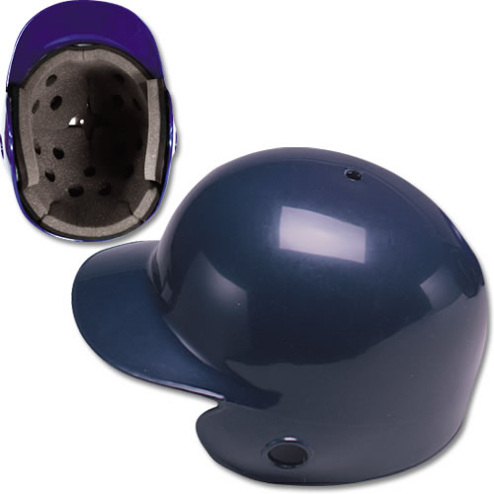
Design 3: Baseball Helmet
Components
  Baseball helmet
  Plastic Sheet
  Balloon
Pros
  Resembles expanding pressure in head
Cons
  Difficult to measure accuracy
  Can not measure a vacuum
  Difficult to test for drift

Slide 10
Design Matrix
Component | Weight | Plastic Pipes | Graduated Cylinder | Baseball Helmet
Accuracy | 40 | 38 | 38 | 25
Ease of Use | 25 | 24 | 15 | 18
Simplicity | 20 | 10 | 10 | 5
Model of Existing System | 15 | 18 | 18 | 14
Total | 100 | 90 | 83 | 62

Slide 11
Future Work
Order Components
Manufacture
Develop protocol
Test
Deliver

Slide 12
Acknowledgements
Elena Bezrukova
Prof. Frank Fronczak
Client: Dr. Josh Medow
Advisor: Prof. Willis Tompkins

Slide 13
References
Nation Institutes of Health, Nation Institute of Neurological Disorders and Stroke. (2008) Hydrocephalus fact sheet (NIH Publication No. 08-385), Bethesda, MD: Office of Communications and Public Liaison
Ghajar, J. (1995). Intracranial Pressure Monitoring Techniques. New Horiz, 3(3),395-399
Kroin, J et al. (200) Long-term testing of an intracranial pressure monitoring device. J. Neurosurg. Volume 93
Collins, C. (1967) Miniature Passive Pressure Transensor for Implanting in the Eye. IEEE Transactions Bio-Medical Engineering BME-14, NO. 2

Slide 14
Questions?

