Slide 1
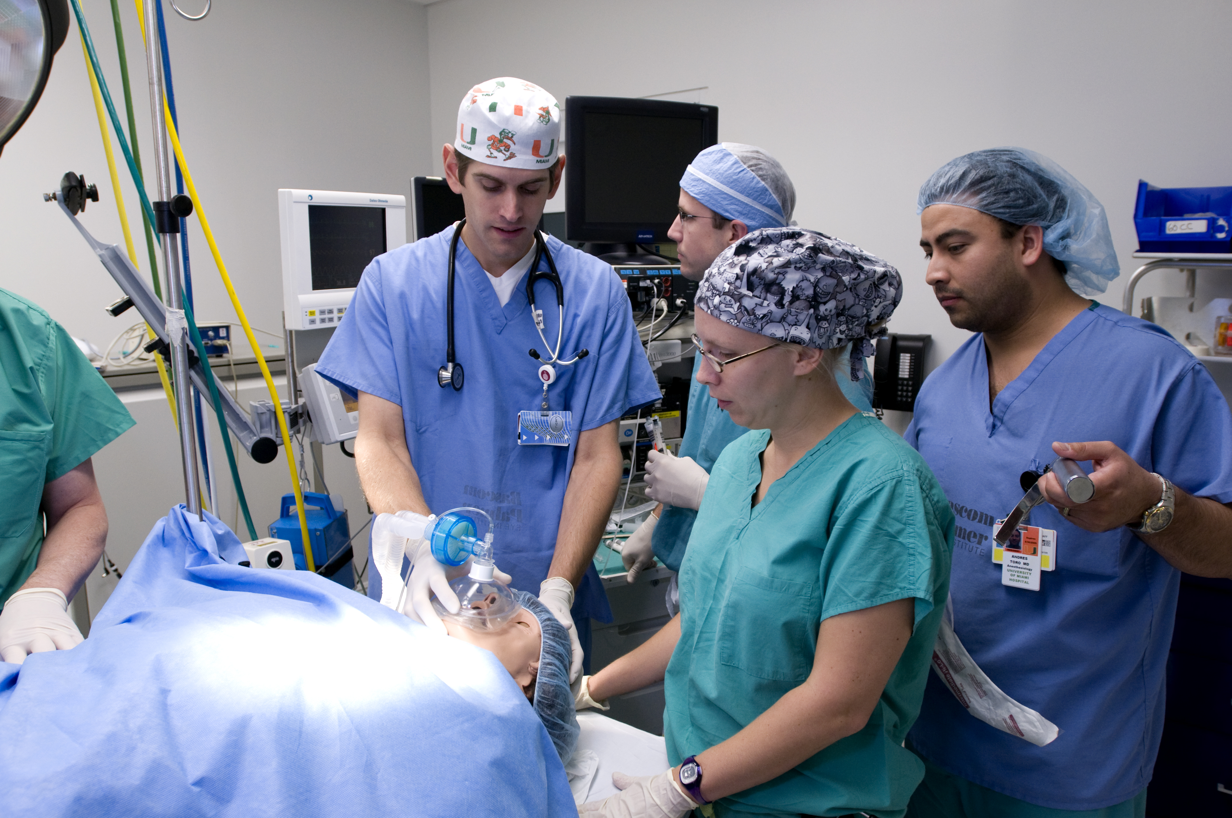


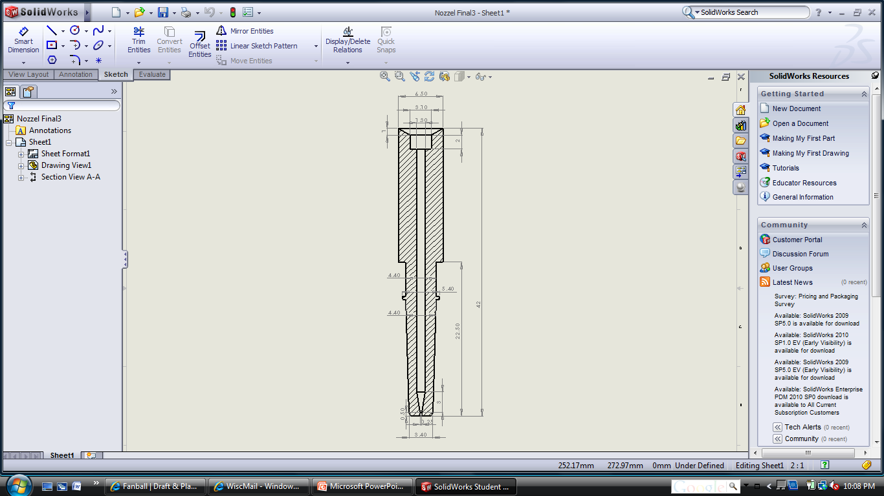
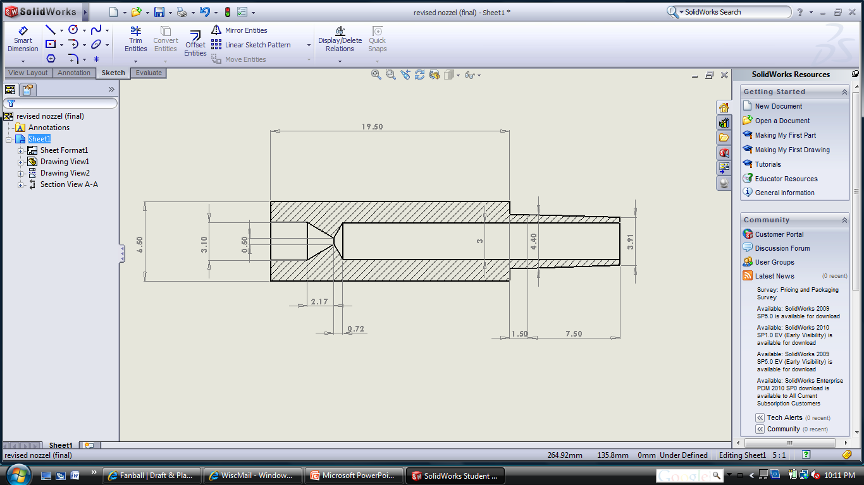
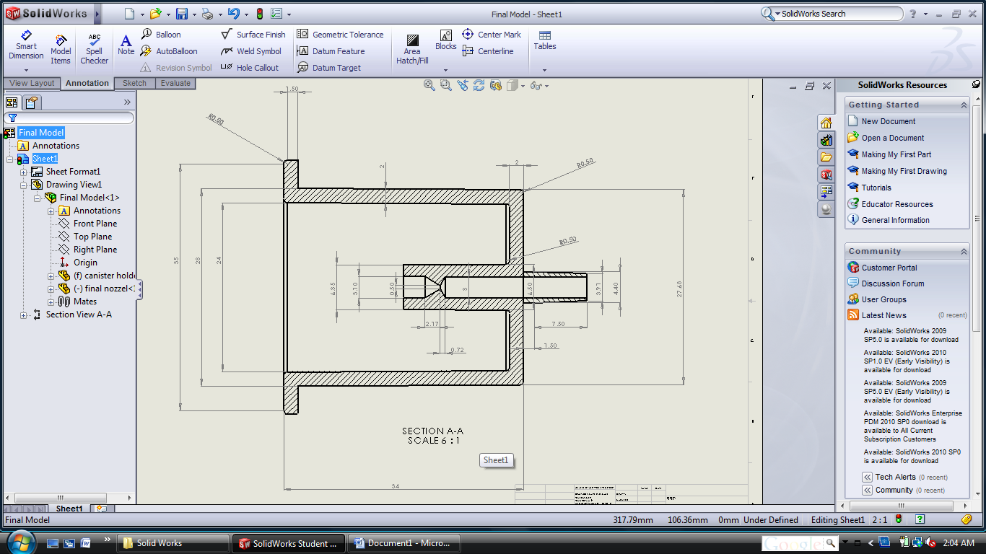
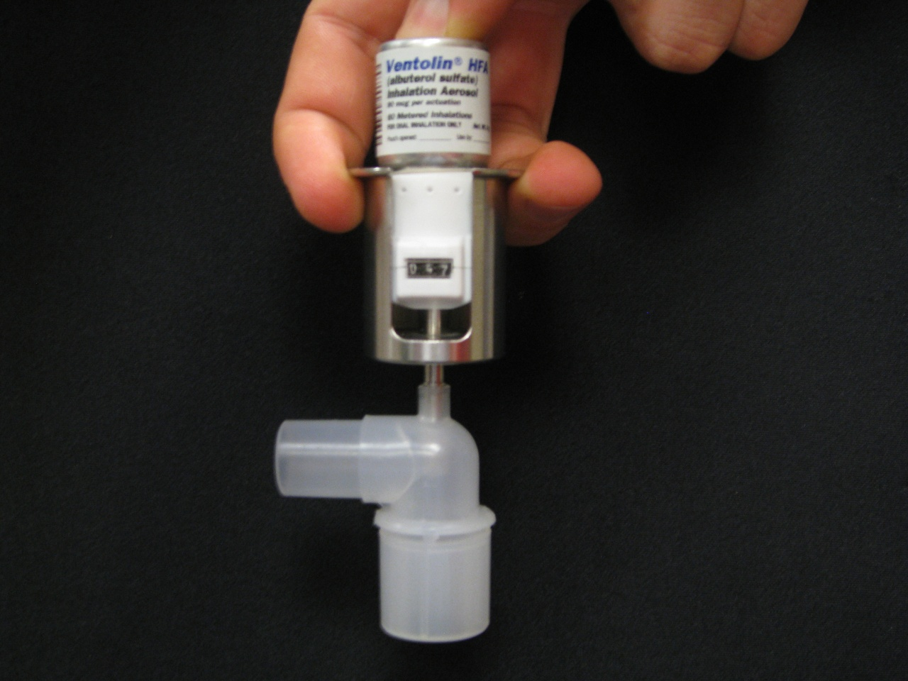
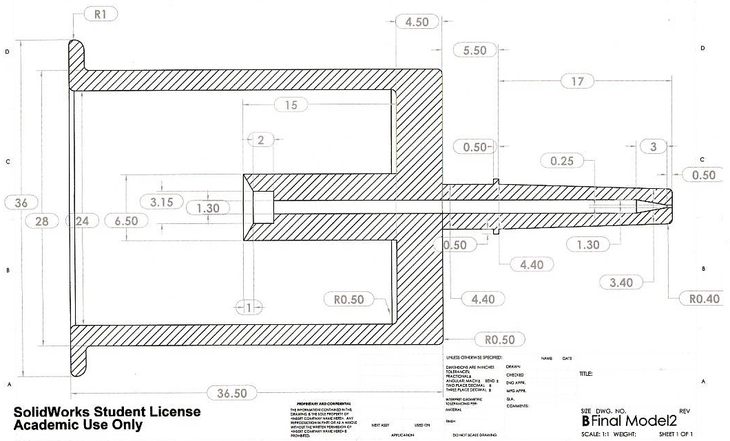
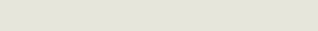
Endotracheal Tube Adaptor
Team Members: Ryan Childs, Evan Joyce, Timothy Barry, Ozair Chaudhry
Client: Mark Schroeder, MD, UW-Hospital Anesthesiologist Advisor: Paul Thompson, PhD, UW-Madison Biomedical Engineering Dept.
Abstract
New Prototype
Testing
If an anesthetized patient becomes asthmatic during surgery, albuterol must be administered into the ventilation circuit through an endotracheal tube adaptor to alleviate symptoms. This semester we expanded upon our work from the previous semester by making several design changes to the nozzle and body of our original prototype to help address problems with the spray pattern, ease of commercialization (injection molding), and universality of the adaptor. Laser diffraction and UV Spectroscopy experiments were performed to give a quantitative comparison between the old and new prototypes and other existing technologies. These tests showed that our original prototype generates a higher percentage of desirable small particles in the size range of 5-10 µm, and that it also deposits a larger amount of albuterol in comparison to the new prototype and other devices. In conclusion, the functional changes we made were detrimental to our prototype’s performance while the structural changes provided a viable commercial product.
Malvern Laser Diffraction
Fig. 6. Particle size distribution of new prototype with ET tube
The total percentage of particles under 50 µm is 4.60*10^-5 %.
Fig. 7. Particle size distribution of old prototype with ET tube.
The total percentage of particles under 50 µm is 0.99 % .
Background
Client is an anesthesiologist at the UW-Hospital
Albuterol is used as a fast acting bronchodilator
  Difficult to administer through endotracheal tube (ETT) to intubated patients
Geometrical changes were made to the albuterol canister used at the UW-Hospital
  Propellant changed from CFC to HFA
  Actuation counter cap
Preliminary prototype produced last semester
  Addressed geometrical changes
  Appearance of spray pattern raised concerns
Fig. 3. SolidWorks model of old prototype nozzle
Fig. 4. SolidWorks model of new prototype nozzle
Fig. 8. Particle size distribution of new prototype without ET tube.
The total percentage of particles under 50 µm is 0.28 %.
Fig. 9. Particle size distribution of old prototype without ET tube.
The total percentage of particles under 50 µm is 8.99 %.
Functional Changes
  Orifice size – orifice diameter increased from 0.25 mm to 0.5 mm
    Reduced pressure and bottleneck effect present in old prototype
  Taper style – reverse taper
    The reverse taper created a pressure drop that slowed down the medication allowing for a cloud formation and better particle distribution
UV Spectroscopy
5 actuation per test into 5 ml of NaOH (1 M)
Max of 450 µg albuterol per test
Constant flow rate (~8 L/min)
8 mm I.D. ET tube
Last Semester
Commercialization
Fig. 10. Standard curve for UV Spectroscopy experiment
Test | Absorbance | Concentration (mg/L) | Mass (μg) | Percent Delivered (%)
Old Prototype | 0.142 | 3.32 | 16.61 | 3.69
New Prototype | 0.037 | 0.87 | 4.33 | 0.96
MDI | 0.842 | 19.74 | 98.72 | 21.94
60cc Syringe | 0.727 | 17.04 | 85.23 | 18.94
Bronchodilator Tee | 0.109 | 2.57 | 12.83 | 2.85
Fig. 11. Table of results from UV Spectroscopy experiment
Conclusion
Fig. 1. Old prototype with Luer port
Fig. 2. Full SolidWorks model of old prototype
Fig. 5. Full SolidWorks model of new prototype
This semester we made several functional design changes which adversely affected the spray characteristics of our prototype. However, we successfully made structural changes that produced a commercial-ready product and thus filed a design patent with a private attorney. Going forward we will incorporate elements of both designs to create a final product that is both highly effective at delivering significant amounts of albuterol in the size range of 5-10 µm and easily mass-producable.
Design Criteria
Improve upon existing spray pattern by changing nozzle functionality
  Ideal particle diameter between 5-10 µm
  Slow particle velocity by creating pressure drop
  Increase orifice size (from 0.25 mm to 0.5 mm)
Improve compatibility, general aesthetics
  Adjust nozzle length to Luer standard (7.5 mm)
  Round sharp edges/corners
Make an injection moldable design
  Draft angles, uniform thickness
Structural Changes
  Nozzle Length – shortened nozzle to accommodate all Luer ports
  Minor aesthetic changes – removed stopping ridge, added draft angles, and added filets
  Patent Application & Process
    Hired and communicated with a patent attorney throughout the semester
    Reviewed over 30 similar patents
    Reviewed and edited patent application drawings/sketches
    Preliminary industry survey at the national anesthesiologist convention
Special Thanks
Mark Schroeder – MD, UW-Hospital
Professor Paul Thompson – PhD. Department of Biomedical Engineering
Anesthesiology Department – UW-Hospital
Adam Mcneilly and Professor Jaal Ghandhi – Department of Mechanical Engineering
Yukihiro Hara – Water sciences graduate student
Professor Glenn Bower – Department of Mechanical Engineering
Professor Rolf Reitz – Department of Mechanical Engineering
Doug Dummer – Physics Machine Shop
Ted Barthel – Whyte Hirschboeck Dudek S.C.

