Slide 1

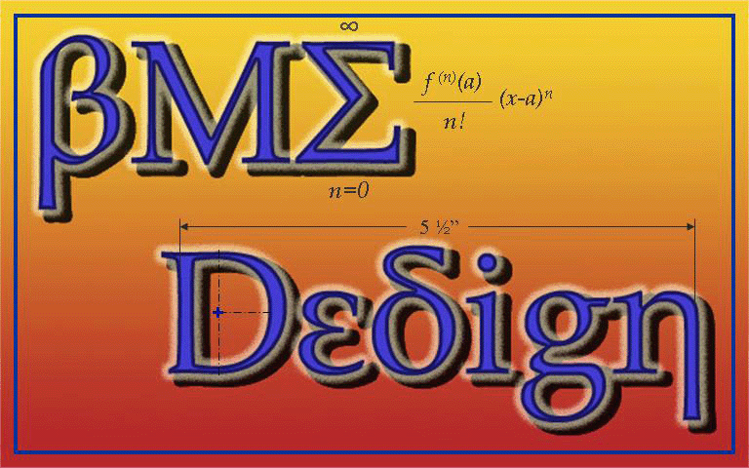
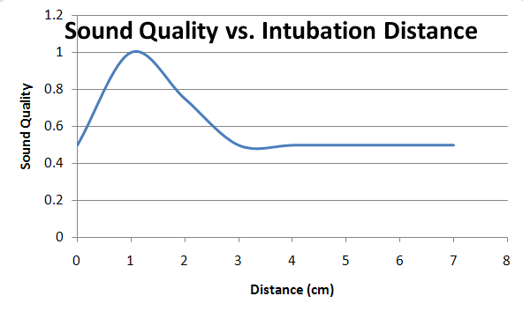
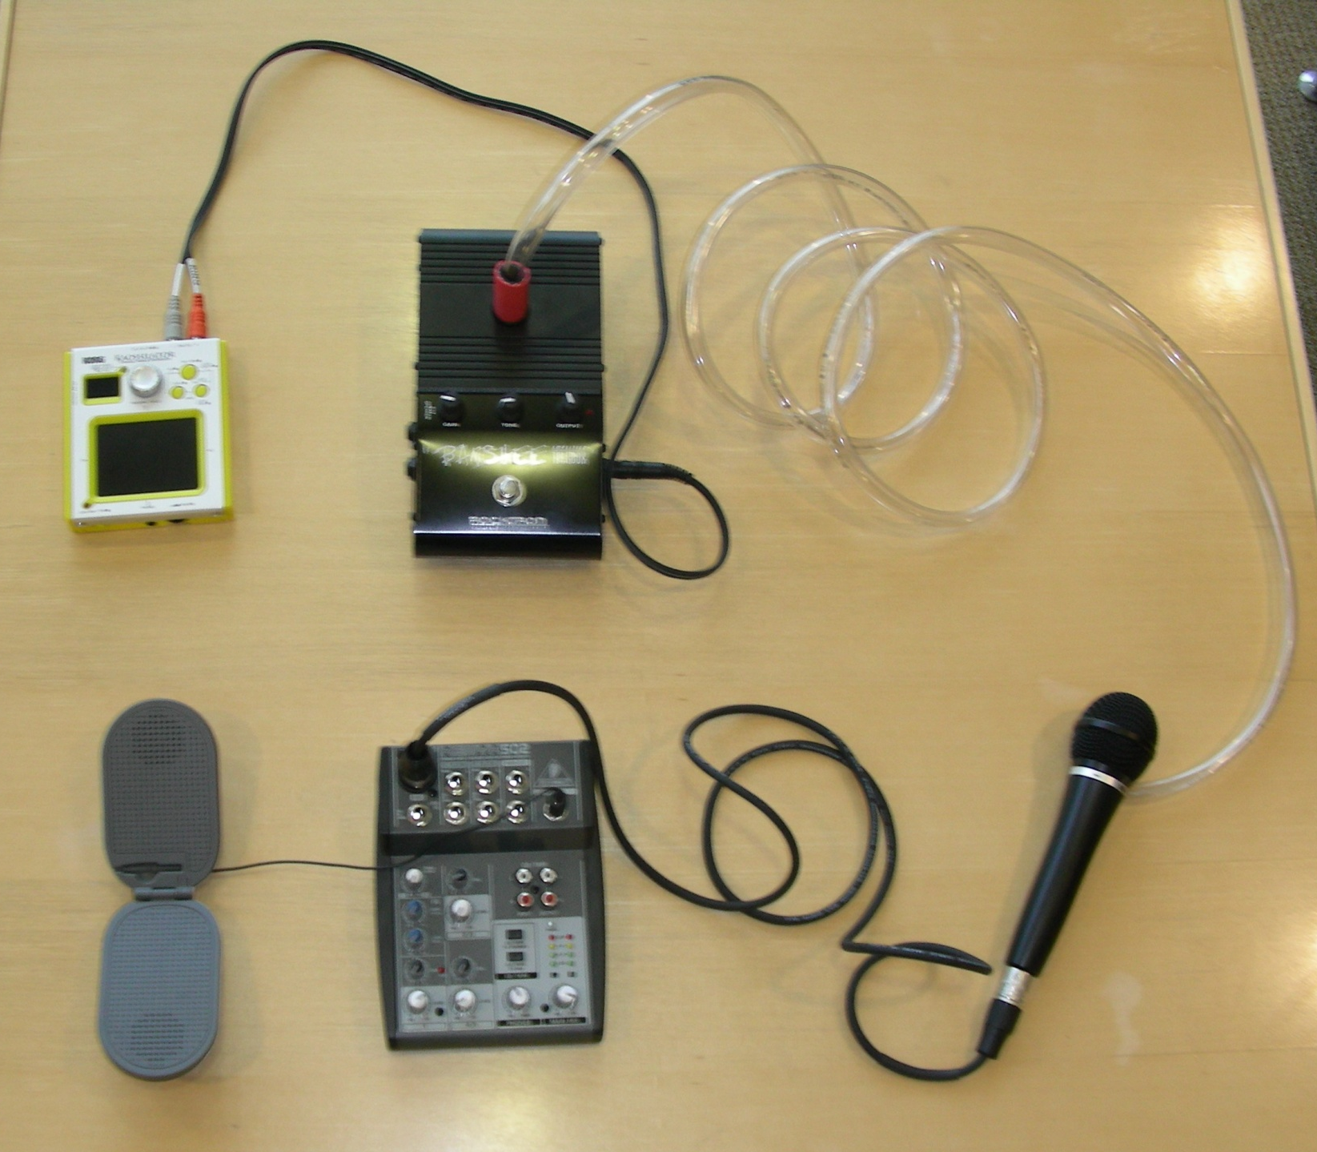
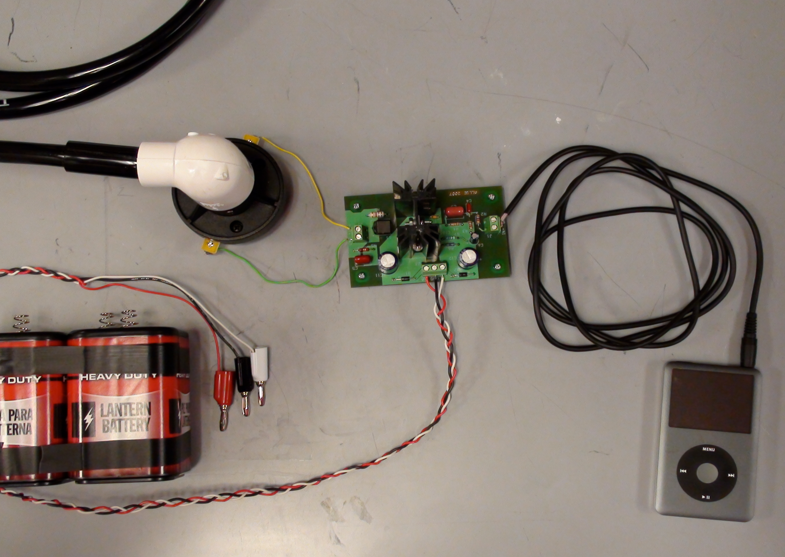
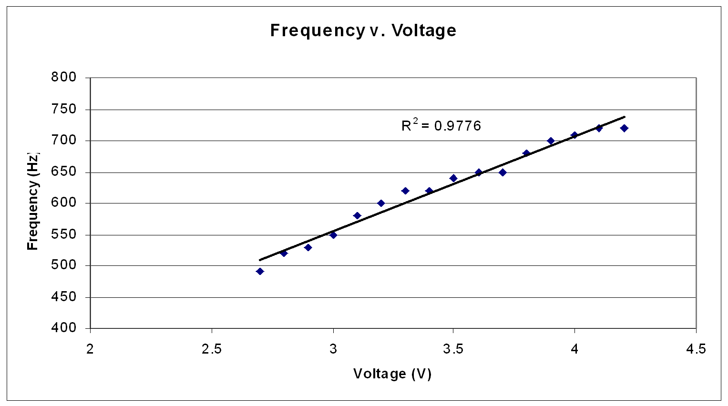
Augmentative Communication Device
Team Members: Prachi Agarwal, Erin Devine, Brian Mogen, Steve Wyche
Client: Lawrence Kaplan, MD
Advisor: Professor Thomas Yen PhD
Abstract
Final Design
Testing- Tube Placement
Dr. Lawrence Kaplan, at the Child Development Clinic at the Waisman Center, has noticed that there exists a lack of communication devices for people who have lost the ability to produce sound. Current products are slow, impersonal and expensive. We have developed a device that allows the user to reduce the time between cognition and speech, use unlimited vocabulary and add inflection to their statements.
We have taken the design from last semester and created our own circuit that accepts customizable input
Signal provided by an iPod
  Recorded vocal sounds
Signal is amplified before passing through the compression driver
The compression driver generates mechanical sound from the signal and the signal is propagated to the mouth through a tube
The mouth shapes the sound into language
Background and Motivation
Wide range of speech problems:
  Neuromotor dysfunction (Cerebral Palsy)
  Laryngectomy
  Paralyzed diaphragm
  Vocal chord paralysis
Speech is frustrating
  Slow
  Lack of expression
These problems make augmentative communicative devices currently on the market ineffective since they leave the user feeling left out of conversations or unable to express themselves. Problems with the current technology include:
  Slow (approximately 30 words per minute)
  Users feel unintelligent
  Can’t always keep up with conversation
  Lack emotional expression
  Expensive ($1500 - $3,000)
  Not used often
Addressing these issues for people with communicative disorders if the motivation behind our design.
The best sound quality was created when the tube was only inserted
into the mouth 1 cm
Testing- Input
Figure 1: Our old design with input from the Kaossilator and the talkbox generating the mechanical sound
Figure 1: Our old design with input from the Kaossilator and the talkbox generating the mechanical sound
Frequency and Voltage have a linear relationship
Testing- Understandability
Future Work
Certain Letters were difficult to understand: C,D,F, and T especially. We hope to address this issue when developing the software.
Create personalized sound input
Develop iPhone/iTouch app
  Personalized sound source
  Control pitch and volume to add expression
Continue to refine the hardware
Develop method for sterilization (UV)
Finalize patent process
Present to interested corporations
Client Requirements
Phonetics-based device
Reduce the delay between cognition and speech
Ability to distinguish between statements, questions, and exclamations
Create the ability to engage in normal, everyday conversation
Affordable (Preferably under $1500)
Portable
Adaptable to various types of speaking difficulties
Our testing panel was made up of 10 people who had never listened to the device before. Overall understandability was quite good. The worst phrase, number 3, was still understood 70% of the time.
Special Thanks
Professor Thomas Yen, PhD
Dr. Lawrence Kaplan, MD
Professor Mark Allie
Amit J. Nimunkar
Timothy Balgemann
Budget
References
Compression Drivers $30
Various Supplies $25
Grand Total: $55
R. Patel. Phonatory control in adults with cerebral palsy and severe dysarthria. Augmentative and Alternative Communication; 2002, Vol. 18, No. 1, Pages 2-10.
A Waller, F Dennis, J Brodie, A Y Cairns. “Evaluating the use of TalksBac, a predictive communication device for nonfluent adults with aphasia.” International Journal of Language & Communication Disorders; 1998, Vol. 33, No. 1, Pages 45-70.
National Institute of Neurological Disorders and Stroke. “Cerebral Palsy: Hope Through Research.” http://www.ninds.nih.gov/disorders/cerebral_palsy/detail_cerebral_ palsy.htm#88033104
Gait Analysis Laboratory. “Cerebral Palsy Program/Guide.” http://gait.aidi.udel.edu/gaitlab/cpGuide.html

