Slide 1
Cartilage bioreactor
Client: Dr. Wan Ju Li
Advisor: Professor Block
Sarah Springborn
Luisa Meyer
BeomKang Huh
Sarah Czaplewski

Slide 2
Overview
Joint Trauma and Degeneration
  Current Treatments
  Future Directions
Non-Destructive Testing for Tissue Engineering
  Requirements for High Field MR
MR Compatible Bioreactor Designs
Assessment of Materials and Deformation Methods
Bioreactor Construction and Validation

Slide 3
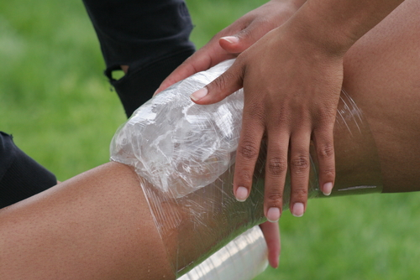
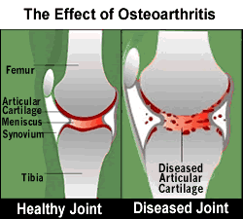
Cartilage Damage and Treatments
Cartilage cannot repair itself
Accident/Injury
Osteoarthritis
  Cartilage between joints wears away
  Affects 21 million Americans
Current Treatments
  Cartilage transfer
  Joint replacement

Slide 4

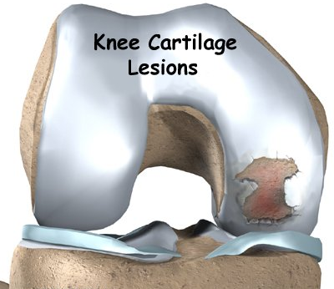
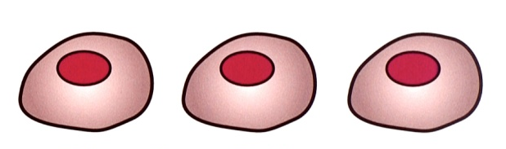
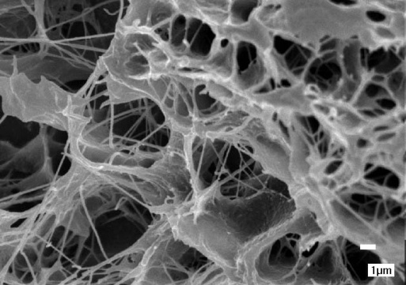
Cartilage Regeneration
Goal: repair lesions to articular cartilage
Mature cells are implanted to fill lesions
Stem cells removed from patient
Cells grow in scaffold
Cells mature and differentiate due to applied conditions

Slide 5
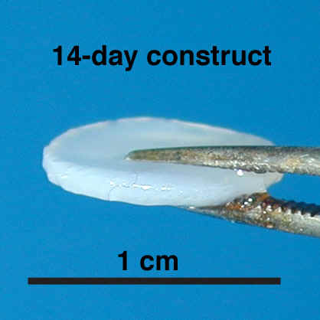
Non-Destructive Testing
Current Methods
  Testing throughout stages of development
  Destroys cells
  Isolates proteins, genes, etc for analysis
Proposed Method
  Testing throughout stages of development
  Cells remain viable
  Images of mechanical loading

Slide 6
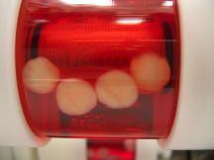
Requirements for MR and Compression
Material
  Biocompatible
  Autoclave and MR safe
Physical Design
  3 inch diameter
  Leak-proof removable cap
Mechanical Loading
  Tissue cannot move
  5-20% Deformation
~1.5 cm
~3 mm

Slide 7
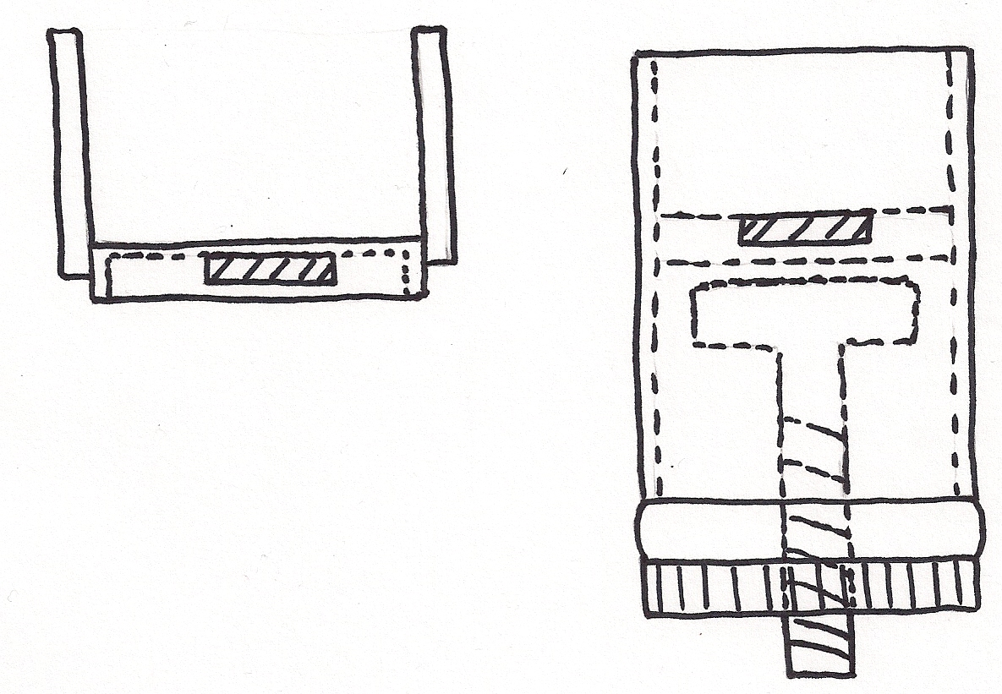
Plunger Compression
Manual twist or push compression
Rubber Seal
Cap
Guide rails for fixation to slide into
Removable fixation
Compressor
Legs to lift tissue off the bottom
Tissue
Side View of Bioreactor
Side View of Fixation

Slide 8
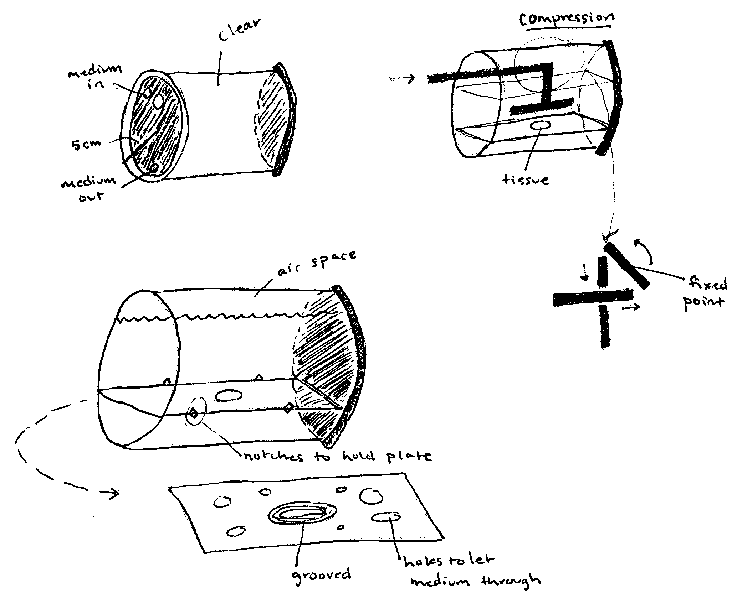
Lever Compression

Slide 9
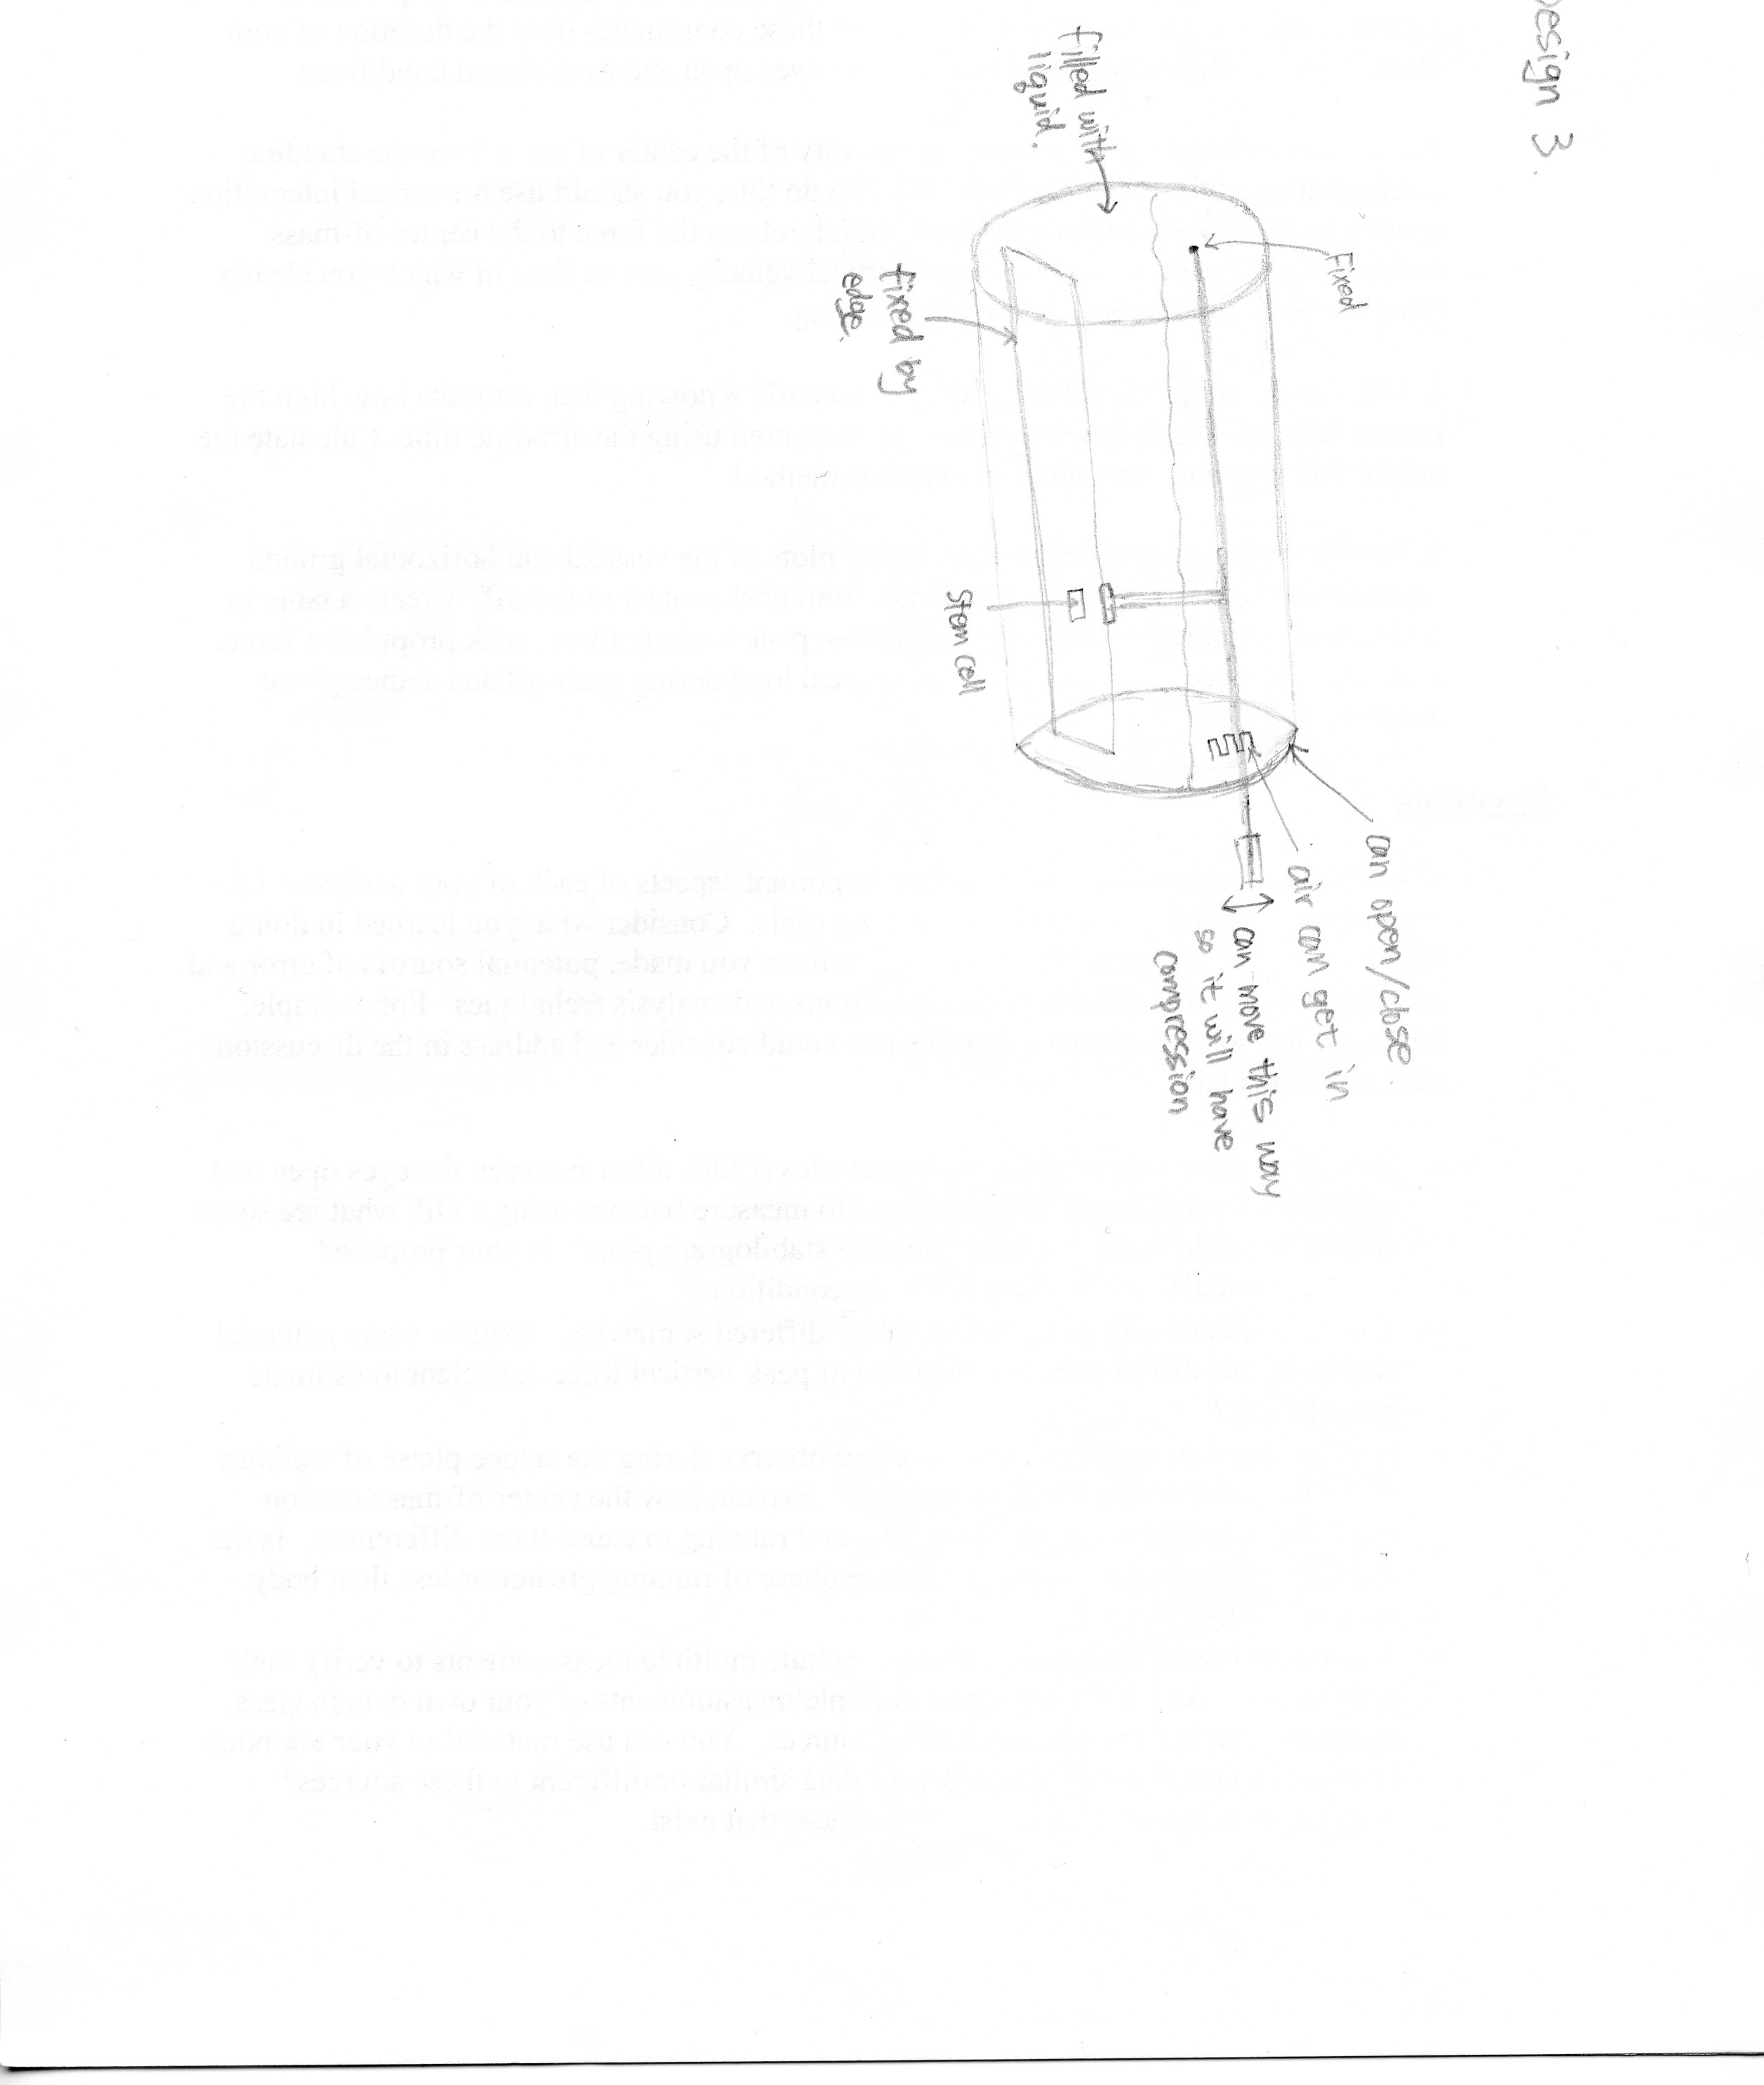
Angled Compression

Slide 10
Design Matrix - Materials
 | Resistance to Heat* | Transparency* | Durability | Cost | Ease of Fabrication | Total (35)
Bioceramics | 10 | 2 | 1 | 1 | 1 | 15
Teflon | 10 | 2 | 5 | 2 | 2 | 21
PVC | 4 | 10 | 4 | 3 | 5 | 26
Poly-carbonate | 6 | 10 | 4 | 5 | 5 | 30
* The score is weighted by a factor of two

Slide 11
Design Matrix – Overall Designs
 | Risk of Leakage* | Fixation* | Maintain Force* | Durability | Ease of Fabrication | Cost | Total (50)
Plunger | 8 | 6 | 8 | 4 | 5 | 3 | 38
Lever | 6 | 8 | 4 | 3 | 2 | 1 | 28
Angled | 6 | 8 | 6 | 4 | 4 | 3 | 35
* The score is weighted by a factor of two

Slide 12
Proposed Design
Manual twist or push compression
Clear Polycarbonate Plastic
Rubber Seal
Cap
Guide rails for fixation to slide into
Removable fixation
Compressor
Legs to lift tissue off the bottom
Tissue
Side View of Bioreactor
Side View of Fixation

Slide 13
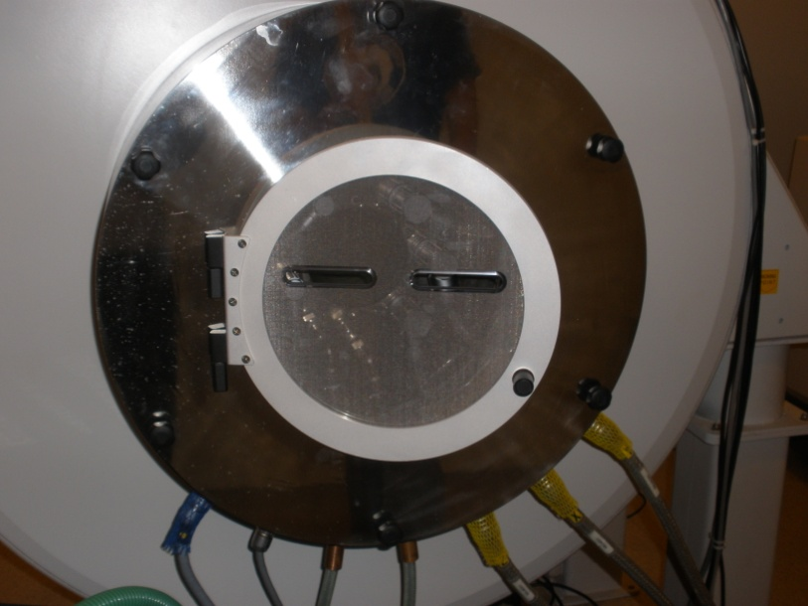
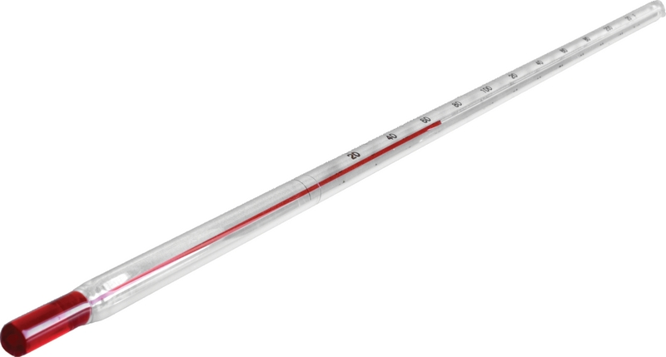
Bioreactor Validation
Create “mock-up” of design
Determine thermal conductivity of imaging coil
Observe temperature decay
Establish necessary volume of medium for imaging
  Air space

Slide 14
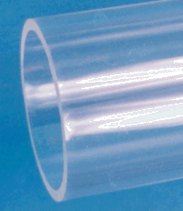
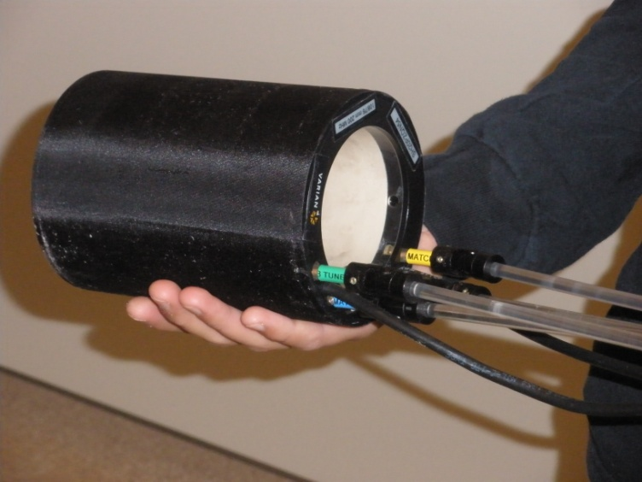
Bioreactor Construction
Order components
  Polycarbonate
  Non-ferrous hardware
Fabricate prototype

Slide 15
References
Articular Cartilage Restoration." 01 Feb 2009. American Academy of Orthopaedic Surgeons, Web. 11 Oct 2009. <http://orthoinfo.aaos.org/topic.cfm?topic=A00422>.
"Osteoarthritis." MedicineNet. Web. 11 Oct 2009. <http://www.medicinenet.com/osteoarthritis/article.htm>.
Tuli, Richard, Wan-Ju Li, and Rocky Tuan. "Current State of Cartilage Tissue Engineering." Arthritis Research & Therapy 5.5 (2003): n. pag. Web. 11 Oct 2009. <http://www.pubmedcentral.nih.gov/articlerender.fcgi?artid=193737>.

Slide 16
Acknowledgments
Thank you to:
  Dr. Li
  Professor Block

Slide 17
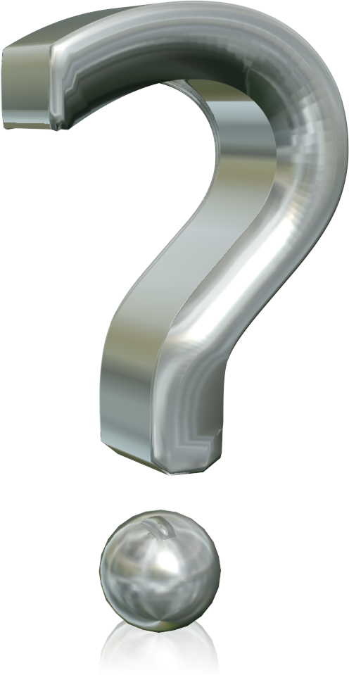
Questions?

