Slide 1


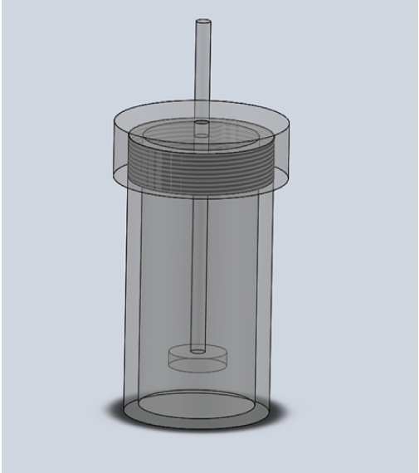

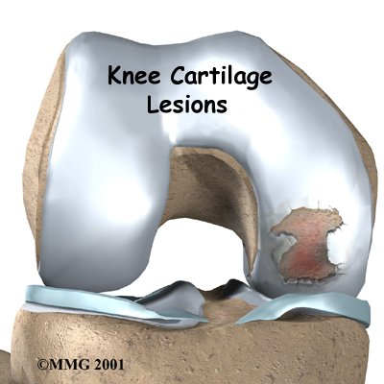
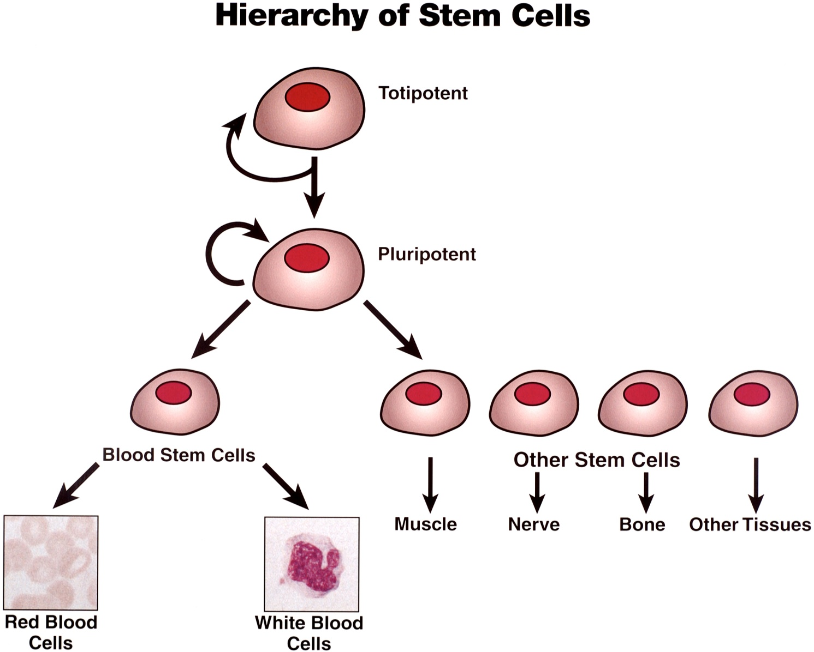
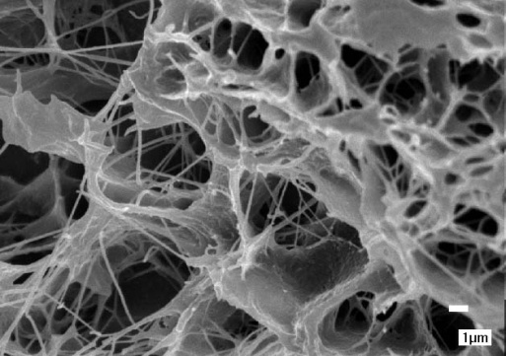
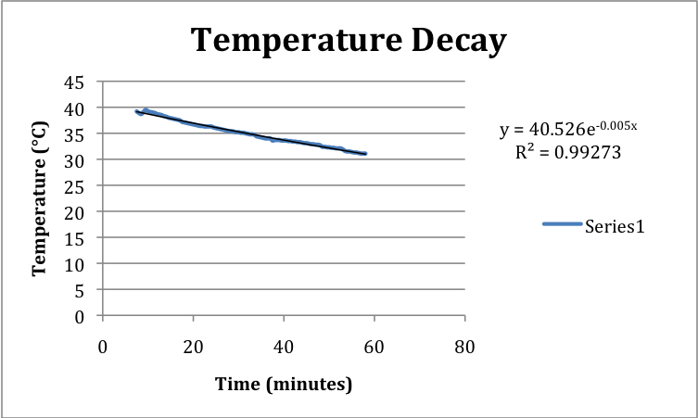
MRI-COMPATIBLE BIOREACTOR FOR CARTILAGE LOADING
Sarah Czaplewski Luisa Meyer Sarah Springborn BeomKang Huh
Cartilage Tissue Engineering
Advisor: Walter Block, PhD¹
Client: Wan Ju Li, PhD²
¹Department of Biomedical Engineering – University of Wisconsin-Madison
²Department of Orthopedics and Rehabilitation – University of Wisconsin-Madison
Discussion
Need for Cartilage Regeneration
Compression provides consistent results
Percent deformation is different than expected likely due to:
  Testing tools we not as precise as needed
  Testing cap could not be tightly secured
  Fabrication error
Calculated compression
Insulation or medium perfusion is needed to sustain body temp for long scans
Cartilage has limited and inadequate self-healing potential
Cartilage damage is very common
  Traumatic injury
  Osteoarthritis
Current surgical repairs rarely restore function and can be invasive
  Debridement (“cleaning of the joint”)
  Microfracture
  Joint replacement
  Autologous cartilage implants
Final Design
Structure
Hollowed out cylinder made from polycarbonate
Screw-on cap fitted with rubber gasket to prevent leaking
Twist-down compressor rod
Sized to fit inside animal scanner
Inner Mechanism and Force Application
Compressor rod can be screwed down to cause deformation
Table to hold cartilage during force application
Marker system
Overview of Process
Limitations
Majority of team needed to obtain shop permits
Limited machining experience created time restraints
Difficulty measuring very small deformation required
Stem cells removed from patient
Mature cells are implanted to fill lesions
Testing
Cells grow in scaffold
Crude Temperature Test
Future Work
Procedure
Adhered two small sections of plastic
Heated in oven at various temperatures
Results
200°F -- plastic was clear and solid and the adhesive remained strong.
250°F -- change in strength or transparence of plastic or adhesive.
300°F -- plastic became translucent and the adhesive became slightly pliable.
Device can withstand autoclave range
Further Compression Testing
  More accurate measure of deformation
  Method to measure force generated
  Different stiffness trial materials
Automatic Perfusion System
  Enable oxygen and nutrient exchange
  Maintain body temp
  Temporary solution to sustain temp, use wrap of insulating material
Scale to fit multiple scanner sizes and cartilage sizes
Cells mature and differentiate due to applied conditions
Current Research
Compression Test
Determines proper amount of growth factors to promote proliferation and differentiation
Assesses overall stability and maturation
Testing is destructive to tissue cultures
Need a method to MRI cartilage tissue under compression without destroying tissue
  No current devices or bioreactors have this capability
Procedure
Prepared agarose gels geometrically similar to cartilage plugs
Placed gels into mock-up of final prototype
Results
Generated consistent deformation
Values vary from expected
Percent Agarose | Average Height (mm) | Average Final Height (mm) | Distance compressed (mm) | Percent Deformation
5% | 2.636 | 2.441 | 0.195 | 8.290%
10% | 2.299 | 2.038 | 0.261 | 11.126%
References
Problem Statement
Atala, Anthony, Robert Lanza, James A. Thomson, and Robert M. Nerem. Principles of Regenerative Medicine. Boston: Academic Press, 2008. Print.
Athanasiou, Kyriacos A., Eric M. Darling, and Jerry C. Hu. "Articular Cartilage Engineering." Synthesis Lectures on Tissue engineering 1 (2009): 1- 182. PubMed. Web. 23 Nov. 2009.
Tuli, Richard, Wan-Ju Li, and Rocky S. Tuan. "Current State of Cartilage Tissue Engineering." Arthritis Research & Therapy 5.5 (2003): 235-38. PubMed. Web. 27 Nov. 2009.
The objective of this project is to produce a MRI-compatible bioreactor with the capability to compress cartilage tissue cultures.
Temperature Decay Test
Procedure
Heated water to approximate body temp
Filled bioreactor and water and inserted fiber optic probe
Recorded temperature every 30 sec
  Preserve tissue (i.e. biocompatible)
  Sustain autoclave temperatures (~130°C)
  Compress tissues to 5-20% of thickness
  Create leak-proof seal
  Hold tissue in place (immobile)
  Maintain temperature range of 32-37°C for duration of scan
  Allow user to see cartilage (clear material)
~1.5 cm
Acknowledgements
~3 mm
Results
Temperature remained between 37°C and 32°C for 39 minutes
Another method is needed to maintain temp for long scans
Dr. Wan-Ju Li Department of Orthopedics and Rehabilitation
Prof. Block -- Department of Biomedical Engineering
Beth Rauche
Shop personnel

