Slide 1

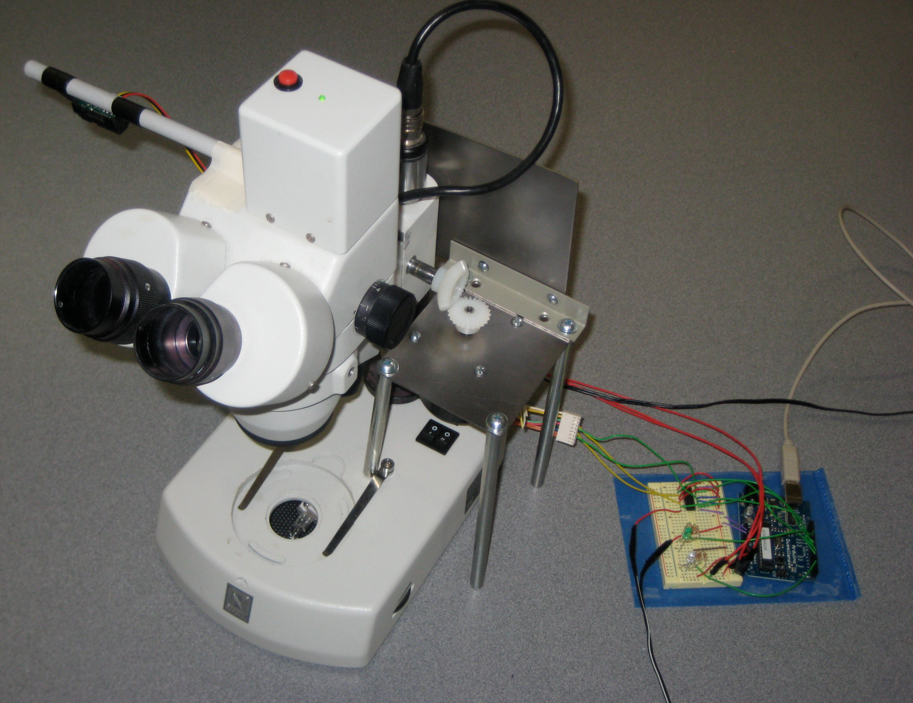
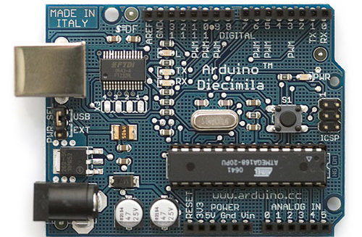
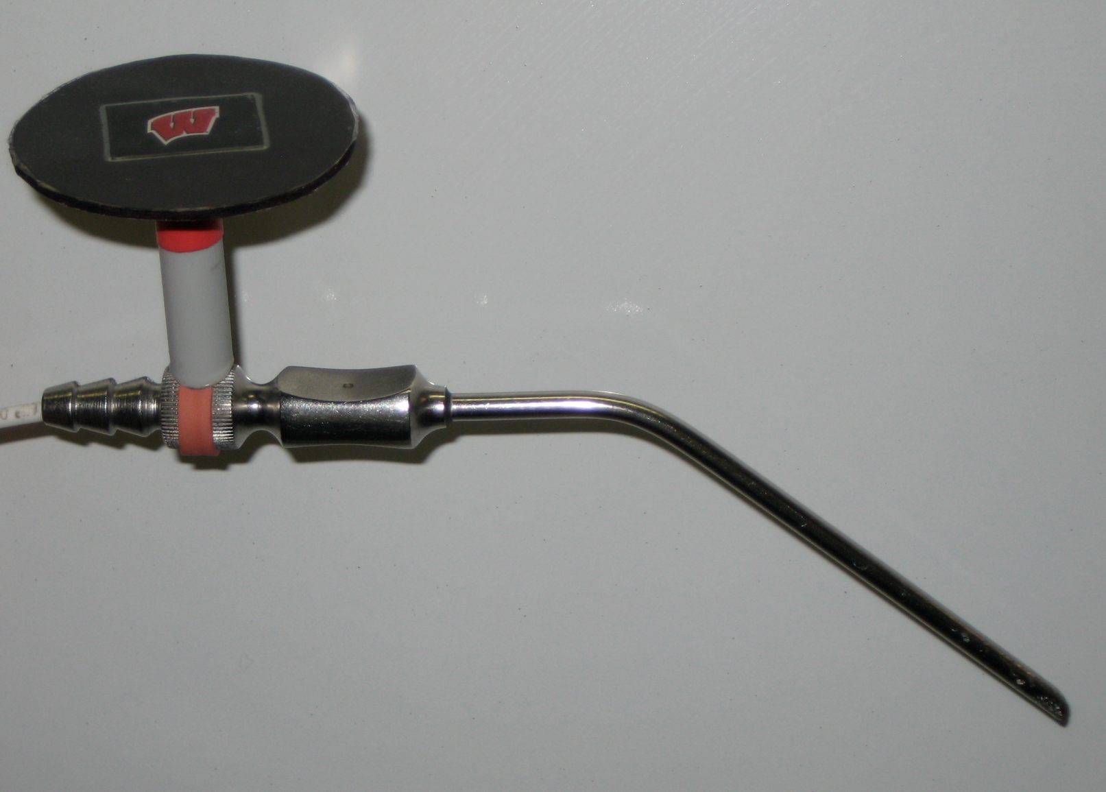
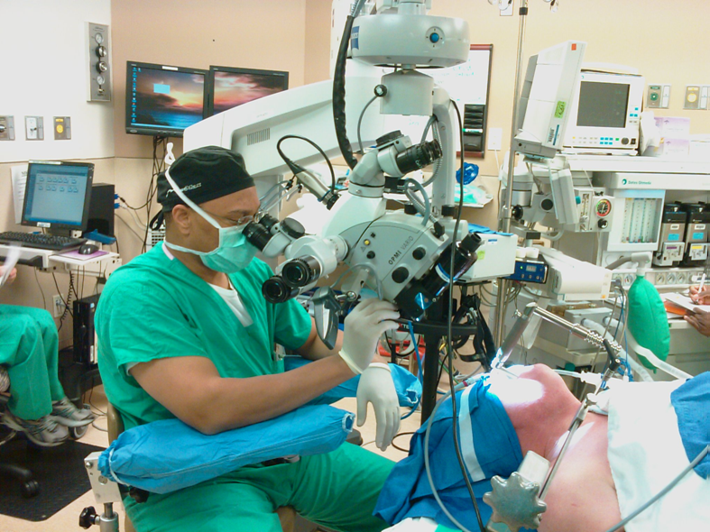
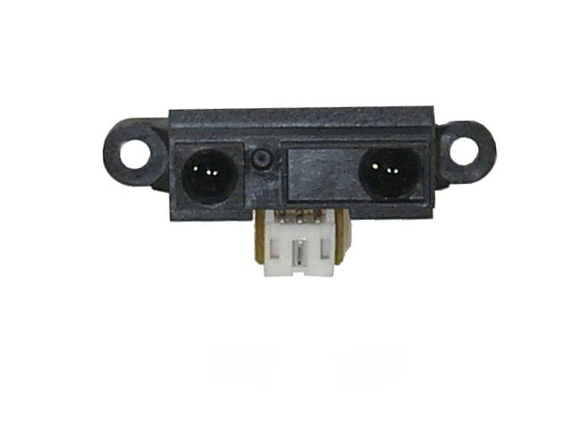
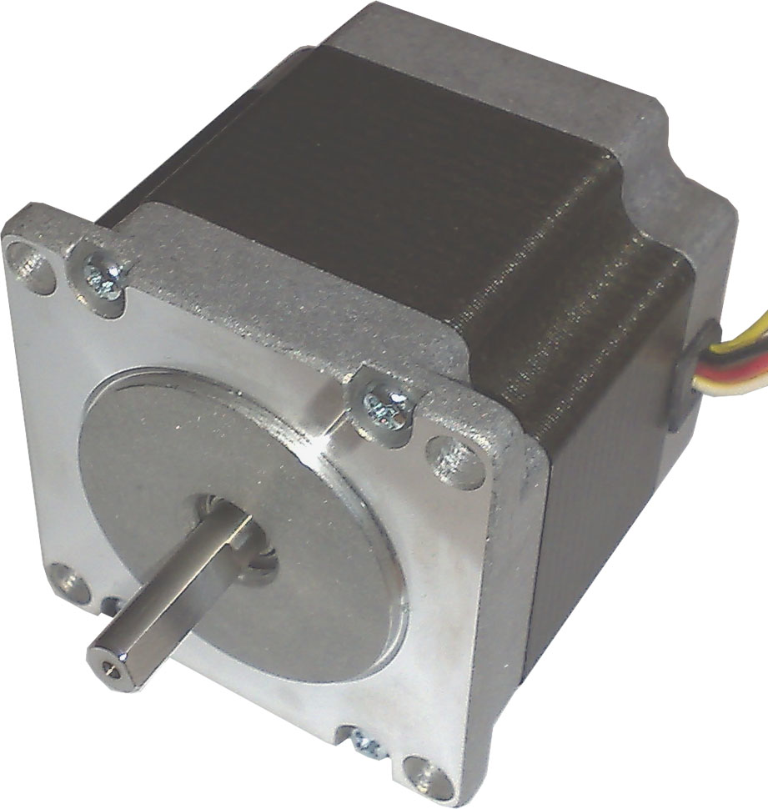
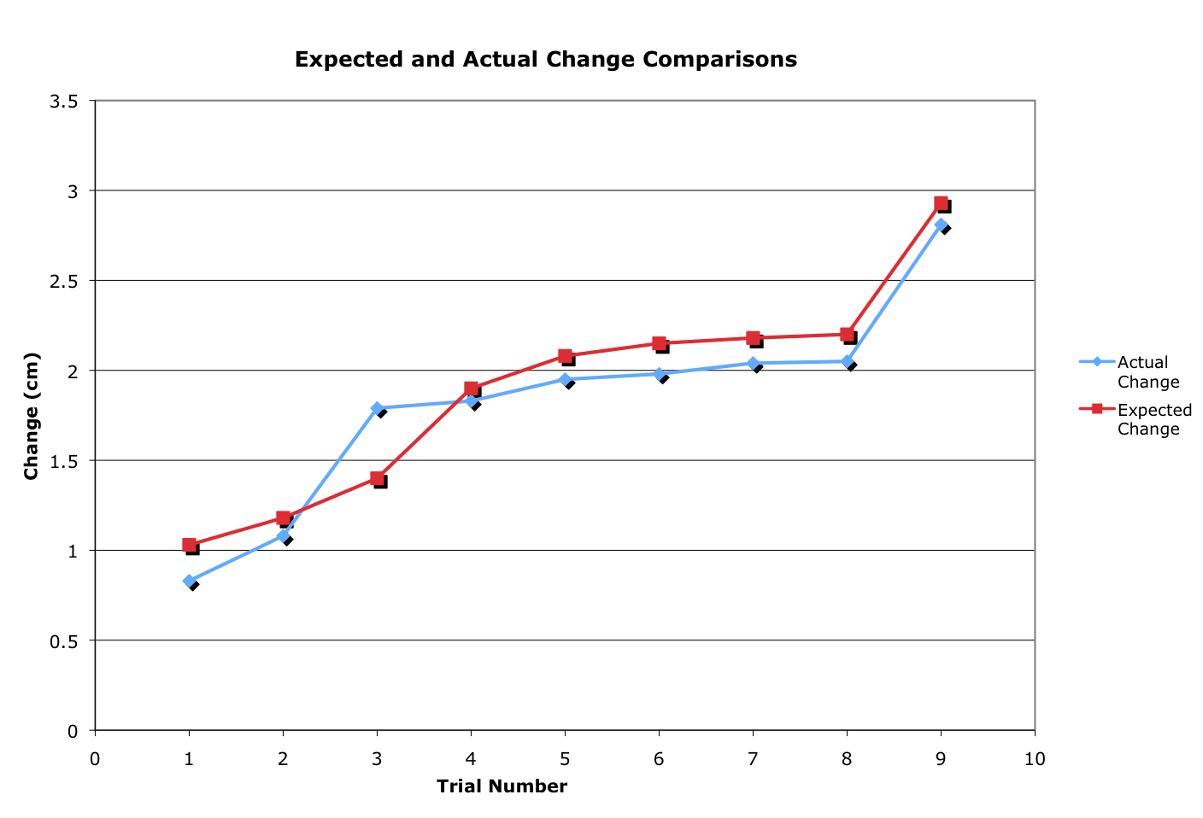
INSTRUMENT CONTROLLED MICROSCOPY
Mason Jellings, Justin Gearing, Sarah Reichert, John Byce
Client: Dr. Joshua Medow
Advisor: Professor Thomas Yen
Abstract
Final Design
Current autofocus mechanisms in neurosurgical microscopes are ineffective during surgical procedures. As a result, our client, Dr. Joshua Medow, prompted us to engineer a device capable of tracking and focusing a surgical microscope to the tip of a neurosurgical instrument.
To accomplish this task, we fabricated an apparatus that focuses a compound microscope to the tip of a surgical aspirator as its depth from the lens varies. Our final design uses an infrared sensor to detect the position of the aspirator. This position data is relayed to a microcontroller, which outputs corresponding signals to a stepper motor, mounted to the microscope, to adjust the focus to the desired depth.
The final design was tested by changing the distance read by the sensor, documenting the changes output by the sensor and comparing them to the actual distance change enacted by the system. The testing showed that the average change from expected to actual change of microscope depth was 0.163 cm with a standard deviation of 0.093.
Figure 4 (right)- Arduino microcontroller. The microcontroller has a USB port for easy program installation and modifications, as well as 5V input. It boasts +5V ports which power the infrared sensor, and has digital inputs. The outputs of the microcontroller are used to send signals to the stepper motor to control the microscope’s focus knobs.
(http://www.hacknmod.com)
Figure 2 (above)- The final design uses a Sharp GP2D12 infrared distance sensor to determine the instrument’s position. The infrared sensor outputs a corresponding voltage to an Arduino microcontroller.^{[3]} A program stored on the microcontroller returns the distance between the sensor and disk based on varying voltage inputs. The distance is used to output the necessary signal to a L293D chip, which amplifies the current to power a Vexta stepper motor. This stepper motor is then signaled to adjust the microscope focus knob. This direct method of focus adjustment will be applicable to any microscope that utilizes knob focusing with simple hardware (motor and mounting) changes necessary for implementation into a neurosurgical microscope.
Figure 5 (left)- The disk mounted on the surgical aspirator. This disk is used to reflect infrared LED rays emitted from our sensor back to the sensing device. Knowledge of its geometry is used to determine the location of the tip.
Figure 3 (left)- The Sharp GP2D12 infrared position sensor. The sensor uses a 25 Hz frequency pulse and the incident angle to output varying voltages that can be converted to distances. The sensor runs on 5V supplied by the Arduino microcontroller.
(http://www.ece.ubc.ca)
Figure 6 (right)- Stepper motor mounted to microscope. The Vexta 12V stepper motor uses input from the microcontroller to move the focus knob on the microscope. The motor is capable of extremely fine adjustments, with a rotation of 1.8° per step. Using known positions from the infrared sensor, the program sends pulses to the motor for the required number of steps to rotate the focus knobs in order to obtain the desired depth of focus.
(http://www.electrozoneuk.com)
Figure 1 (above)- A surgeon observing a surgical cavity with an operating microscope. (http://www.crim.ncsu.edu)
Introduction
Testing
Background:
During neurosurgery, a surgeon navigates within a cavity using an operating microscope. Current auto-focusing mechanisms pinpoint optimal focus through calculating either contrast variance or resolution.^{[1]} These methods do not function properly in a surgical cavity, so the focus must be adjusted manually by the surgeon. Up to 40% of total surgery time is attributed to this refocusing of the microscope.^{[2]}
Motivation:
Our client, Dr. Joshua Medow, requested that we design and fabricate a system that detects the position and automatically focuses the lens of a surgical microscope to the depth at which the surgeon operates. The aim of our design is to increase the efficiency of surgical procedures by reducing the time lost to manual refocusing.
Chart 1 (left)- The graph displays the distance read by the sensor vs. the actual distance the lens of the microscope is moved by our stepper motor. As seen by the close proximity of the curves, our design moves consistently and accurately as the sensor reading changes. The testing showed that the average change from expected to actual change of microscope depth was 0.163 cm with a standard deviation of 0.093
Future Work
Further Testing
  Long term use
  Implemented use
More Accurate Sensor
  Neodymium Magnet and 3D compass
Camera Technology
Integrate with neurosurgical microscope
Acknowledgements
Design Criteria
Ergonomics
Dr. Joshua Medow
Prof. Thomas Yen
Permits all surgical maneuvers
Easily sterilized
Lightweight
Safe in surgical setting
Incorporable into procedure
Easily replaceable
Compact
Greater efficiency than current process
Safety
  No sharp corners or edges
Efficiency
  Saves time over manual focus
Ease of use
  Simple controls
  Easy setup/takedown
  LED indicator ensures proper function
Performance
  Minimal lag time of focus
References
1. Price, J. H., & Gough, D. A. (1994). Comparison of phase-contrast and fluorescence digital autofocus for scanning microscopy. Cytometry, 16(4), 283-297.
2. Uluç, K. M. D., Kujoth, G. C. P. D., & BaşKaya, M. K. M. D. (2009). Operating microscopes: Past, present, and future. Nuerosurgical Focus, 27(3), E4.
3. Almeida, L., Azevedo, J., Cunha, B., Fonseca, P., Lau, N., & Pereira, A. (2006). Micro- ratio robotics contest: Technical problems and solutions.

