Slide 1
Instrument Controlled Microscopy for Neurosurgical Applications
By: Mason Jellings, Sarah Reichert, John Byce, and Justin Gearing
Advisor: Prof. Tom Yen
Client: Dr. Joshua Medow

Slide 2
Overview
Background
Current Design
Problem Statement and Motivation
Design Requirements
Design Alternatives
  Hall Effect Sensor
  Infrared Sensor
  Sliding Sensor
Design Matrix
Projected Costs
Future Work

Slide 3
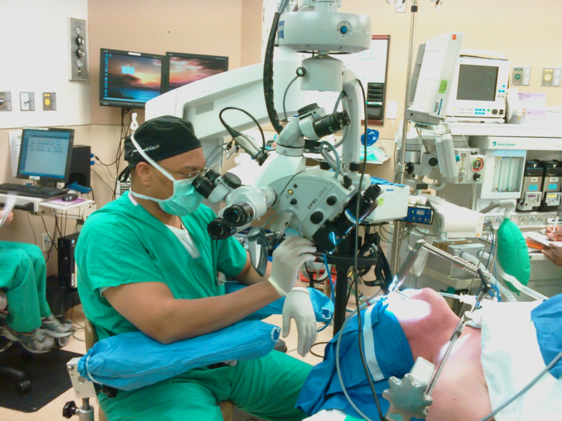
Background
Neurosurgery
  Central and peripheral nervous system diseases and injuries
Microscope
  Used to magnify area of operation
  8-16 inches (20-40cm) from cavity
  Currently requires manually focusing due to autofocus limitations
www.crim.ncsu.edu

Slide 4
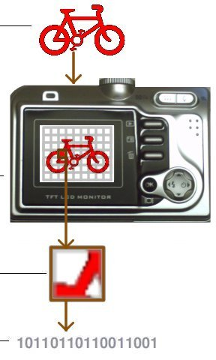
Current Design
Similar to passive autofocus in cameras
  Light directed to charge-coupled device
  Microprocessor computes contrast
  Lens adjusted to achieve best focus
Ineffective in surgical applications
  Lack of contrast in magnified portions of brain and spine
  Incapable of refocusing at surgeon’s discretion
Explainthatstuff.com

Slide 5
Problem Statement and Motivation
Current Problem
  Dysfunctional Autofocus
  Manual refocus hinders procedure
Our task
  Depth tracking of instrument tip
  Integration to microscopic interface

Slide 6
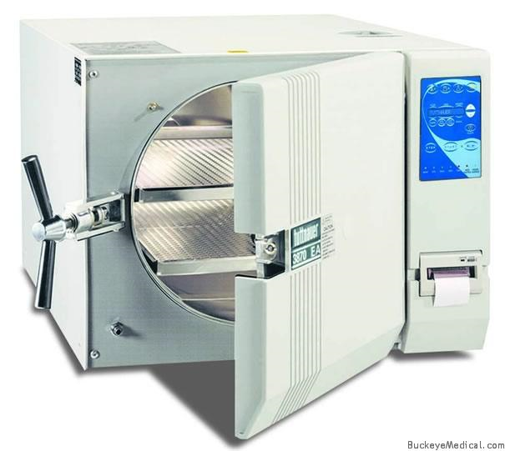
Design Requirements
Safety
  Materials
  Sterilization
  Housed electrical components
Ergonomics
  Limited background required
  Ease of integration
Buckeyemedical.com

Slide 7
Design Requirements
Performance Requirements
  Lag time of <1sec
  Tracking accuracy of 0.25” (6mm)
  Long-term reliability
Physical Specifications
  Maximum size: 6”x6”
  Maximum weight: 5lbs
  Weight of components on instrument

Slide 8
Design Requirements
Operating Environment
  Temperature (~25º C)
  Dust-Free, clean
Durability
  Life in service of 3 to 5 years
  Long periods of inactivity

Slide 9
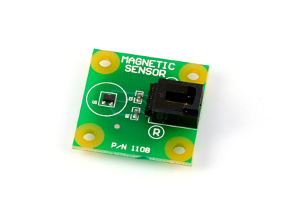
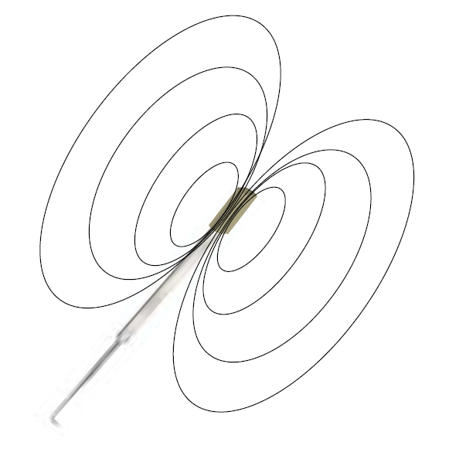
Hall Effect Sensor Design
General Function
  Measures angle between reference axis and magnetic field
Configuration
  Magnet mounted on instrument
  Sensor mounted above
Ѳ

Slide 10
Hall Effect Sensor Design
Pros
Cons
No wires
May be able to gain more information from a single sensor
Little to no interference due to objects between magnet and sensor
Relatively short range
Relatively heavy magnet mounted on instrument
Identical Ѳ for several positions of the instrument
  Surgeon required to maintain a standardized instrument position while focusing

Slide 11
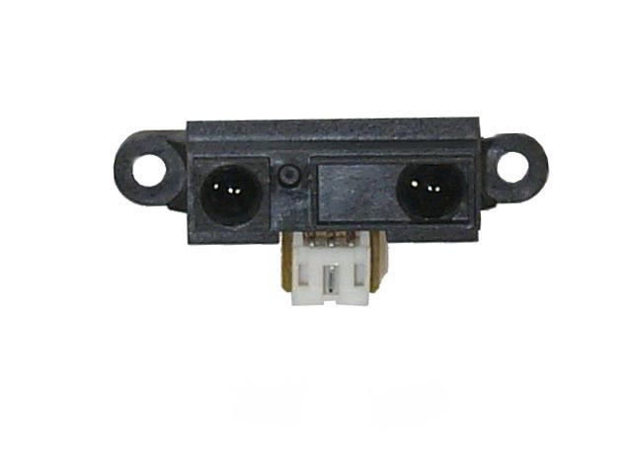
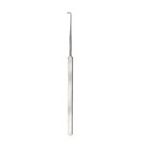
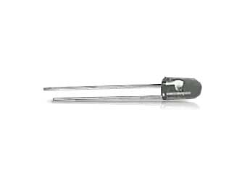
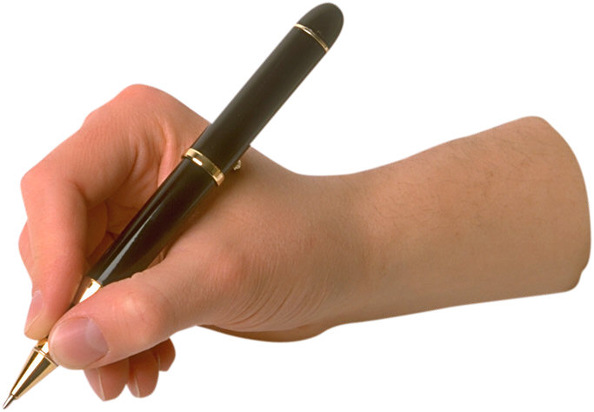
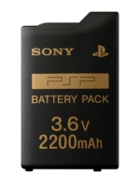

Infrared Sensor Design
General Function of Infrared Sensor
  Measures angle between incident ray and an axis perpendicular to the sensor
Ѳ

Slide 12
Infrared Sensor Design
Pros
Cons
Relatively few, unrestrictive wires
Lightweight component mounted on instrument
Relatively inexpensive
Only one possible combination of Ѳs for each position
Long Range
Wires
Possible interference from objects between LED and sensors
Uncertain how sensors will respond to multiple light sources
  Must once again standardize angle of instrument during focusing

Slide 13
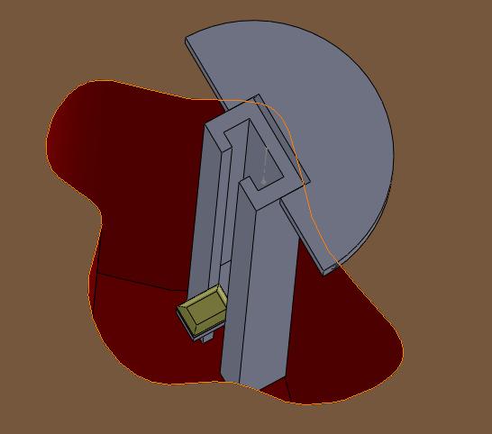
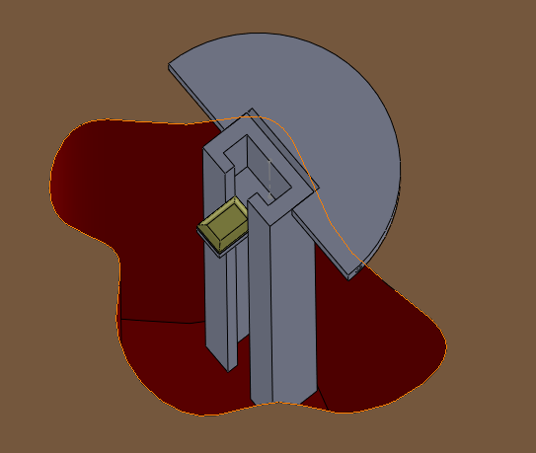
Sliding Marker
Marker mounted on sliding assembly
Pros
Cons
Doesn’t effect tool
Accuracy
Size
Cost
Applications

Slide 14
Design Matrix
Design | Cost (5) | Accuracy (15) | Ease of Use (25) | Feasibility (35) | Appropriate Size (20) | Total (100)
Infrared Sensor | 5 | 10 | 25 | 35 | 10 | 75
Hall effect Sensor | 5 | 10 | 25 | 12 | 12 | 62
Sliding Sensor | 3 | 13 | 20 | 17 | 15 | 70

Slide 15
Projected Costs
Item | Cost
Infrared Sensor* | $ 50.00
Infrared Marker* | $ 25.00
Batteries for Marker | $ 10.00
Magnetic Sensor | $ 8.97
Miscellaneous Supplies | $ 50.00
Rare Earth Magnet | $ 2.00
Shipping/Tax | $ 10.00
TOTAL | $155.97
*Depends on particular one chosen

Slide 16
Future Work
Testing
Programming
Mounting of magnet or LED
Integrate second sensor or LED to allow the system to determine the position of the instrument’s tip in any instrument configuration
More programming
LED display
Auto-focus mechanism
Microscope integration

Slide 17
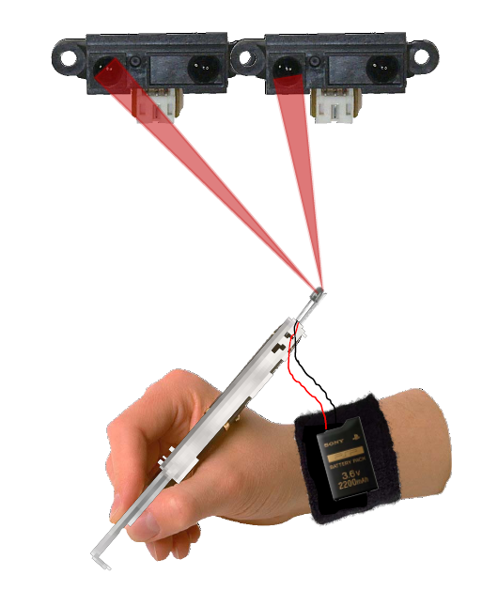
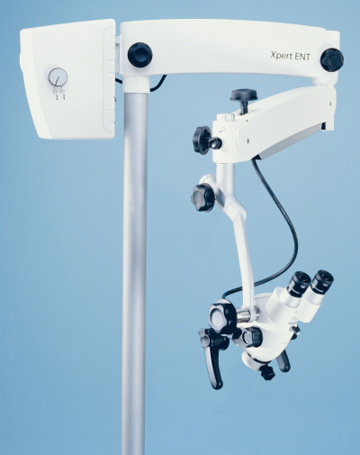
Future Work

Slide 18
References
http://www.crim.ncsu.edu/?q=system/files/papers/Surgeon.png
http://www.buckeyemedical.com/images/P/tuttnauer-3870ea-open-01.jpg
"Neurosurgery." c2009. Encyclopedia of Surgery. <http://www.surgeryencyclopedia.com/La-Pa/Neurosurgery.html> 14 October 2009.
Medow, Dr. Joshua. Personal interview. 07 September 2009.
Brown, Gary. “How Autofocus Cameras Work.” 01 April 2000. HowStuffWorks.com. <http://electronics.howstuffworks.com/autofocus.htm> 12 October 2009.
Woodford, Chris. "CCDs(charge-coupled devices)." 12 May 2008. ExplainThatStuff.com. <http://www.explainthatstuff.com/howccdswork.html> 12 October 2009.
Center for Robotics and intelligent Machines, North Carolina University. <http://www.crim.ncsu.edu/?q=system/files/papers/Surgeon.png> 14 October 2009.

