Slide 1
Quad Rat Vitals Monitor
Client: Dr. Alex Converse
Advisor: Dr. Tom Yen
Team:
Jack Ho
Kuya Takami
Nathan Werbeckes
Joseph Yuen

Slide 2
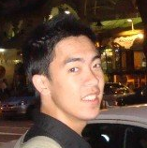
Problem Statement
Vitals for anesthetized rats during PET imaging
  SpO₂ (±2%)
  Heart rate (200-500 bpm)
  Rectal temperature (93 – 100° F)
  Respiration rate (20-30 bpm)
Current oximeter is designed for “small animals”
  Inaccurate at faster heart rates
Current devices too expensive
  Budget = $4,000 USD
Problem Statement : Background Info : Strategy : Future Work
Jack Ho
Team Leader

Slide 3
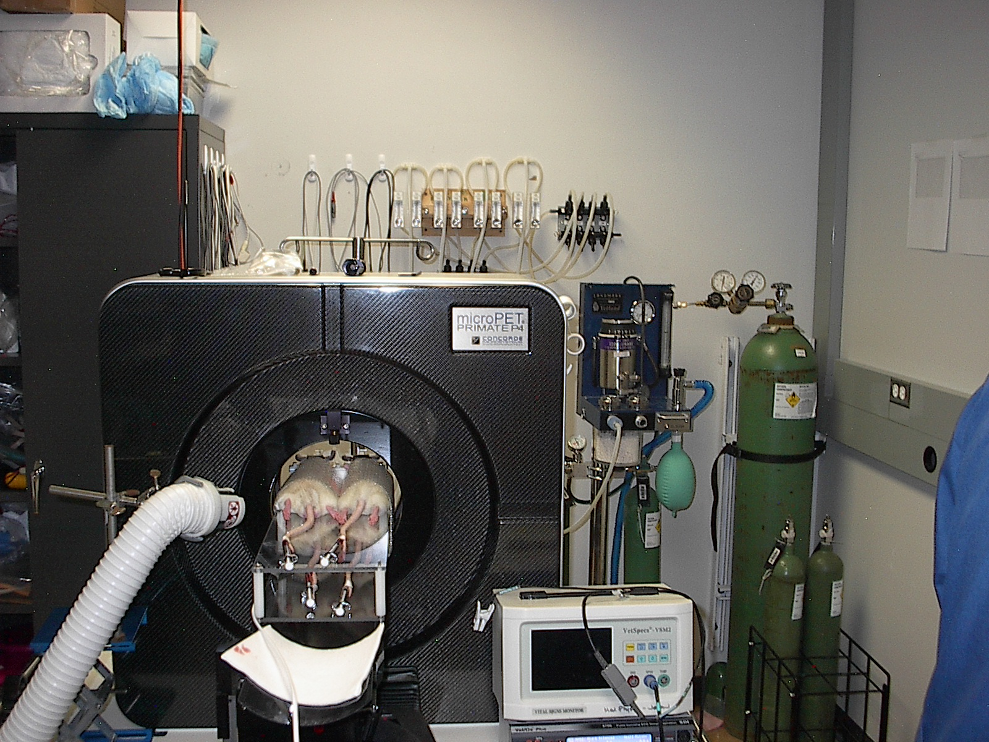
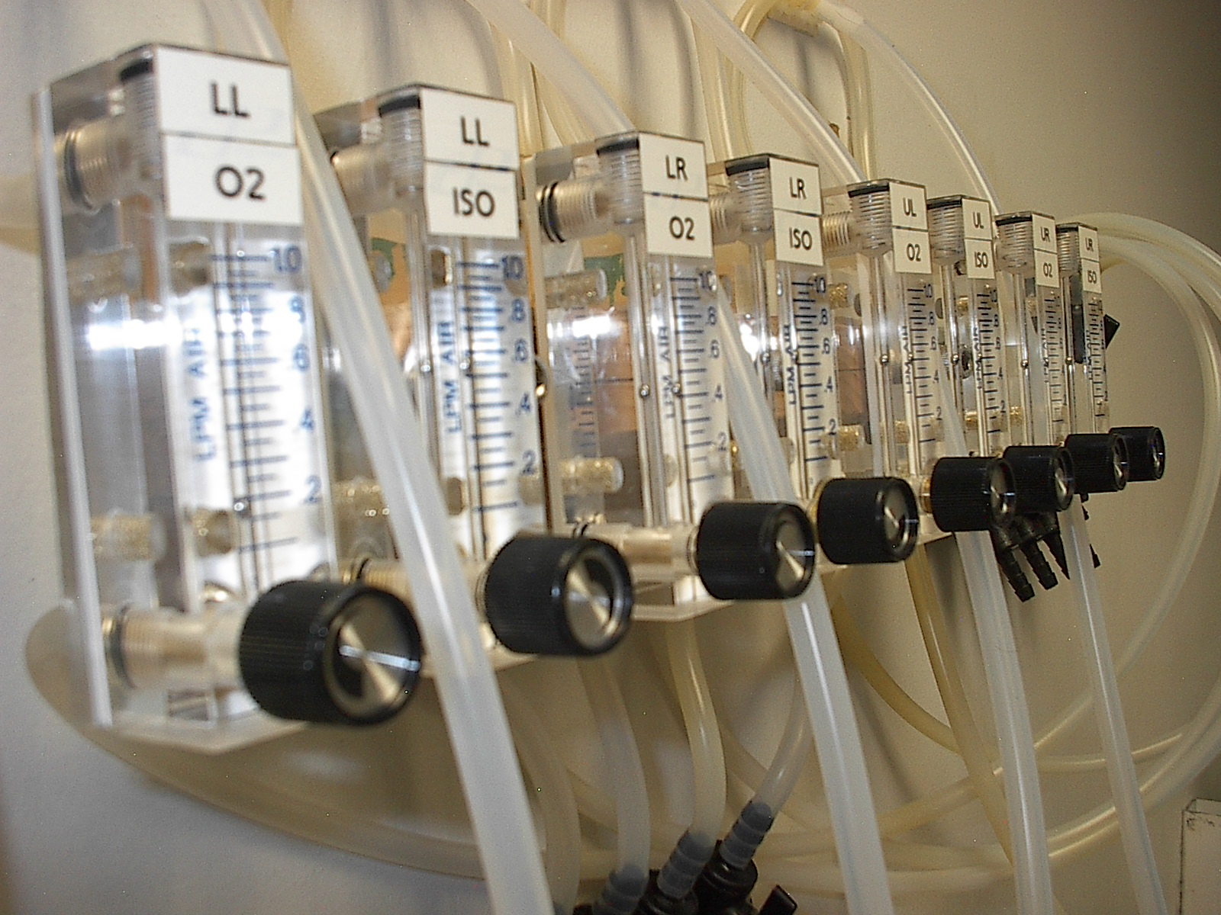
Quad Adjustable Isoflurane Delivery*
Isoflurane
O₂
Rat
Rat
Rat
Rat
Problem Statement : Background Info : Strategy : Future Work
Jack Ho
Team Leader
*Slide by Dr. Alex Converse

Slide 5
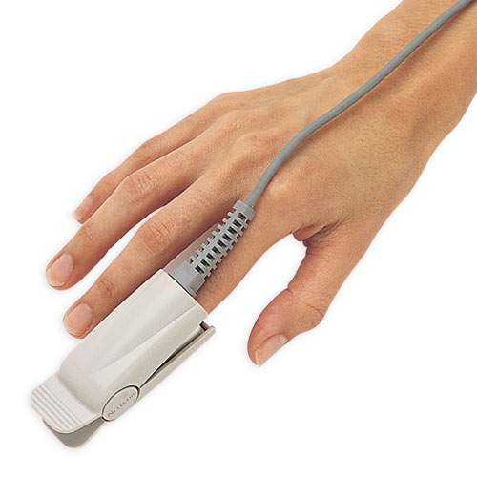
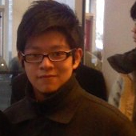
Pulse Oximeter
Red and infrared LED and photodiode
Absorption is different between oxyhemoglobin and its deoxygenated form
Oxygen absorption can calculated from ratio
Measures heart rate
Mostly for humans
Nellcor, Criticare, Nonin, etc.
Problem Statement : Background Info : Strategy : Future Work
Joseph Yuen
BSAC

Slide 6
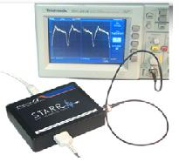
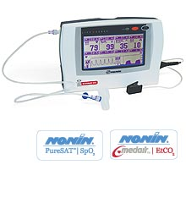
Current Devices
Veterinary Oximeters
  Nonin, Bionet, etc.
Starr Life Sciences
  MouseOx
Expensive
Problem Statement : Background Info : Strategy : Future Work
Joseph Yuen
BSAC

Slide 7
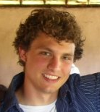
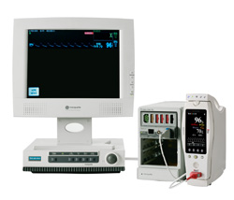
Design 1: Buy
Buy pulse oximeter built for rats/mice
Buy sensors designed for rats/mice
Build a multiplexor
Design | Cost | Construction | Design/planning | Adaptable | 4 rats
#1 | 0 | 8 | 10 | 10 | 3
Problem Statement : Background Info : Strategy : Future Work
Nate Werbeckes
BWIG

Slide 8
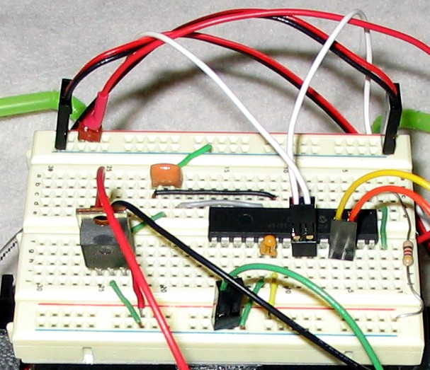
Design 2: Build
Build sensor designed for rat’s paw
Build filters, comparators, differential amps, etc. to compute pulse/ox
Convert to digital signal and input through USB
Design | Cost | Construction | Design/planning | Adaptable | 4 rats
#2 | 9 | 1 | 1 | 5 | 8
Problem Statement : Background Info : Strategy : Future Work
Nate Werbeckes
BWIG

Slide 9

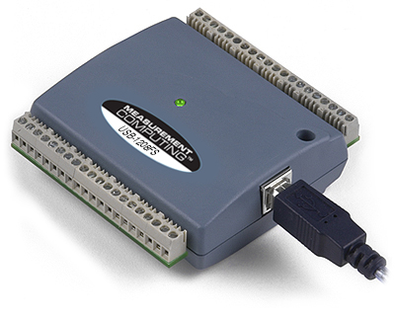
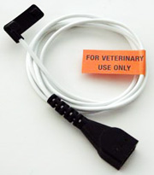
Design 3: Adapt
Reverse engineer human sensor
Split wires and plug into data acquisition box
Code pulse/ox computation in LabVIEW
Design | Cost | Construction | Design/planning | Adaptable | 4 rats
#3 | 6 | 7 | 7 | 9 | 9
Problem Statement : Background Info : Strategy : Future Work
Nate Werbeckes
BWIG

Slide 10
Design Matrix
Design | Cost | Construction | Designing/Planning | Adaptable | 4 rats
Buy | 0 | 8 | 10 | 10 | 3
Build | 9 | 1 | 1 | 5 | 8
Adapt | 6 | 7 | 7 | 9 | 9
Weights | 0.35 | 0.25 | 0.2 | 0.1 | 0.1
Design | Cost | Construction | Designing/Planning | Adaptable | 4 rats | Total
Buy | 0 | 2.8 | 2.0 | 1.0 | 0.3 | 6.1
Build | 3.1 | 0.25 | 0.25 | 0.5 | 0.8 | 4.9
Adapt | 2.1 | 1.75 | 1.4 | 0.9 | 0.9 | 7.05
Problem Statement : Background Info : Strategy : Future Work
Nate Werbeckes
BWIG

Slide 11
Flow Chart of LabVIEW processes
Red +
Detect increasing edges
Calculate time in between edges
Red - Ground
Red/IR
IR +
IR - Ground
Calculate SpO2
Convert to bpm
Ground
Graph
Display SpO2
Display bpm
Problem Statement : Background Info : Strategy : Future Work
Nate Werbeckes
BWIG

Slide 12
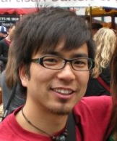
Future Work
Pulse/Ox Sensor
Computer
LabView
DAq Box
Thermometer
Respiratory Rate
Isoflurane & O₂ Control
Problem Statement : Background Info : Strategy : Future Work
Kuya Takami
Communicator

Slide 13
References
Webster, J. G., Design of Pulse Oximeters. IOP Publishing Ltd 1997.
D. Ford, D. Nachreiner, R. Thomas, “Design of a Pulse Oximeter for Use in Mice” , 2005
Starr Life Sciences,
http://starrlifesciences.com/ (website).

Slide 14
?

