Slide 1
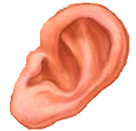

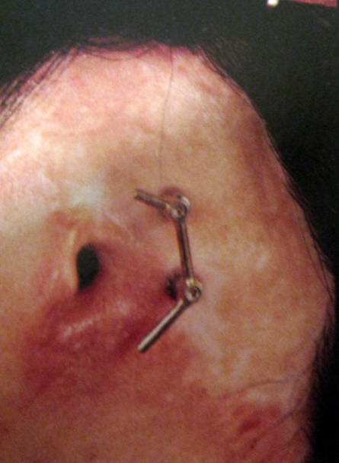
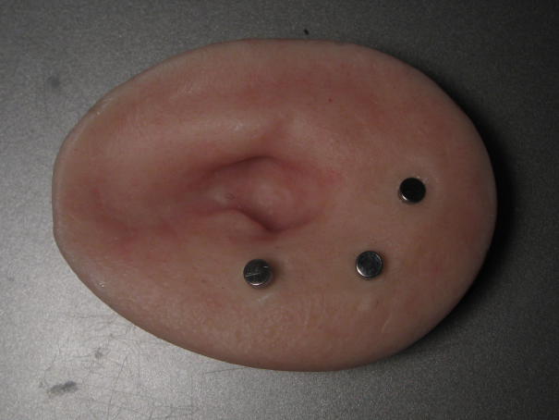
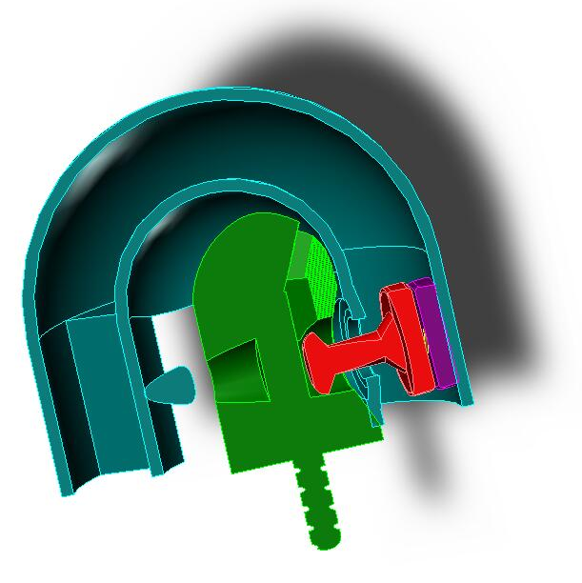
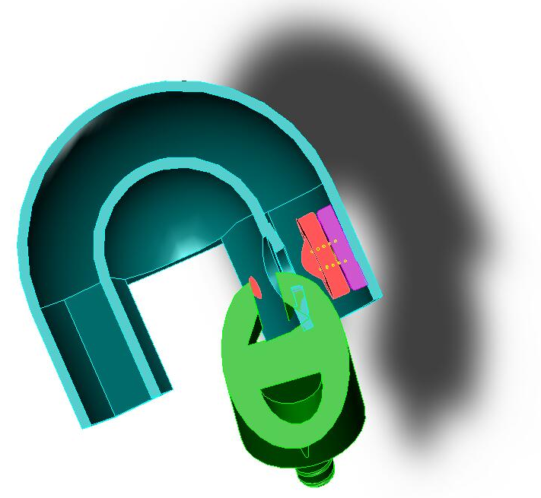
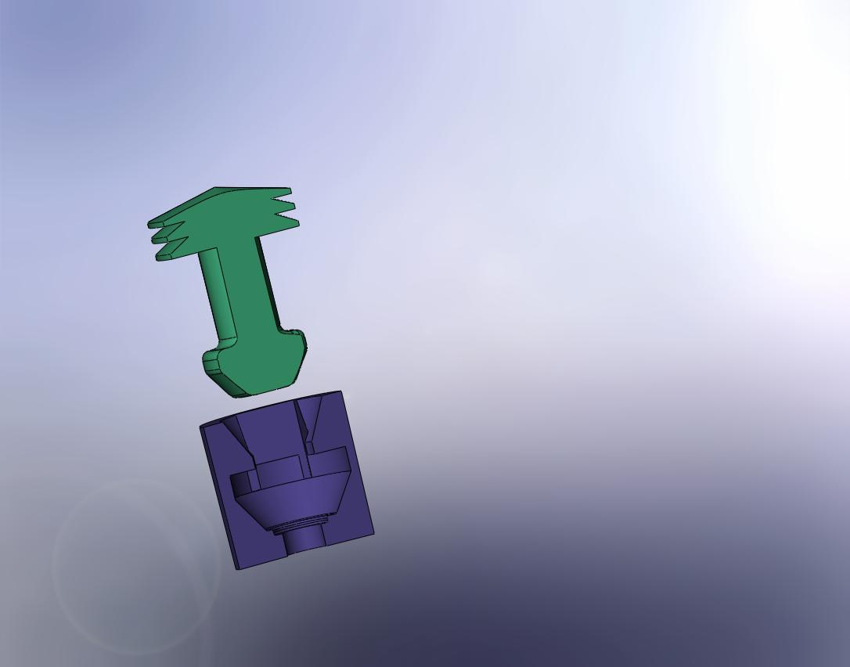
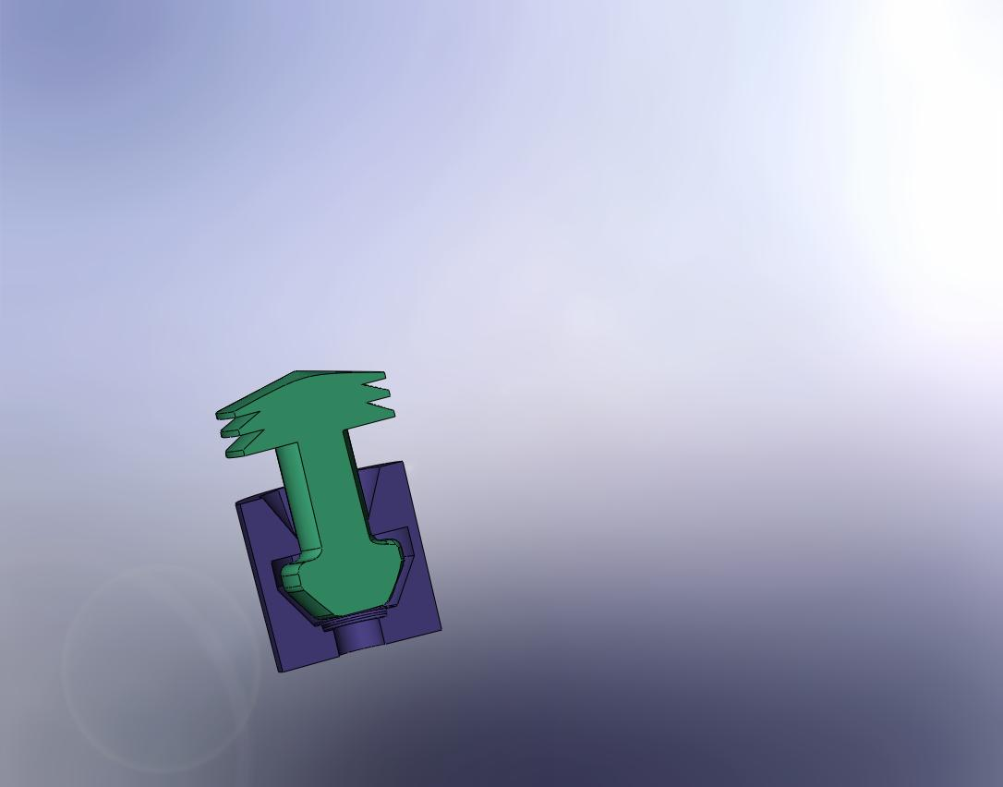
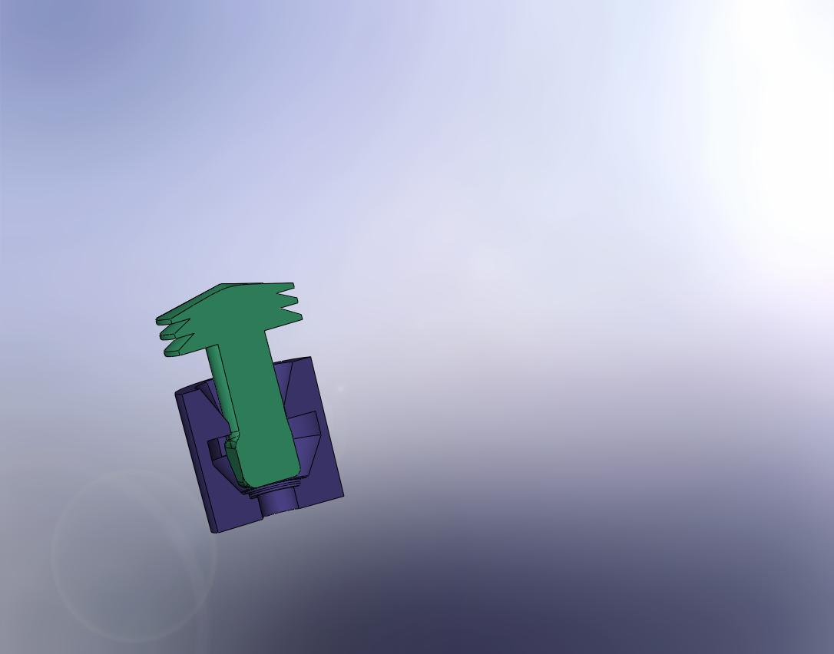
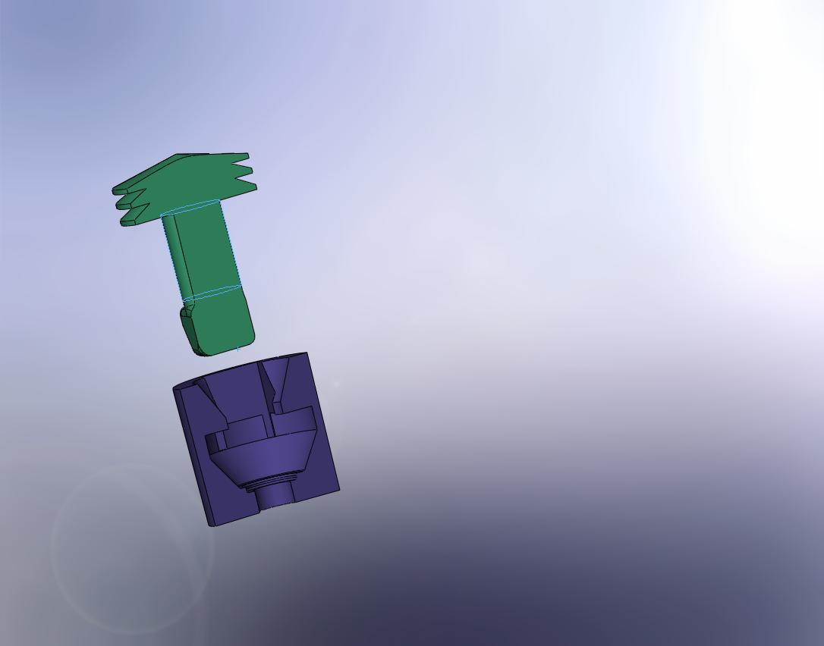
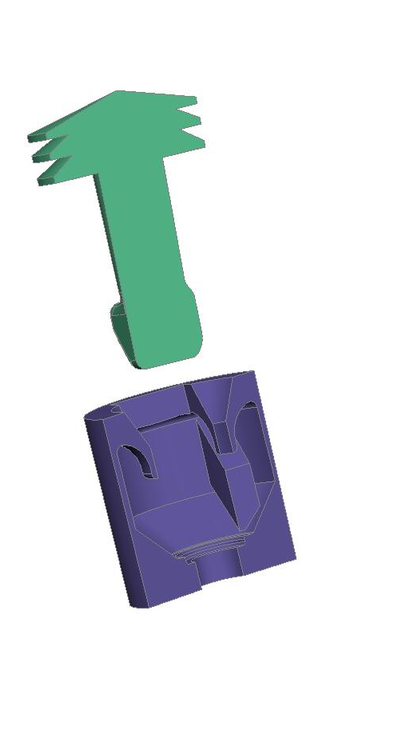
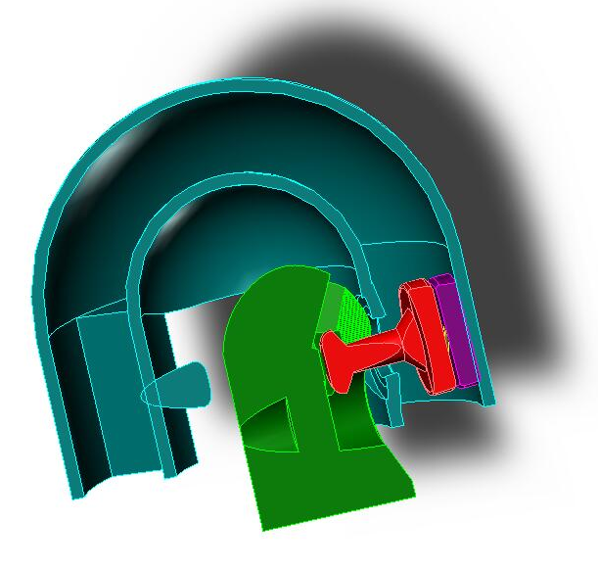
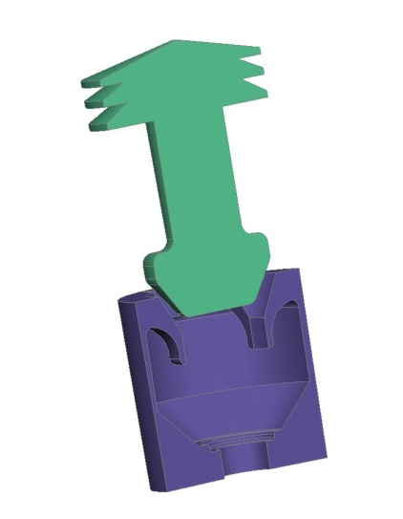
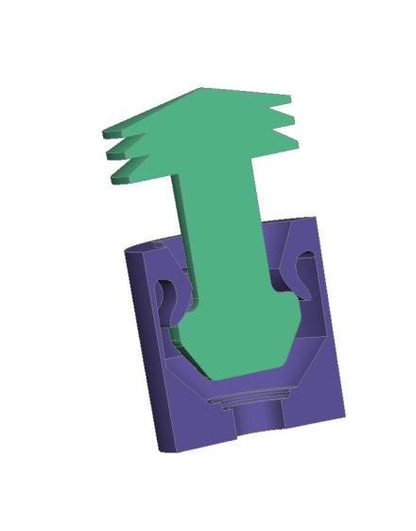
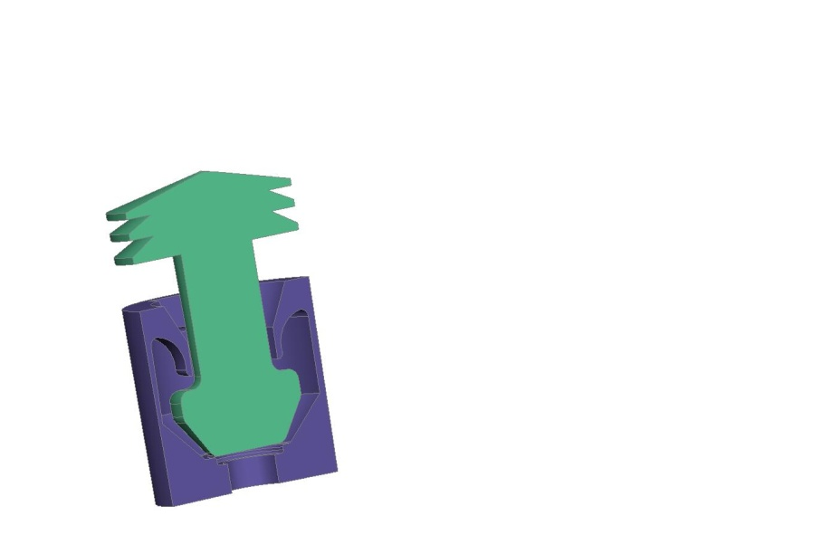
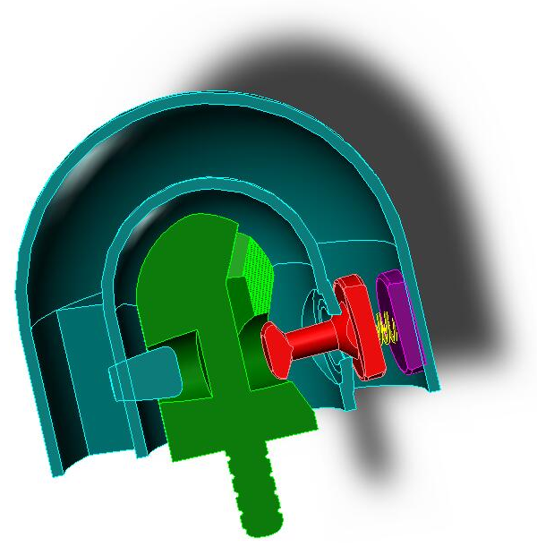
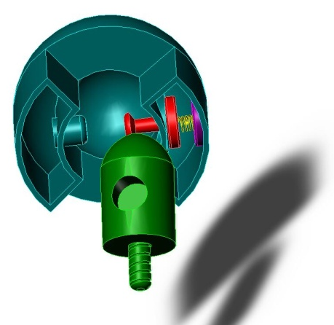
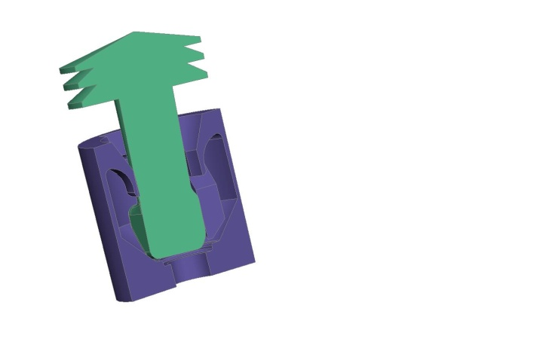
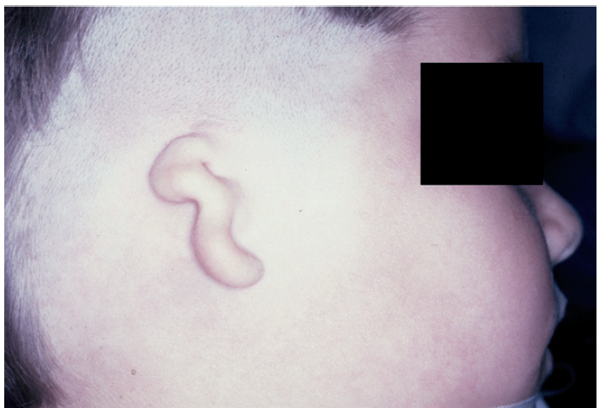
Ear Prosthetic Attachment
C. Flanagan, S. Offutt, A. Rieves, J. White
Client: Gregory G. Gion, BA, BS, MMS, CCA¹ Advisor: William Murphy, Ph.D²
Problem Statement
¹The Medical Art Prosthetics Clinic ²Department of Biomedical Engineering
Abstract
Testing
Need for replacement of damaged tissues
Ear reconstruction options:
  Reconstructive Surgery
  Prosthesis
Project focus on osseointegration
Identify Performance of:
  Mechanics
  Aesthetics
  Materials
Generalize mechanism to other prostheses
Prosthetic ears are created for patients with microtia, a congenital defect that affects 1 in 10,000 births, as well as patients that have ears removed due to cancer and trauma. The current standard for ear prostheses is osseointegrated abutments and either magnets or bar clip prosthetic attachments. Osseointegration is a technology that grew out of the dental industry and was not effectively translated to other prosthetic applications. The magnet and bar clip attachments are not ideal because they do not adequately support an active lifestyle. To optimize the ear prosthesis attachment; two generations of designs were created. The mechanism for both is the same; the attachment is snapped into place and is secured by the flanges of the abutment cap. To remove, the attachment is rotated and moved along guiding tracks until free of the abutment cap. The final generation was constructed with polyethylene with alterations from the first generation that allowed for increased flexibility. Tensile tests were done using an Instron to compare the retentive strengths of the final prototype to the Maxi-magnet and O-ring magnet. In future generations, the aim is to improve the mating mechanism and perform other mechanical tests including impact, shear and fatigue.
Competing Products
Design Constraints
Magnetic Retention
  O-Ring with Magnet
  Teloscopic
  Spherical
Clip Designs
  Splinted
  Unsplinted
Able to withstand average shear, tensile, compressive, bending and torsion stresses
Instinctive and passive release mechanism
Safe for prolonged wear and easily cleaned
Adapted for FDA-approved abutment
Easily concealable and will not interfere with daily activities
Motivation
Tensile Testing
  Generation 2 prototype exhibits lower tensile failure at lower strain rates, likely due to
    Prong rotation
    Improper alignment
  Prototype performed comparably at higher strain rates
  Preliminary testing yielded positive results
    Need to expand testing to analyze fatigue and other “normal” stresses using full silicon ear model
Patient Feedback
  Positive feedback regarding magnetic retentive device
  Patients enjoy the ease of removal and attachment
  Ear displacement occurs while
    Removing shirt
    Carrying large items
  Microtia affects 1:10,000 birthsª
  Improve quality of life for patients^{b}
  Develop better outcomes than reconstruction^{b}
  6% patients unhappy with stability of prosthetic^{c}
FIGURE 2 (left). Bar clip attachment
The Osseointegration Book. Per Ingvar Branemeyer 2005.
FIGURE 3 (right). Magnetic post attachment
Gregory G Gion 2008.
Design Development
Background
Generation 0
Generation 1 Mechanism
Generation 2 Mechanism
Microtia – Congenital deformity of pinna
  Four Grades^{d}
    Slightly smaller ear, small but present ear canal
    Partial or hemiear, stenotic ear canal
    Absence of external ear, absent ear canal
    Anotia
Osseointegration
  Dr. Branemark
  Many technologies
  borrowed from dental
  industry
  Other applications:
    Craniofacial prostheses
    BAHA
    Clip designs
Push attachment toward spring-loaded prong
Allow spring-loaded prong to move upward along track
Allow attachment to curve around abutment cap once straight portion of abutment cap is cleared
Snap attachment
into place. Abutment cap is in line with prongs
Release mechanism completed
 | Function | Generation 1 | Generation 2
Material | Flexible but strong | Polypropylene | Polyethylene
Dimensions | Small enough to contain device within prosthesis | 7 mm tall, 7 mm diameter | 2 mm shorter to make more discrete
Flanges | Flex during attachment; provide barrier against vertical displacement | Flanges horizontally connect to inner wall | Flanges slope upward to increase flexibility
Tolerance | Involves strategic use of open space to permit simple, passive release | 2.7 mm tolerance in release slits; 0.5 mm tolerance in cavity | 3.7 mm tolerance in release slits; 0.75 mm tolerance in cavity
Integration with Prosthesis | Prevents forcible removal or rotation of attachment with respect to prosthesis | Tiered rivet prevents forcible removal, but not rotation | Tiered rivet prevents forcible removal and rotation
Barrier Mechanism | Prevents accidental release due to rotation in direction of gravity | Block design provides strong barrier | Wedge design is more space-efficient without diminishing strength
Advantages over G₀ |  | No post-manufacture modifications, cost effective, replaceable | Generation 1 advantages & less brittle
Future Work
Advantages
  Intuitive attachment and release
  Highly constrained, but passive mechanical release allows for reliable connection and comfortable wear
  Adaptable for other prosthetics
Disadvantages
  Larger size required for magnets and springs
  Complex internal details not accessible with machine shop equipment
Technology
  Further improve mating mechanism between post and abutment cap
  Improve interaction between post and silicon ear
  Perform longitudinal studies on usability and strength
  Investigate resistive materials for added support
Translation
  Modify design to other prosthetic types
  Work with Mr. Gion’s patient populace
FIGURE 1. Typical severe microtia
Eavey et al. Microtia Repair. J Oral Maxillofac Surg 2006.
Acknowledgements
References
Many thanks to Prof. Bill Murphy, Mr. Greg Gion, Dr. Michael Bentz, Bill Lang, Alan Gomez and Midwest Prototyping, LLC for their project support.
Y Zou et al. Acta Oto-Laryngologica 7: 705-710, 2007
G Gion. J Oral Maxillofac Surg 64: 1639-1654, 2006
R Goldenberg et al. Otology & Neurotology 22: 145-152, 2001
R Ruder et al. Clinical Pediatrics 35: 461-465, 1996

