Slide 1

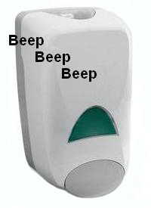


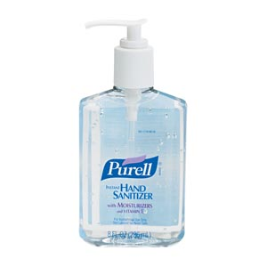


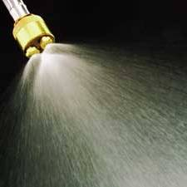

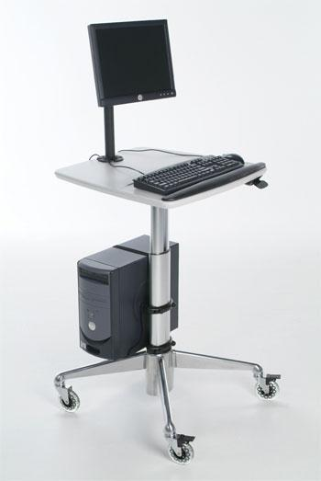
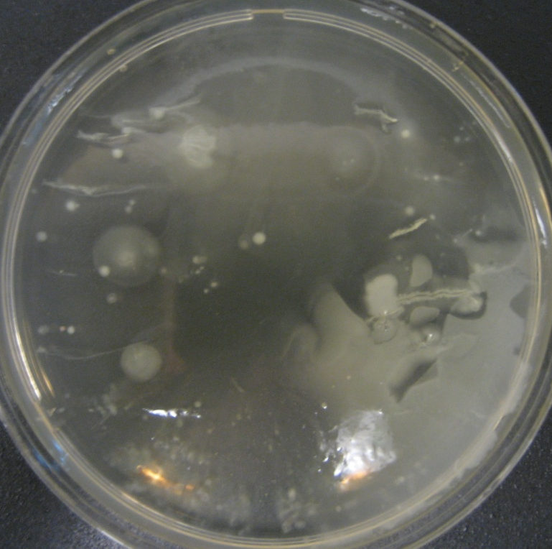
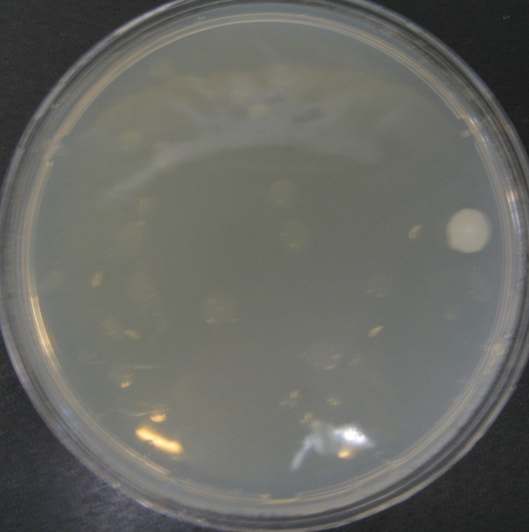
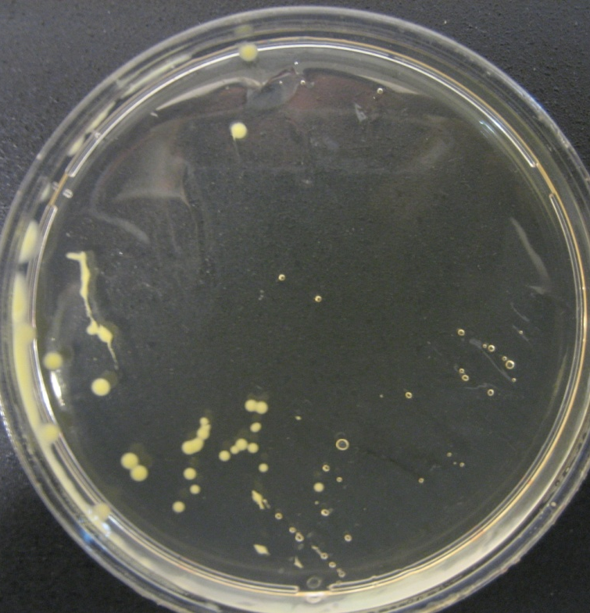
Intervention Device for Handwashing Compliance
C. Flanagan, R. Hrobsky, A. Rieves, B. Rogers
Client: Carla J. Alvarado, Ph.D¹ Advisor: Brenda Ogle, Ph.D²
Problem Statement
¹Department of Industrial Engineering, Center for Quality and Productivity Improvement Courses ²Department of Biomedical Engineering
Abstract
Final Design
Hand hygiene
  An integral part of health care professional’s job
  The single most important infection control procedure
Project Goals
  Increase handwashing compliance
  Streamline process
  Produce an affordable product
  Maintain patient/user safety
Hospital acquired infections are responsible for approximately 99,000 deaths per year. Thus, hand hygiene of the clinician is paramount to patient safety. To increase hand washing compliance and reduce the possibility of cross-patient infection, a device was created to interface with electronic medical records entry systems and deliver a dose of disinfectant to both the user’s hands and keyboard. A custom designed pump atomizes an ethanol-based disinfectant onto the user’s hands and keyboard upon a pre-determined command signal. In order to evaluate the effectiveness of the system several tests were performed. A microbial culture test verified that the delivery system was effective for sufficient disinfection. Also, a keyboard durability test confirmed that a keyboard does not lose its functionality even after a 48 hour exposure to concentrated ethanol. Finally, a questionnaire was given to 29 nurses at UW-Hospital. The surveys indicated that 76% of nurses would support the implementation of this design. In the future further testing will be done on the formulation of the disinfectant, as well as more efficient ways to effect atomization.
Linear actuator drives the production of an atomized spray of disinfectant to the keyboard and the user’s hands
Design Constraints
Competing Products
Components
Airtight reservoir – contains disinfectant & prevents evaporation
Linear actuator – automated, runs on DC power to deliver disinfectant by supplying a constant force
30 cc syringe – plunger component connects to linear actuator piston to deliver constant volume of disinfectant
One-way valves – prevent backflow into
reservoir and syringe
Spray nozzle – produces a fine mist of
disinfectant onto the keyboard
Circuit – automates device upon pre-
determined command signal
Features
Nozzle orientation covers entire keyboard
Streamlined design
Rapid delivery
Versatile for different disinfectant formulations
Safely dispenses disinfectant
Disinfects user’s hands and maintains cleanliness of keyboard
Designed for prolonged use
Fits seamlessly into clinical environment
Retrofitted
Cost-effective
Handwashing Signal Device
Purell®
Motivation
Annual Statistics on Hospital-Related Infections
  1.7 million infections
  99,000 associated deaths
  Average hand washing compliance is only 48%
InduProof®
Background
Testing
Spalding Definition for Decontamination¹
APIC Guidelines for Handwashing²
Procedure kills vegetative microorganisms, all fungi, and inactivates most viruses
Intermediate-Level Disinfection
If hand not visibly soiled ; use alcohol-based hand rub
Required after contact with inanimate objects
Usability Survey
Microbial Testing
Keyboard Durability
Mechanism
Hand
Hygiene
Inoculated agar plate with subjects’ hand sweat after 10 minutes of wearing gloves
Hands dried for subsequent 10 minutes
Subjects used the device and sweat sample was cultured again
Cultures were kept at 37 ˚C for 48 hours and analyzed
Keyboard was submerged in 70% w/w for 48 hours and tested for functionality
  Some corrosion observed in plastic
  Keyboard still operated
Log onto computer
First keystroke initiates spray
10 mL delivered to keyboard & hands in approx. 3 sec
Entering data & attending to patient is hygienic and efficient
Computers On Wheels (COWs) for Patient Records
  Clinical staff workstation in patient room
    Mobile between rooms
  Used on all medical floors
  Streamlined design
  Password protected
  Multiple interventions per patient contact
Ethanol for Disinfection
  Ethanol vs. Other Disinfectants
    UV radiation, ionic silver, iodine
  70% Ethanol > Isopropyl Alcohol
    Works against adenovirus
  Ideal sanitizer
    kill 99.99% of germs
Emollients for User Acceptance
  Vitamin E
Evaporation Test
Ethanol solution was placed on a scale in various sized dishes and the amount evaporated was measured in mg
Future Work
Technology
Develop shield to focus spray range
Generalize attachment for different WOW designs
Optimize reservoir
Translation
Test different disinfectant formulations
Adapt design for easy commercial assembly
Long-term usage testing in clinical setting
4
Number of interventions per patient
15
Patients seen per shift
15
Minutes spent charting per patient visit
Asdsadlfkjasd
References
Spalding Definition. http://www.co.dare.nc.us/depts/EMS/Bloodborne/page23.htm
APIC Guidelines. http://www.guideline.gov/summary/summary.aspx?ss=15&doc_id=3484
Ethanol and Emollients. http://www.cdc.gov/mmwr/preview/mmwrhtml/rr5116a1.htm
Hand Hygiene Statistics. Bischoff, W.E. et al. “Handwashing compliance by health care workers: The impact of introducing an accessible, alcohol-based hand antiseptic.” Arch Intern Med. 2000 April; 10 (160): 1017-1021.
Indukey. http://www.indukey.com/content/featured_prod.html
Purell. http://www.pfizerch.com/brand.aspx?id=310
Handwashing Signal Device. www.handwashinghelp.com
Hospital-Related Infection Statistics. Klevens, R. Monina et al. “Estimated Health care-Associated Infections and Deaths in US Hospitals, 2002.” Public Health Reports. 2007 March; 122: 60-66.
  Glycerin
  Isopropyl Palmitate

