Slide 1


Intervention Device for Handwashing Compliance
Claire Flanagan
Robyn Hrobsky
Adam Rieves
Brad Rogers

Slide 2
Outline
Clinical Handwashing
Implementation
Design
Future Work
Phase I
Phase II
Background Research
Design Requirements
Final design
Testing
Task Analysis
Spray Mechanism
Disinfecting Method
Competing Products
Ethical Consideration
Guidelines

Slide 3
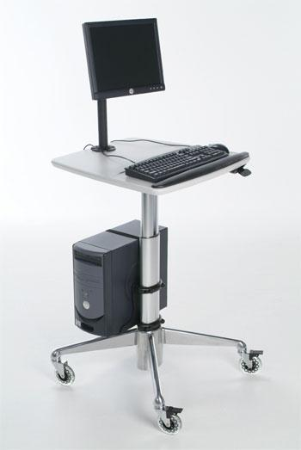

COWS in clinics
Computers on Wheels
  Clinical staff workstation in patient room
    Mobile between rooms
  Used on all medical floors
  Streamlined Design
  Password Protected
  Multiple interventions per patient contact

Slide 4
Handwashing Guidelines
Spalding Definition for Decontamination¹
  Intermediate-Level Disinfection
    Procedure kills vegetative microorganisms, all fungi, and inactivates most viruses
APIC Guidelines for Handwashing²
  Hand not visibly soiled →alcohol-based hand rub
  Required after contact with inanimate objects
Some Disinfecting methods
  Alcohol
  Ionic silver
  UV-Irradiation

Slide 5
Types of Disinfectants
Alcohol
Hydrogen Peroxide
Iodine
Triclosan®
Ionic Silver
UV-irradiation

Slide 6
Competing Products
Microban® Keyboards
InduProof®
  Antimicrobial surface
  Easily cleaned
Unotron®
  Can be immersed under running water
Purell®

Slide 7
Design Constraints
Safely dispenses disinfectant
Disinfects user’s hands and maintains cleanliness of keyboard
Designed for prolonged use
Fits seamlessly into clinical environment
Retrofitted
Cost effective

Slide 8
Problem Statement
Hand hygiene
  An integral part of a health care professional’s job
  The single most important infection control procedure
Project Goals
  Increase handwashing compliance
  Streamline process
  Produce an affordable product
  Maintain patient/user safety

Slide 9
Design: Phase I
Two separate tasks → two separate designs
  Disinfect keyboard
    Ionic silver
    UV-irradiation
    Alcohol spray
  Disinfect hands
    Chamber
    Biometric sensor
    Alcohol spray

Slide 10
Design: Phase I
Keyboard Matrix
Criteria | Weight | UV | Silver | Alcohol Spray
Compliance | 20 | 19 | 19 | 20
Interference with task | 15 | 13 | 15 | 13
Long term exposure/safety | 10 | 10 | 10 | 8
Affordability | 10 | 8 | 8 | 9
Length of Service | 10 | 6 | 6 | 6
Ease of monitoring | 5 | 5 | 3 | 4
Installation | 5 | 4 | 3 | 5
Testability | 5 | 4 | 2 | 4
Ease of manufacture | 5 | 4 | 3 | 4
Patient acceptance | 5 | 4 | 4 | 5
Incorporation of both tasks | 10 | 0 | 0 | 10
TOTAL | 100 | 77 | 73 | 88

Slide 11
Design: Phase I
User Matrix
Criteria | Weight | Sensor | Chamber | Alcohol Spray
Compliance | 20 | 16 | 19 | 20
Interference with task | 15 | 10 | 4 | 14
Long term exposure/safety | 10 | 7 | 7 | 9
Affordability | 10 | 10 | 8 | 10
Length of Service | 10 | 8 | 5 | 8
Installation | 5 | 4 | 3 | 3
Ease of monitoring | 5 | 4 | 3 | 5
Testability | 5 | 5 | 3 | 5
Ease of manufacture | 5 | 3 | 4 | 3
Patient acceptance | 5 | 3 | 2 | 4
Incorporation of both tasks | 10 | 0 | 10 | 10
TOTAL | 100 | 70 | 68 | 91

Slide 12

Design: Phase II
Atomization
  Will quickly evaporate
  Purchased spray nozzle (McMaster-Carr, P/N 4759T22)
    9-70µm diameter droplets
    2.33ml/s flow at 40PSIG
  Pressure required
    Compressed air
    Peristaltic pump

Slide 13
Design: Phase II
Compressed Air
Compressed air source
  Hospital’s line
  Tank on COW
Solenoid valve
Check valve regulates flow of disinfectant
Disinfectant stored in rigid reservoir

Slide 14
Design: Phase II
Compressed Air Schematic
Reservoir of Disinfectant
Computer Controlled Solenoid Valve
Compressed Air Source
One-Way Check Valve

Slide 15
Design: Phase II
Compressed Air
Advantages
Disadvantages
Inexpensive to develop
Reliable
Low power consumption
Easily maintained
  Reduced mobility
  Bulky
  Aesthetics
  Many wires

Slide 16
Design: Phase II
Peristaltic Pump
Mechanism: Positive displacement
  Low pressure input, high pressure output
Commonly used in clinical settings
Specialized tubing
  Provides constant flow
  Chemical/pressure compatibility
Rotary or linear mechanism for motor
  Three-phase power is favorable
Design:
  Pumps disinfectant from flexible reservoir through fogging nozzle

Slide 17
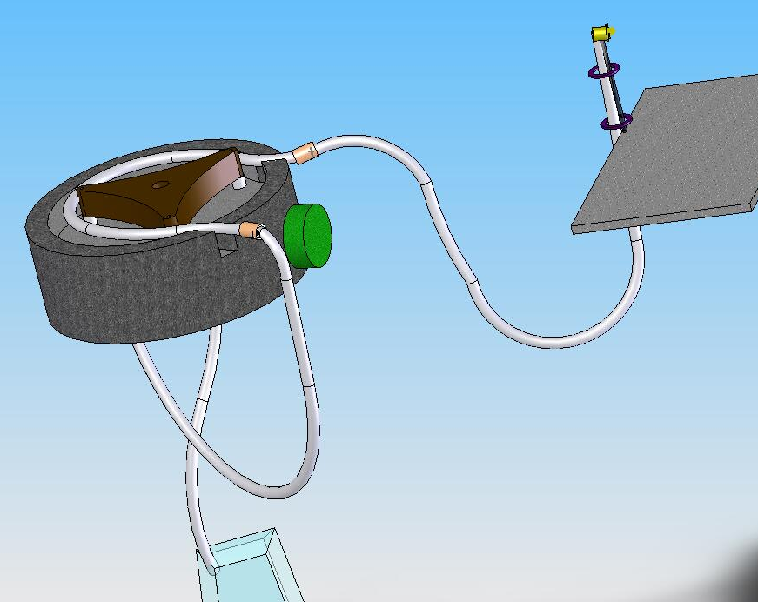
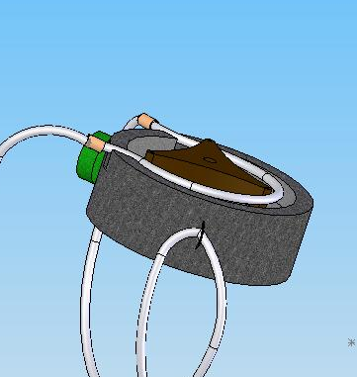
Design: Phase II
Peristaltic Pump Design

Slide 18
Design: Phase II
Peristaltic Pump
Advantages
Disadvantages
Efficient delivery
Mobile
Flexible reservoir
Low-cost product
Flow rate of pump must support pressure accumulation
Tubing may be expensive to replace
Expensive product development phase

Slide 19
Design: Phase II
Matrix
Criteria | Weight | Compressed air | Peristaltic
Mechanical Complexity | 25 | 10 | 25
Cost | 20 | 20 | 10
Size/mobility | 15 | 5 | 15
Disinfectant Storage | 15 | 5 | 15
Life in Service | 10 | 5 | 10
Installation | 10 | 5 | 10
Power Source | 5 | 2.5 | 5
TOTAL | 100 | 52.5 | 90

Slide 20
Future Work
Clinical Visit
Design Development
Testing
Task analysis to validate design constraints
Develop pump design
Pressure/flow performance requirements
Automate device
Optimize atomization capacity
Surface area test
Evaporation rate of 65% alcohol
Test disinfectant efficacy
Glove juice test
Keyboard inoculation
Human factors considerations
Will observe actual COW used in UW clinics

Slide 21
References
1. Disinfection of Surfaces
http://www.co.dare.nc.us/depts/EMS/Bloodborne/page23.htm
2. National Guideline Clearinghouse
http://www.guideline.gov/summary/summary.aspx?ss=15&doc_id=3484

Slide 22
Questions???
Feeling Dirty?

